Slide 2
What's ID verifier/manual ID verification
This is where a volunteer meets face-to-face with a Girlguiding ID verifier to verify their identity and ID documents. ID verifiers will no longer need to input the volunteer's ID document details to the disclosure system when meeting with them. Instead, the volunteer will do this themselves, which will later be verified by their ID verifier in person.
A volunteer will use manual verification if:
They’re unable to use the digital ID verification method. This could be for various reasons, such as not having photo ID or access to a smartphone, and failure to obtain a digital ID. Find out more about what a volunteer needs to complete digital ID verification.
They’d simply prefer to meet an ID verifier instead.

Slide 3
Manual ID verification
What they’ll need
At least 3 original ID documents which combined must show their:
Full legal name
Date of birth
Registered UK address
Photo

Slide 4
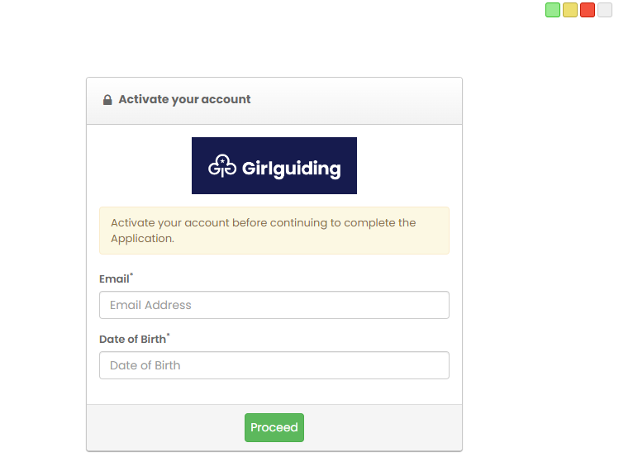
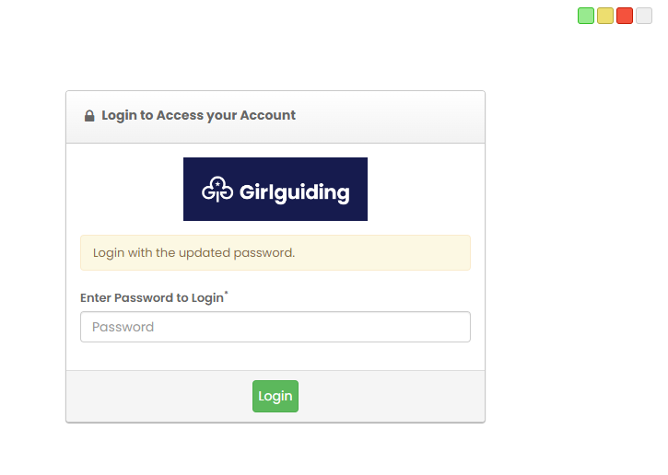
Manual ID verification
Volunteer process – Get started
You’ll receive an email with a link to start your DBS application on the disclosure system
Activate your account and then log in

Slide 5
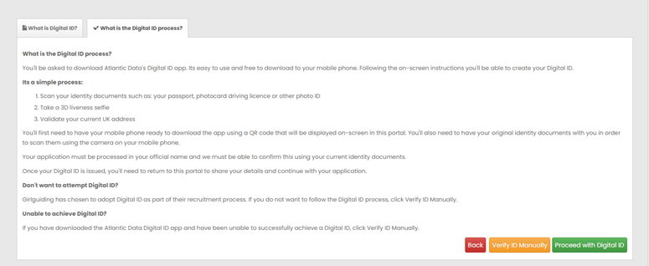
Manual ID verification
Volunteer process
Confirm your details. If they’re correct, click the green ‘Complete Application Now’ button. If not, email disclosures@girlguiding.org.uk.
The next screen will tell you more about the Digital ID process. Click the green ‘Proceed’ button to move onto the next screen where you can select the orange ‘Verify ID Manually’ button.

Slide 6
Manual ID verification
Volunteer process
Click the green ‘Proceed’ button and read the following guidance screens about completing your application.
Guide to completing your application
Your name and address history
You’re ready to complete your application
Click the green ‘Go to my application’ button.
Review the Applicant Consent information. Agree to the consent by ticking the boxes and the click the green ‘Proceed’ button.

Slide 7
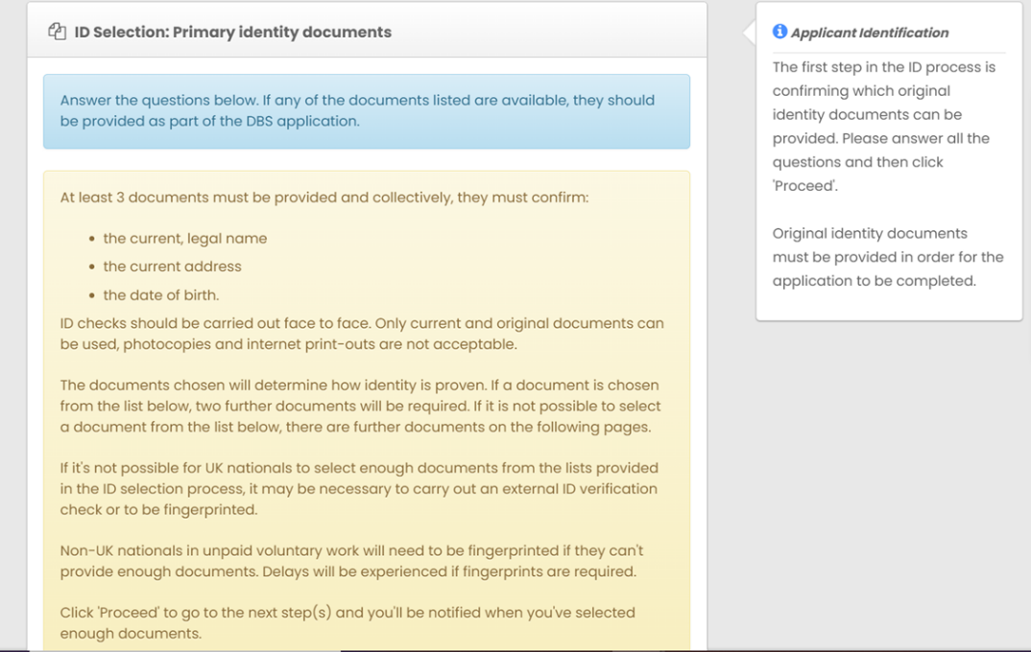
Manual ID verification
Volunteer process
Confirm if you’re a national of the UK or another country, and click the green Proceed button.
Go through the next screens selecting the documents you can provide to an ID verifier.

Slide 8
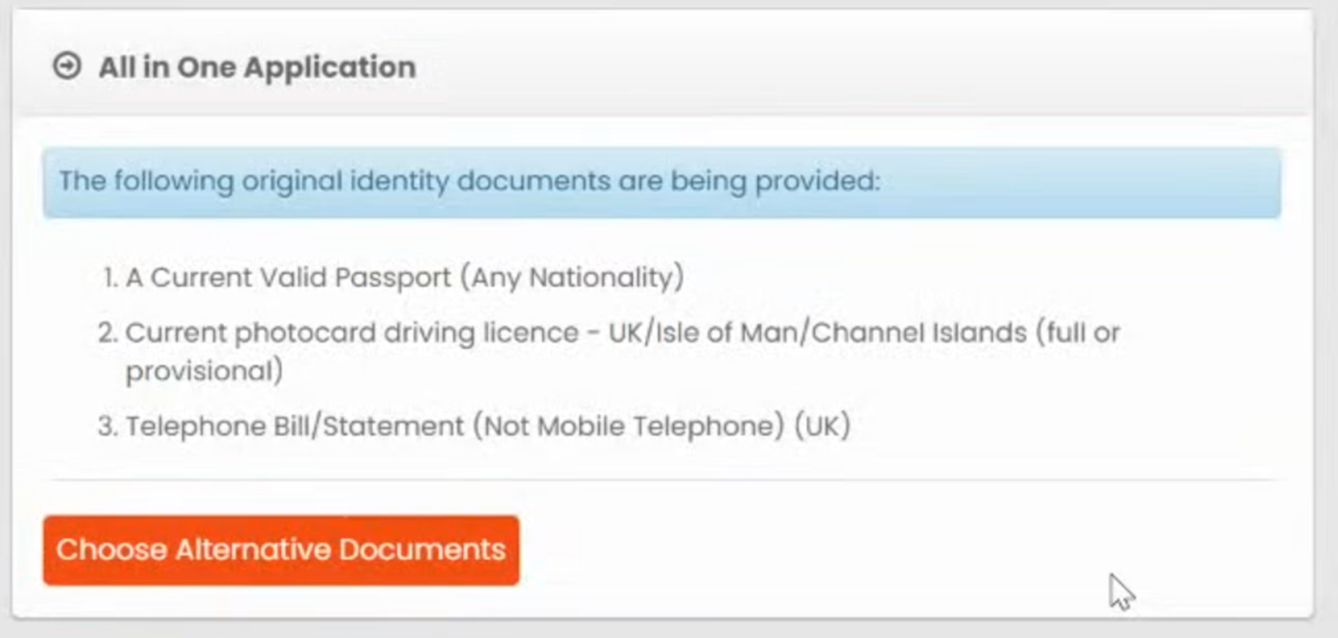
Manual ID verification
Volunteer process
10. Review the document types you have selected. You can change your documents by clicking on the orange 'Choose alternative documents' button. If you are happy, scroll down to the Applicant details section.

Slide 9
Manual ID verification
Volunteer process
Review the pre-filled information taken from your GO record. You’ll need to complete the following sections:
Details of any names used during your lifetime – If you use the title Ms, Mrs or Dr you will be asked to declare surnames. If you have not changed your surname just the tile used, please enter the same surname with the Month and Year you changed your title.
Your Birth details
Other details
Current address and how long you’ve lived there
Additional addresses if you’ve been living at your current address for less than 5 years
Your preferred contact telephone number
Criminal convictions, cautions, reprimands or final warnings

Slide 10
Manual ID verification
Volunteer process
Enter the details for all ID documents you selected. Once completed click the green ‘Proceed’ button.
Review all the information you have provided for your DBS application and ID verification. If there are no changes to be made read and tick the declaration box before clicking the green ‘proceed’ button.
If you need to make any changes, click the red ‘Change’ button.
Your application has been saved and is now pending ID verification. You can log out of the Girlguiding disclosure system.

Slide 11
Manual ID verification
Volunteer process
Meet your ID verifier
To contact an ID verifier in your area to request a face-to-face verification of your documents, go to your ‘my safe practice summary’ in your GO account. Use the action arrow against your disclosure record to ‘Contact ID verifier’.
When you meet with your Girlguiding ID verifier, they’ll:
Log into their account on the Girlguiding disclosure system and search for your application. When found, your application status will be ‘Pending ID verification’. Your ID verifier will click on your name to view your application to verify it.
Review your pre-submitted details on your form against your ID document details.
Check the list of documents you selected on your form is the same as what you’ve provided for the face-to-face ID verification.
Enter the requested details for the ID documents submitted, and confirm that they have confirmed your ID.
Sign, date and submit your application.
Your face-to face ID verification is now complete and your application will be sent to the DBS for processing.

