Slide 2
What's digital ID verification?
Digital ID verification is a service that has been approved by the UK government for people to electronically verify their original identity documents for a DBS application.
For Girlguiding it means that new and existing volunteers in England and Wales can verify their identity without the need to meet with or have their ID verified by a Girlguiding ID verifier.
This is an optional self-serve process for the volunteer.

Slide 3
Digital ID verification
Register for a digital ID
Volunteers will need to submit their original ID documents by scanning them into an app provided by Atlantic Data, who are our existing service provider for Girlguiding’s DBS disclosure system and are an approved identity service provider (IDSP).
Below you can see the steps using the app to register for a digital ID to confirm an identity for a DBS application.

Slide 4
Digital ID verification
What you’ll need
A smartphone with front and back camera and NFC*.
An internet connection.
A current UK address.
Photo ID, such as passport with biometric chip, photocard driving licence or other photo ID.
Proof of your address, such as a bank statement or utility bill.
*Near-field connection – the technology in our smartphones used to connect to other electronic products/devices and make contactless payments and travel. You can check or enable your NFC within your device's settings.

Slide 5
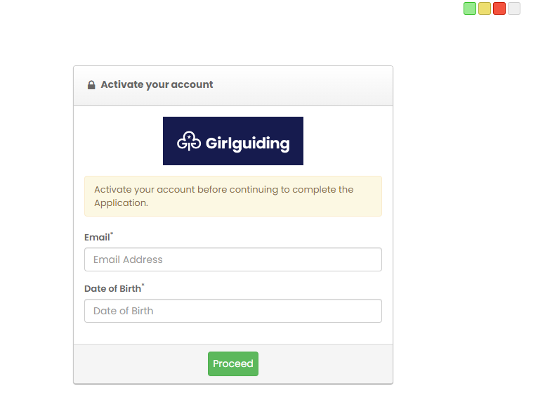
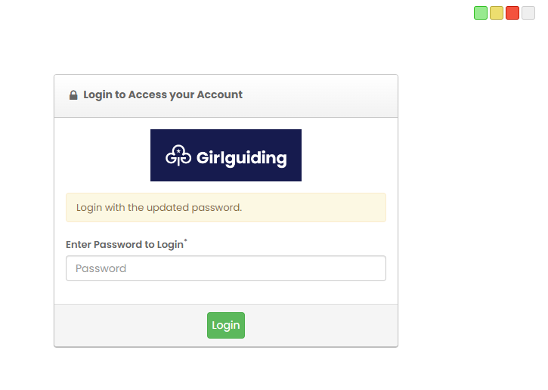
Digital ID verification
Volunteer process – Get started
Disclosure system
You’ll receive an email with a link to start your DBS application on the disclosure system
Activate your account and then log in

Slide 6
Digital ID verification
Volunteer process
Disclosure system
Confirm your details. If they’re correct, click the green ‘Complete Application Now’ button. If not, email disclosures@girlguiding.org.uk.
Read the guidance on the next screen before clicking the green ‘Proceed’ button.
To be eligible for a digital ID you must have a current UK address. Select ‘Yes’ and proceed. If not, you'll need to complete a Manual ID verification.

Slide 7
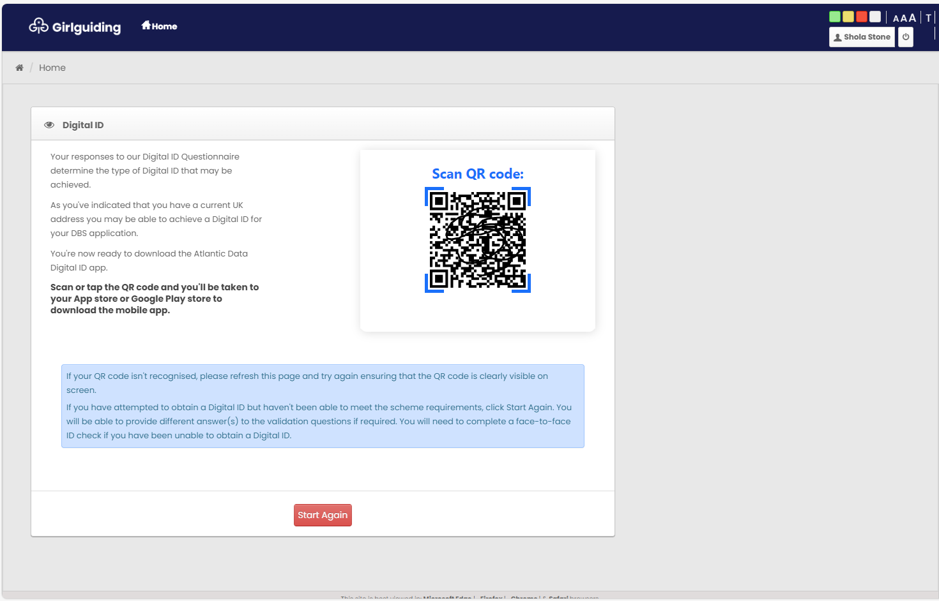
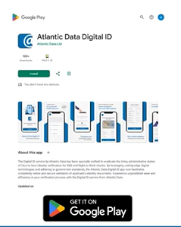
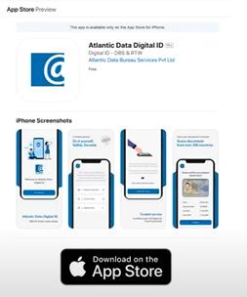
Digital ID verification
Volunteer process
Disclosure system
Scan or tap the QR code to open your App store or Google Play store to download the Atlantic Data Digital ID app.

Slide 8
Digital ID verification
Volunteer process
Registration
Atlantic Data app
You’ll now need to follow the on-screen steps to register the app. You’ll need to:
Agree to the consent statement
Register your mobile number to your Digital ID
Enter the verification code sent to your mobile number
Set a 4-digit security passcode
Take a 3D scan of your face – You may be asked to enable your device’s camera and will need to follow the on-screen guidance – for example, move closer or hold steady
TIP: You may need to try this a few times to get it right. For steadiness you can try propping your mobile up, or leaning it against a surface.

Slide 9
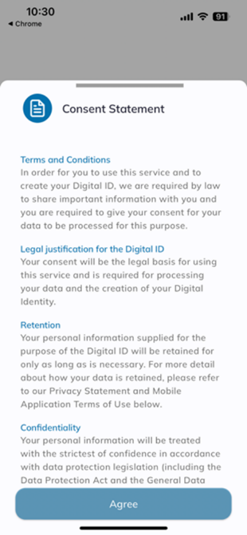
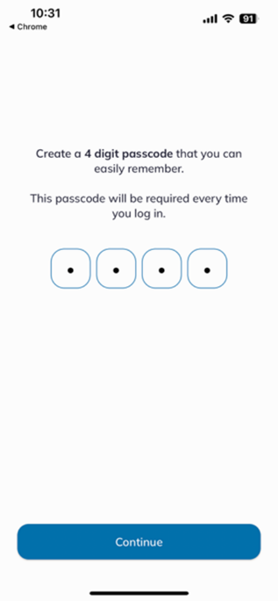
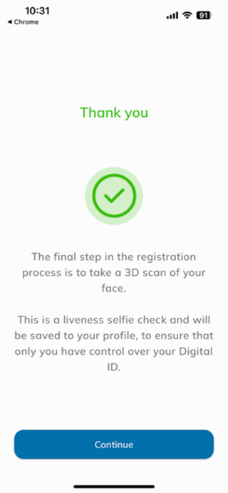
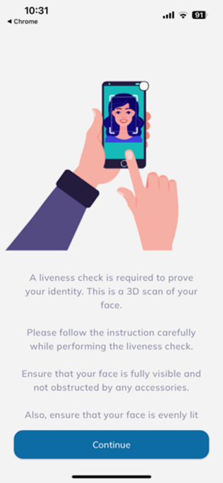
Digital ID verification
Volunteer process
Registration
Atlantic Data app

Slide 10
Digital ID verification
Volunteer process
Applying for digital ID
Atlantic Data app
Enter your 4-digit passcode to access your profile again.
Click ‘Apply for Digital ID’
Disclosure system
Scan or tap the QR code again from your application on the disclosure website. You may need to log back in if it has timed out. Use your email address and the password you created.

Slide 11
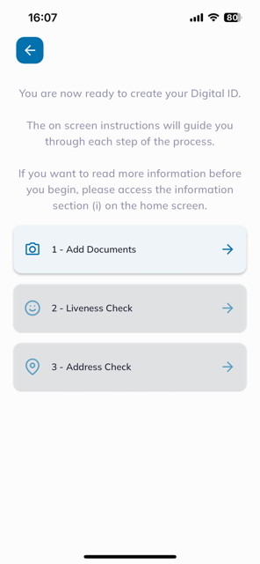
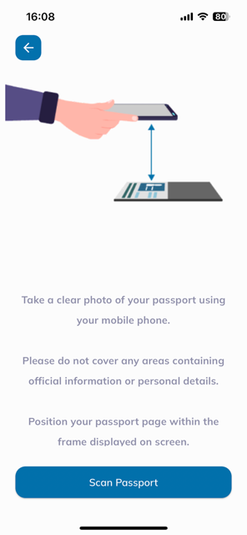
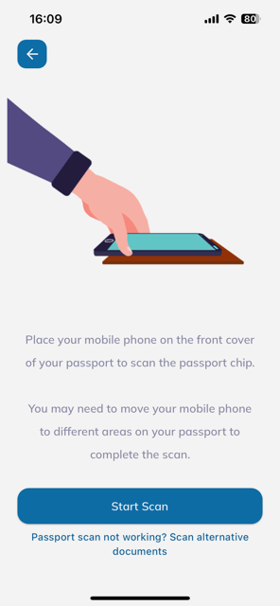
Digital ID verification
Volunteer process
Applying for digital ID: add your documents
Atlantic Data app
Select your nationality and whether you have a passport.
Take a clear picture of your passport page. The app will automatically capture the image when it’s appropriately aligned.
TIP: We advise doing this on a darker surface to make sure the app can capture the corners of your passport page and details. You may need to try more than once.
Confirm your passport details have been captured by clicking Confirm.
Scan your passport’s biometric chip using your mobile’s NFC. Ensure this is enabled within your mobile phone’s settings. Follow the on-screen image of how to hold your phone to your passport cover.
TIP: If you’re not sure if your passport has a biometric chip, you can contact the Girlguiding membership support team with your passport’s country of issue and issue date to find out.

Slide 12
Digital ID verification
Volunteer process
Applying for digital ID: liveness and address checks
Atlantic Data app
Like when registering your profile, take a liveness 3D scan of your face for your digital ID application.
Enter your UK postcode and select your current address from the list. An address check will be completed to verify you live at that address.

Slide 13
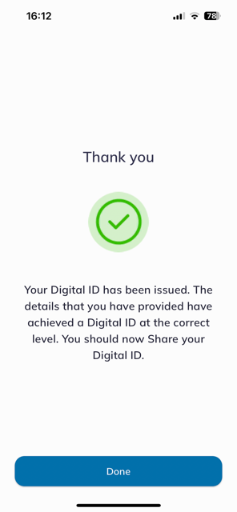
Digital ID verification
Volunteer process
Applying for digital ID: finishing up
Atlantic Data app
Read and tick the box to declare the information you’ve provided is complete and accurate.
Click Submit your digital ID verification for review.
Wait for confirmation from the app that your digital ID has been issued and is ready to be shared.
Note: This is usually within 15 minutes, or within 2 working days if your information is under review. You’ll be notified by SMS and email to log into your app to view its status. You can also check back in the app to see if it’s been issued.

Slide 14
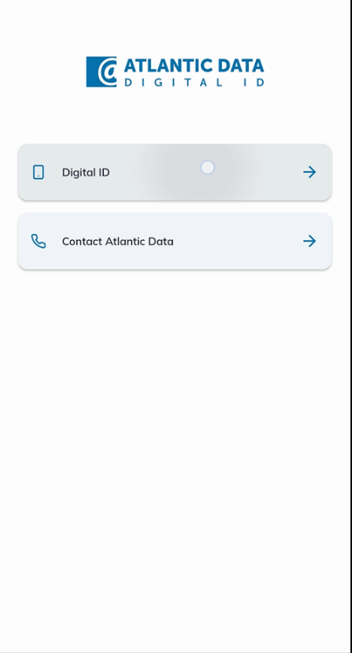
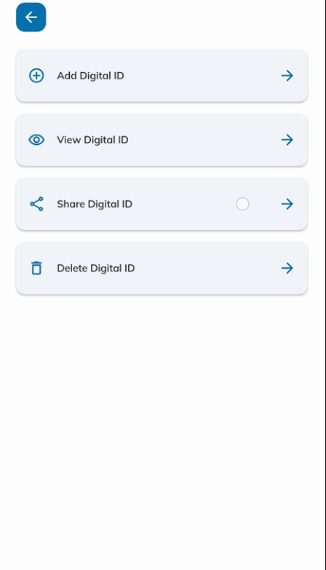
Digital ID verification
Volunteer process
Sharing digital ID
Atlantic Data app
Once your digital ID has been issued, log into your Digital ID app
Click ‘Digital ID’, then ‘Share Digital ID’

Slide 15
Digital ID verification
Volunteer process
Disclosure system
Log back into your DBS application on the Girlguiding disclosure site, where your application will open to a unique QR code screen.
You can continue the application process by visiting the disclosure site in your mobile phone’s web browser and tapping on the QR code to link your application.
Alternatively, you can log in from your desktop or laptop and use your mobile phone’s camera to scan the QR code from the Digital ID app. Click on the blue ‘Scan QR code’ button to open your phone’s camera.
Once your Digital ID has been linked to your DBS application, you’ll complete the remainder of your application using the Girlguiding Disclosure site.
Note: If you don’t get a digital ID, follow the manual ID verification route (with an ID verifier).

Slide 16
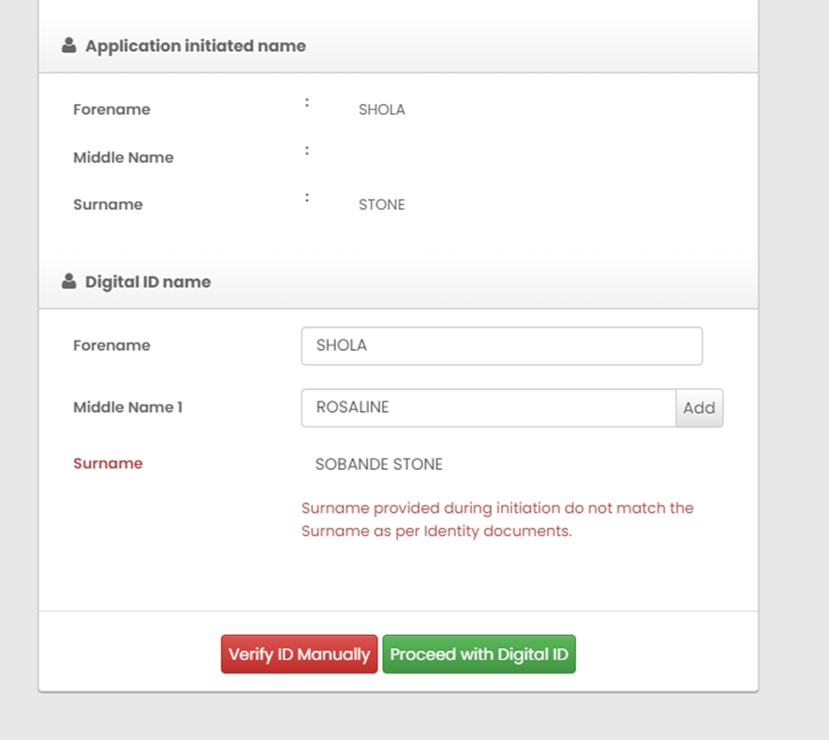
Digital ID verification
Volunteer process
Disclosure system
Confirm your ID.
Important note: If the surname on your digital ID doesn’t match the one on your application, you won’t be able to proceed. You‘ll need a new application initiated.
However, you won’t need to do a new Digital ID as this is valid for 90 days and you’ll be able to share it with your new application.
Log into GO to update your name before emailing to disclosures@girlguiding.org.uk for a new application request to be initiated.

Slide 17
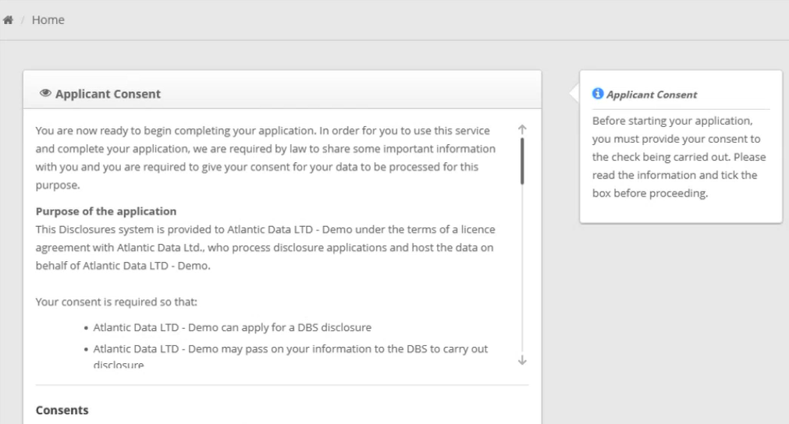
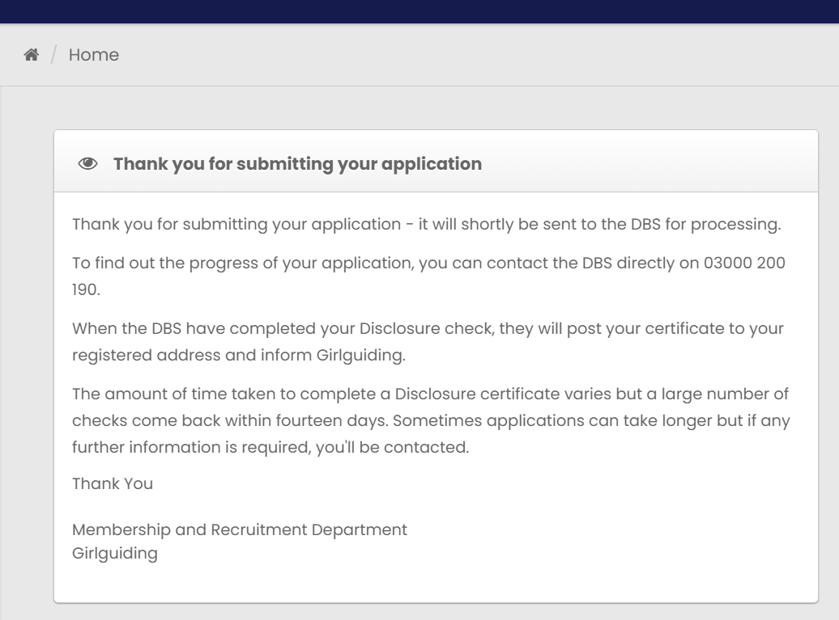
Digital ID verification
Volunteer process
Applicant consent
Disclosure system
Review the pre-filled information taken from your Digital ID and GO record. You’ll need to complete the following sections:
Details of any names used during your lifetime – if you use the title Ms, Mrs or Dr you’ll be asked to declare surnames. If you haven’t changed your surname (just the tile), please enter the same surname with the month and year you changed your title.
Your birth details.
Other details.
How long you’ve lived at your current address.
Additional addresses if you’ve been living at your current address for less than 5 years.
Your preferred contact telephone number.
Criminal convictions, cautions, reprimands or final warnings.
Once completed click the green ‘Proceed’ button to submit your application to the DBS. The application process is now complete.

