Slide 1
Welcome!
MEMBERSHIP GROWTH & RETENTION

Slide 2
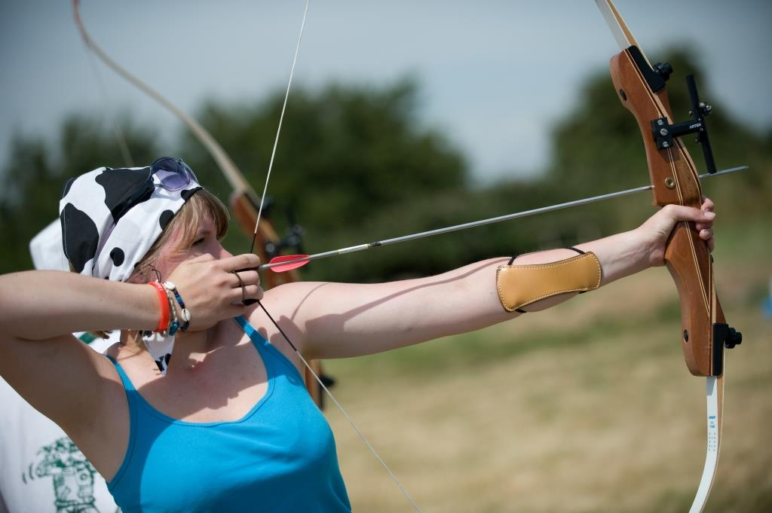
Aims :
/
Objectives:
/
Notes:
When you look at this brands – what do you think about? What is the message they portray/ what do you associate with them?
Why would any organisation need to express certain messages about itself.
Open this up for a short shout out session before moving on to explain why it’s important people know the right information.

Slide 3
Our vision:
An equal world where all girls can make a positive difference, be happy, safe and fulfil their potential.
Our commitment to girls:
By 2020, we will empower more girls to find their voice and be their best through high quality, girl-led programmes delivered by inspirational Leaders.
Our values:
Caring Challenging Empowering Fun Inclusive Inspiring
Access
We will work together to ensure that more girls from all backgrounds benefit from what we do.
Membership Growth
Is about increasing the membership of Girlguiding in terms of both girls and volunteers.
Notes:
When you look at this brands – what do you think about? What is the message they portray/ what do you associate with them?
Why would any organisation need to express certain messages about itself.
Open this up for a short shout out session before moving on to explain why it’s important people know the right information.

Slide 4
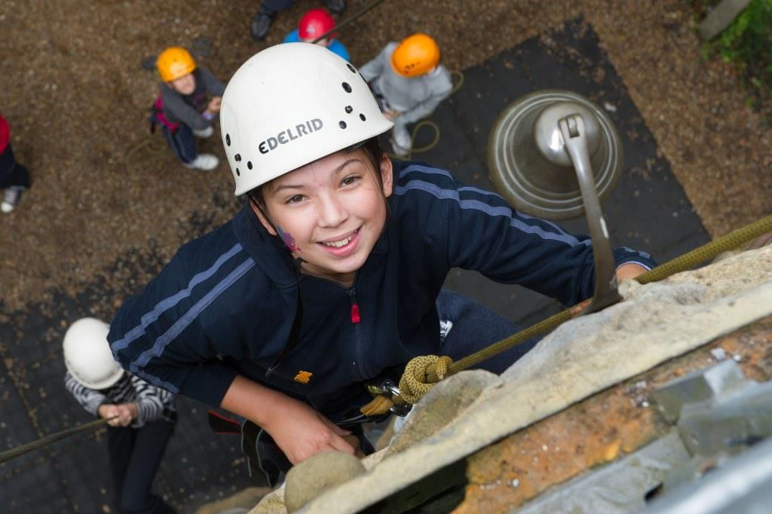
What does Membership Growth encompass?
Strategic mapping and targeting growth, to help the membership grow at all levels. This includes analysing and identifying opportunities for growth.
Welcome and induction which includes identifying the needs of all members and understanding the process and progression.
Recruitment of girls and young women, so we can offer every girl the opportunity to be a member.
Recruitment of adults, so we have enough volunteers to provide high quality guiding to all girls who wish to join.
Notes:
When you look at this brands – what do you think about? What is the message they portray/ what do you associate with them?
Why would any organisation need to express certain messages about itself.
Open this up for a short shout out session before moving on to explain why it’s important people know the right information.

Slide 5
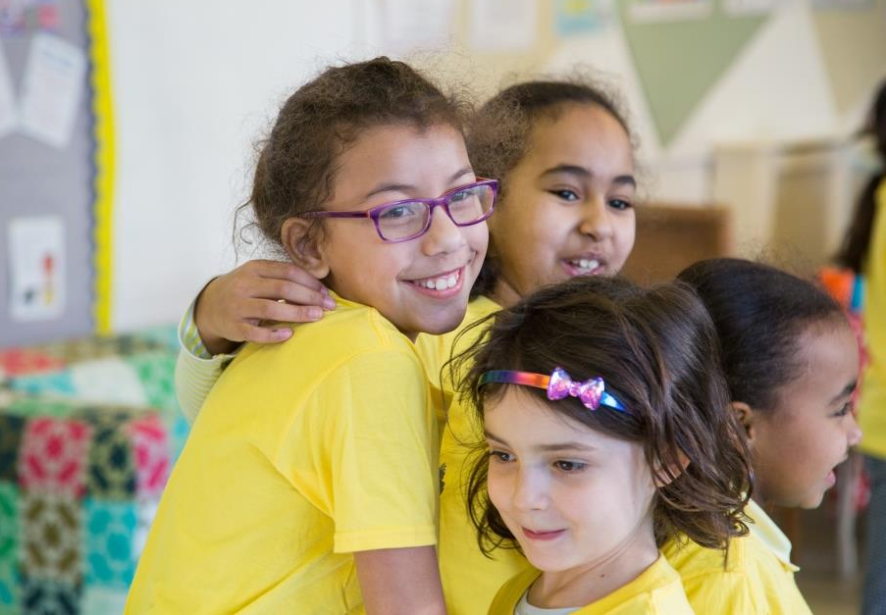
What does Membership Growth encompass?
Sustaining long term growth and supporting retention by:
Promoting successful transition between sections,
Thanks and recognition techniques
Leadership development and high quality programme delivery.
Understanding of flexible guiding methods so that will can increase our existing resources,
Promotion of inclusion and diversity, so members of all backgrounds can be members.
Talking about guiding externally and active promotion of the organisation.
Notes:
When you look at this brands – what do you think about? What is the message they portray/ what do you associate with them?
Why would any organisation need to express certain messages about itself.
Open this up for a short shout out session before moving on to explain why it’s important people know the right information.

Slide 6
What are Membership Growth key messages?
Message 1
Remember that every girl matters – try to involve just one more.
Help participants ensure that activities are girl-led, provide a high quality programme and bring adventure into the meeting place.
Message 2
Make that welcome warm – new members of all ages want to feel they belong.
Help participants understand the importance of a warm welcome and recognise good practice.
Message 3
Make every meeting great-girls vote with their feet.
Make participants aware of simple things they can do to increase their units by one girl.
Message 4
Ask for help – more volunteers means more benefits for both adults and girls.
Encourage participants to get others involved and share how great guiding is.
Notes:
When you look at this brands – what do you think about? What is the message they portray/ what do you associate with them?
Why would any organisation need to express certain messages about itself.
Open this up for a short shout out session before moving on to explain why it’s important people know the right information.

Slide 7
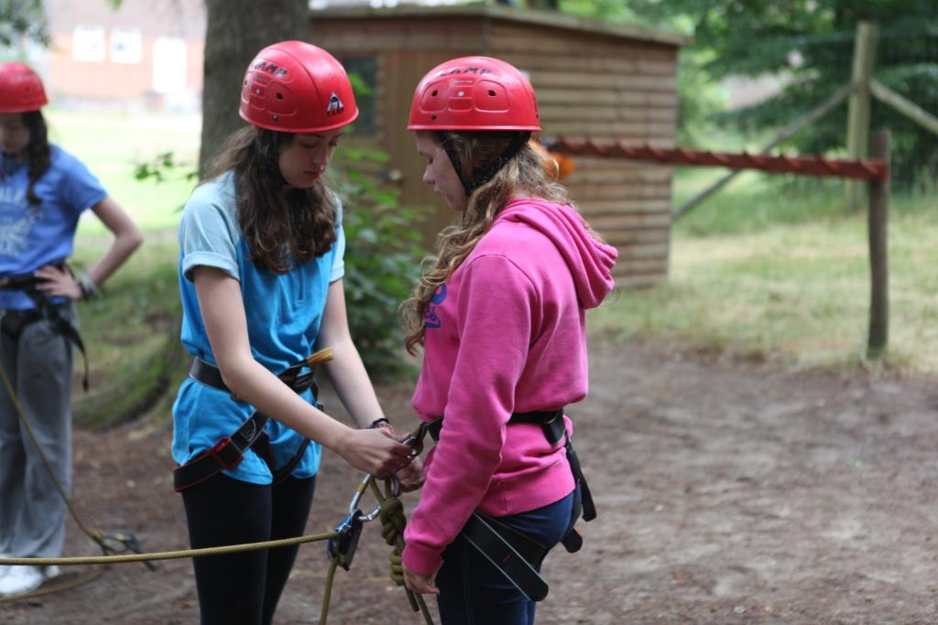
Do we talk about Guiding to others?
Girlguiding is the leading charity for girls and young women in the UK.
Shout out about guiding to all!
Notes:
When you look at this brands – what do you think about? What is the message they portray/ what do you associate with them?
Why would any organisation need to express certain messages about itself.
Open this up for a short shout out session before moving on to explain why it’s important people know the right information.

Slide 8
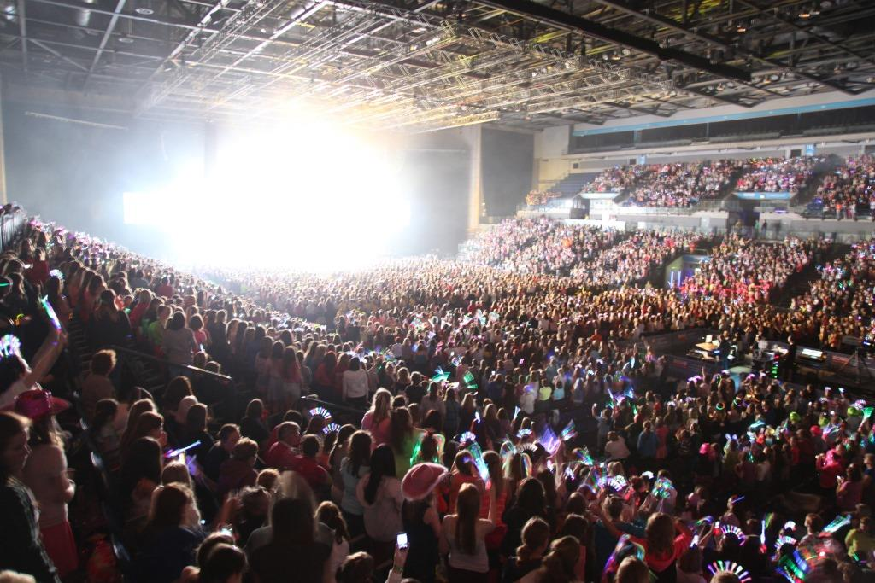
Our Key Messages?
We are for all girls
We give girls their own space
We give girls a voice
We change as the lives of girls change
Notes:
These messages were produced in coordination with our members. Does anyone know what they are? Open up for shout out.
When we asked our members what they thought was important they said:

Slide 9
We are for all girls
We are for all girls and young women, whatever their background and circumstances. We offer them fun, exciting activities and the chance to make lifelong friends. You’ll find us in many communities, helping to give girls a head start in life and encouraging them to be happy, self-confident and curious about the world they live in and the difference they can make.
Notes:
When you look at this brands – what do you think about? What is the message they portray/ what do you associate with them?
Why would any organisation need to express certain messages about itself.
Open this up for a short shout out session before moving on to explain why it’s important people know the right information.

Slide 10
We give girls their own space
We give girls a place where they can really be themselves with other girls and share the experience of growing up as a girl in today’s world. We provide a safe, non-judgemental environment where girls can explore the issues they care about while having lots of fun, enjoying new experiences and learning vital skills.
Notes:
These messages were produced in coordination with our members. Does anyone know what they are? Open up for shout out.
When we asked our members what they thought was important they said:

Slide 11
We give girls a voice
We give girls the confidence, skills and information to make informed decisions. We offer a supportive, inclusive and exciting environment where they can reach their own conclusions about the world. We show them how they can speak out and take positive action to improve their lives and the lives of others. We passionately believe that girls and young women can be a powerful force for good.
Notes:
These messages were produced in coordination with our members. Does anyone know what they are? Open up for shout out.
When we asked our members what they thought was important they said:

Slide 12
We change as the lives of girls change
We are relevant to today’s girls because we listen to them and constantly evolve and adapt what we offer them without losing what makes us uniquely us. We provide support, comfort and friendship in what can often seem a complex world for girls as they grow up.
Notes:
These messages were produced in coordination with our members. Does anyone know what they are? Open up for shout out.
When we asked our members what they thought was important they said:

Slide 13
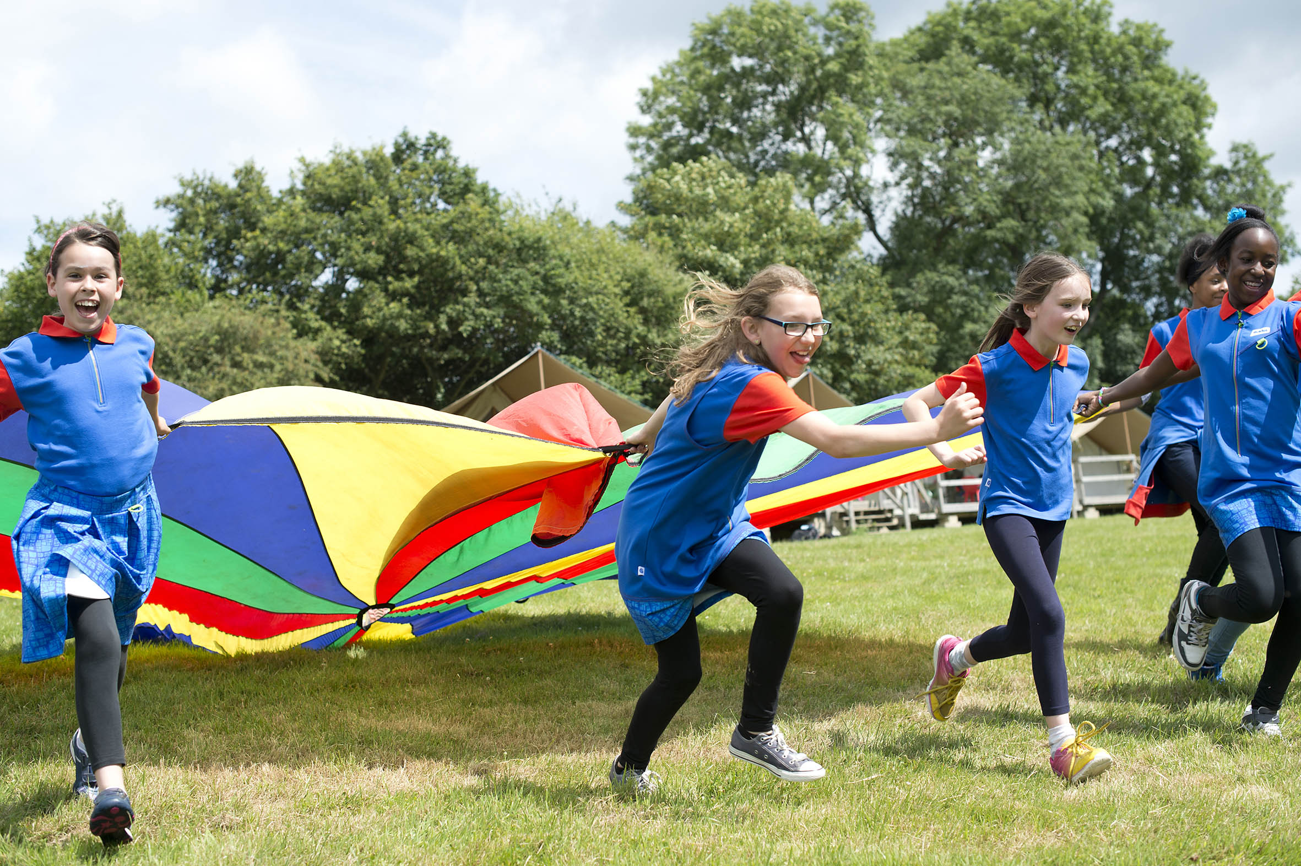
THANK YOU

