Slide 1
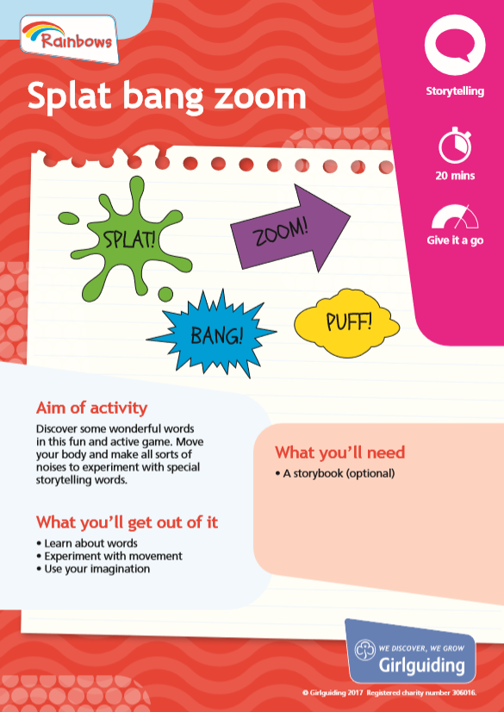
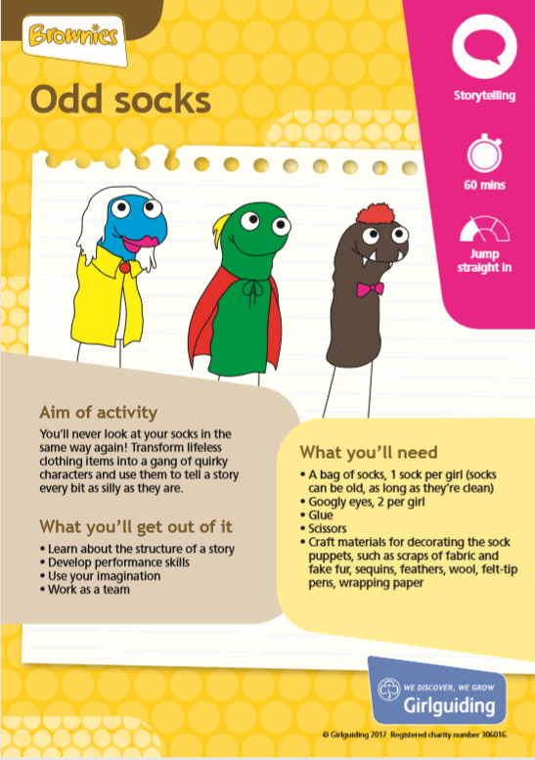
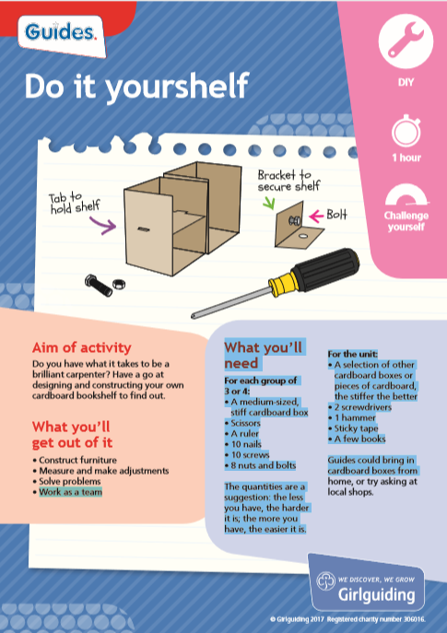
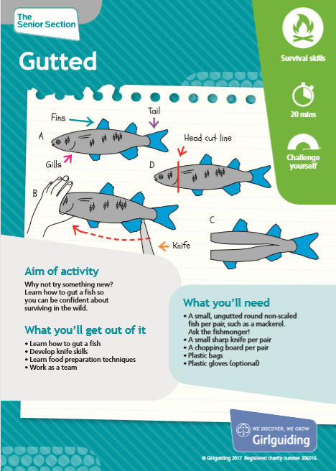
Unit programme planning
Insert your name here!
Today’s trainer:
Notes:
This training session is an introduction to unit programme planning. It is important that participants have a good understanding of the Girlguiding programme before attending this training. We recommend that they complete at least the Girlguiding programme overview module before attending (through face-to-face local trainng, e-learning or webinar training). If they are a new leader, they will also need to have attended training on other key elements of the Girlguiding programme, including the Five Essentials, the Promise etc.
You are welcome to adapt the training session to suit your venue, requirements, learner needs and the context of your training, ensuring you’re retaining the key learning points.
The accompanying training plan contains the key learning points and activities for each slide. In these PowerPoint trainer notes you will find background context and/or suggested delivery ideas to help you as a trainer where appropriate.

Slide 2
Aim
To explore how to create a balanced and varied, girl-led unit programme enabling all girls in the unit to fulfil their potential.
2

Slide 3
Objectives
By the end of the session participants will have:
Refreshed their knowledge of the programme and the Five Essentials.
Explored seven helpful steps to creating a balanced and varied term programme.
Explored ways of ensuring unit activities are selected by the girls, with everyone having an equal voice.
Created their own draft programme plan for a term.
3

Slide 4
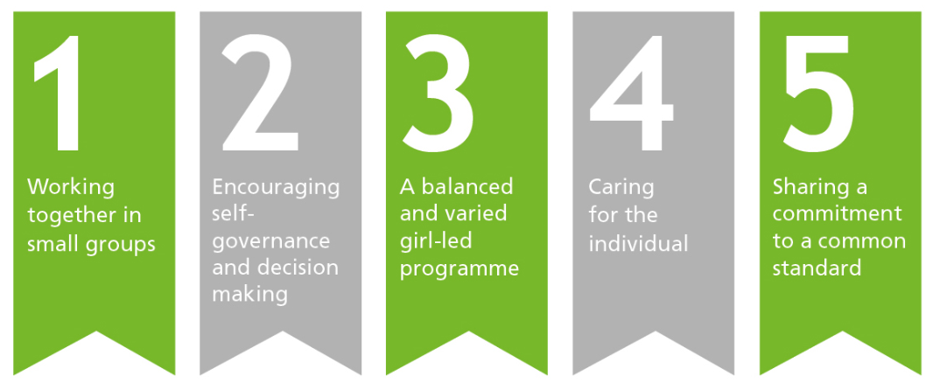
The Five Essentials
4
Notes:
Suggested delivery ideas for trainers
You could start your training session with an ice breaker related to the Five Essentials to get the leaders up, moving and starting to think.
Additional information for trainers
Working together in small groups:
Girls learn about teamwork, sharing experiences, taking responsibility, personal relationships and leadership. This equips them with the skills to make a positive contribution to the group they are working with and to society as a whole.
We challenge girls by asking them to carry out activities together. This provides challenges which girls can meet as a group, and requires them to make decisions, build confidence and be creative.
Encouraging self-government and decision-making:
Making decisions as an individual allows girls to ‘learn by doing’. Girlguiding aims to provide a safe environment for them to make mistakes and learn from them without the pressure of meeting a pre-defined academic standard. Instead, our girls are encouraged to ‘do their best'.
At a group level, girls can plan activities from the broad range available within the programme using the cards and other resources, and share in the management of the unit in age-appropriate ways. Group decision-making uses a range of interpersonal skills, such as negotiation, influencing and listening.
A balanced and varied programme:
Adult Leaders are trained to ensure that every unit’s activities are based around the needs and wants of that particular set of girls. We work to involve girls in our decision-making processes, at every level.
Balance and variety in the programme are achieved through a variety of indoor and outdoor activities, residential experiences, community action projects and more.
Girls can also achieve badges which recognise their efforts when they undertake different tasks and learn new things.
Caring for the individual:
All girls within guiding are expected to be sensitive to the needs and wants of others. Caring for individuals includes learning about relationships and learning how to listen.
Learning how to listen is part of working and making decisions together. This key life skill will enable a girl to care for individuals in later life and have respect for others’ opinions and points of view.
Sharing a commitment to a common standard:
Girlguiding welcomes girls and women from all faiths, cultures and races. A shared commitment to a common standard is expressed in the Promise, which underpins every element of the programme. By making the Promise, girls and leaders express their commitment to the values of guiding, which encompass active citizenship and spiritual development.

Slide 5
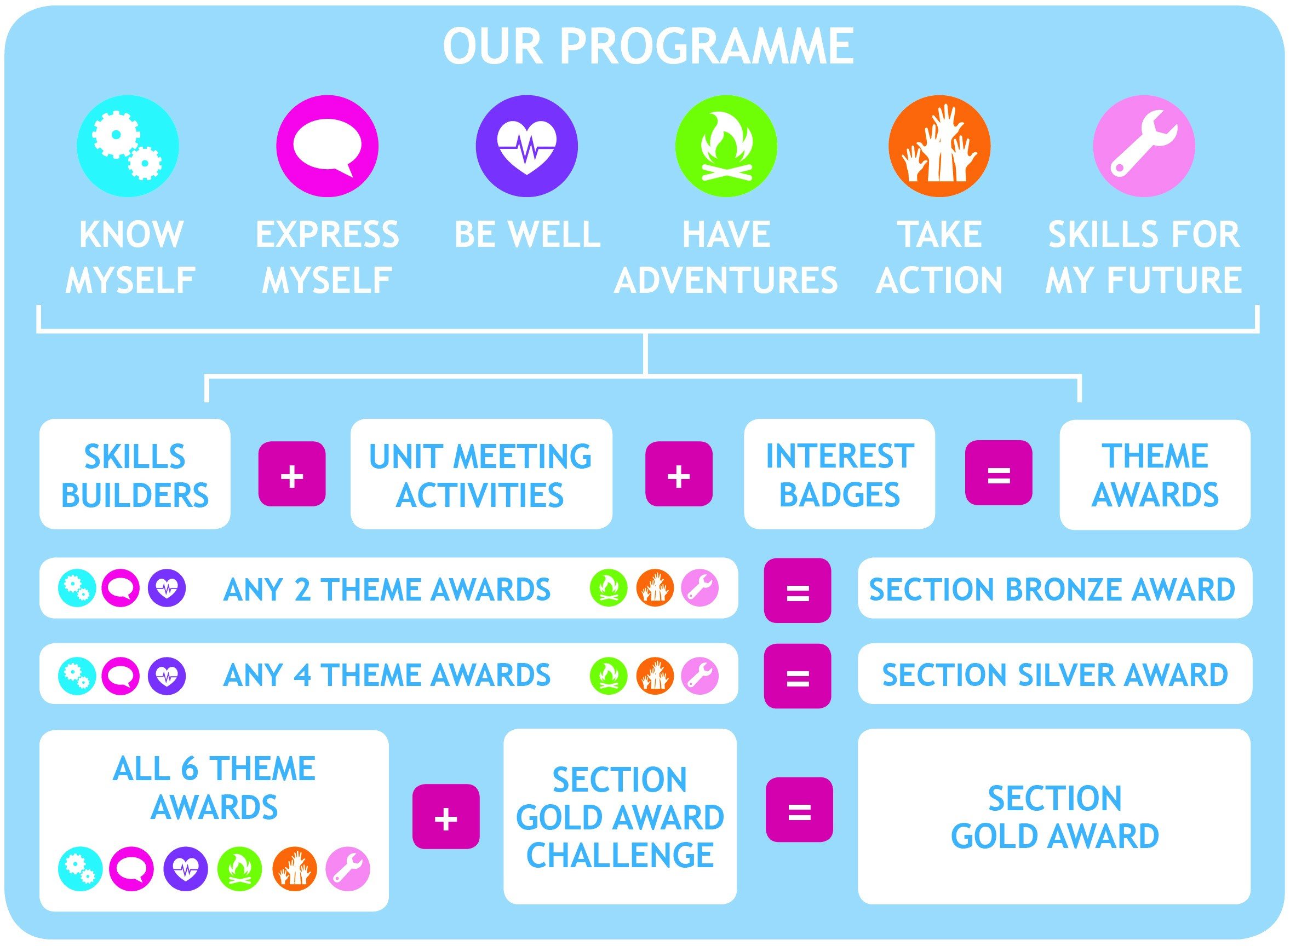
5
5

Slide 6
Seven steps to programme planning
Step 1: Unit planning time.
Step 2: Fixed events and activities.
Step 3: Choose your skills builders.
Step 4: Skills builders, when and how?
Step 5: Interest badges.
Step 6: Which unit meeting activities?
Step 7: Unit meeting activities, when?

Slide 7
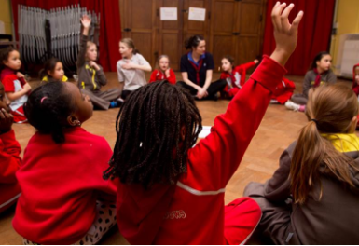
Step 1: Unit planning time

Slide 8
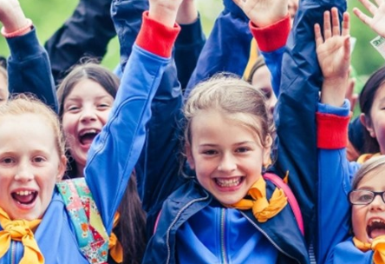
Girl-led decision-making

Slide 9

Step 2: Fixed events and activities

Slide 10






Step 3: Choose your skills builders
Reflect
Network
Innovate
Communicate
Feel good
First aid
Camp
Explore
Make change
Influence
Lead
Live smart
10
Notes:
Additional information for trainers:
Below you will find a reminder of the different skills builders for each theme.
Theme: Know Myself:
a) Reflect - beliefs, values, morals, cultures, identity
b) Network - teamwork, goal-setting and building healthy relationships
Theme: Express Myself
a) Innovate - Science, engineering, design, and creativity
b) Communicate – public speaking, questioning, non-verbal techniques and different audiences
Theme: Be Well
a) Feel good - physical and mental health
b) First Aid – kits, coping in an emergency, incident response and casualty care
Theme: Have Adventures
Camp – tents, fires, outdoor cooking and site management
Explore – planning routes, navigating, travelling and staying healthy while exploring
Theme: Take Action
Make change – identifying issues, fundraising and community action
Influence – campaigning, debating, lobbying and persuading
Theme: Skills for My Future
Live smart – life skills, cooking, DIY, money and careers
Lead – vision, direction, inspiration and negotiation

Slide 11
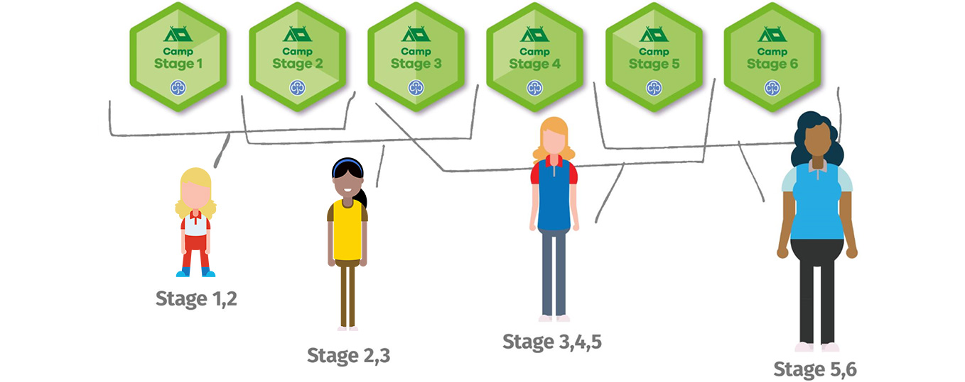
Skills builder stages
11

Slide 12





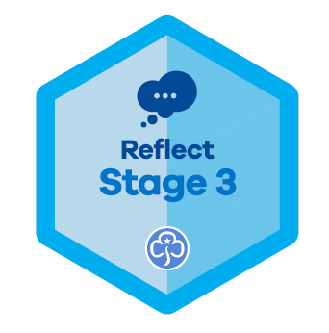
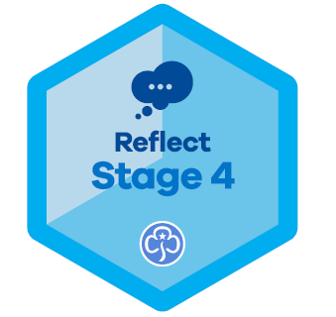
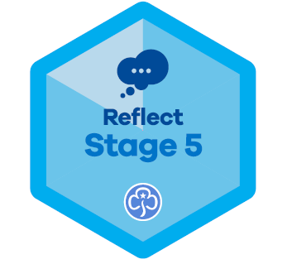
Step 4: When and how to do the activities
Girls should complete skills builders in small groups within the unit.
Within a unit, small groups might work on different skills builders and stages.

Slide 13
Key things to note
It’s OK to have two groups doing the
same thing.
It’s OK to concentrate on one theme and offer two topic choices.
Experienced units may be happy to run several completely different groups
at the same time.
Think outside the box – join up with other units to help deliver the choices the girls are looking for.
Notes:
Additional information for trainers
You may wish to use some examples to illustrate these points. Some suggested examples can be found below:
1st Anytown Rainbows – 15 girls
The unit has chosen to do the Camp skills builder from the Have Adventures theme. There are three groups – one Stage 1 and two Stage 2. The Stage 2 groups do the same activities at the same time.
1st Anytown Brownies – 24 girls
The unit has chosen to do the Have Adventures theme and they have four groups set up – two Stage 2 and two Stage 3 groups for each skills builder (Camp and Explore).
1st Anytown Guides – 20 girls
Girls are in five groups, working on five different skills builders from three themes. They are covering Stages, 3, 4 and 5.
1st Anytown Rangers – six girls
They’ve been joined for the next five meetings by two Rangers from Far Away Village who want to complete their Explore Stage 6 skills builder. They have split into two groups and are working on different activities to each other.

Slide 14
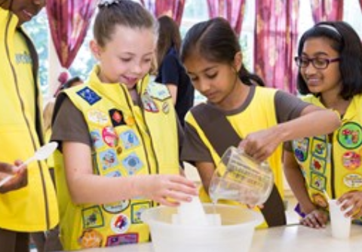
Skills builders and your term

Slide 15




Step 5: Time to support interest badges
Notes:
Additional information for trainers:
Interest badges are a girls individual choice – they can reflect her unique interests and self-development because they are designed to be completed independently away from the unit. They provide her with opportunities to make her own decisions and plan her own engagement (flag Five Essentials link).
There are just three challenges for girls to complete for each badge – and they generally don’t have a fixed outcome or standard to reach. They can take as little as a few hours to complete and offer fun, short-term goals to balance out the longer-term objectives of skills builders and awards (flag the Five Essentials link).
Every girl who does an interest badge can do it differently – there’s no wrong way, which allows all individual girls to explore their interests their way. We hope seeing the wonderful range of different approaches girls take will be inspiring and empowering – and their differences a real cause for celebration (flag the Five Essentials link).
Girls are assessed on whether they have tried their hardest and done their best (which will be different for each girl).
The interest and anniversary badges module looks in more detail at assessing when someone has tried their hardest and done their best.

Slide 16
Step 6: Girls select unit meeting activities
Notes:
Additional information for trainers
Participants should understand the basic key points about unit meeting activity cards.
Unit meeting activities are designed so that the whole unit is doing the same thing at the same time.
They are aligned to the six programme themes to support a balanced and varied programme.
Each pack contains two cards for each theme – and the packs are section specific.
Some of the activities require girls to work in small groups – leaders can align these to sixes and patrols if they like, but equally they can be flexible groups.
The activities on the cards vary in duration and challenge.
Again, the unit meeting activity cards have been designed to support the girls to organise themselves and complete the activities.
These activities will dramatically reduce the amount of time leaders need to spend planning their unit meetings. This leaves more time to enjoy with the girls, and can also be used alongside all their existing favourites.
Girlguiding will continue to update and refresh unit meeting activities, bringing in exciting new topics regularly, to maintain the interest of both volunteers and girls.
Leaders should make sure the equipment and resources required for each activity are available for the meeting. Some items will need to be purchased.

Slide 17
Step 7: Slot the unit meeting
activities into your term plan
Use unit meeting activities to add balance and variation through activities from different themes.
Girls should choose and lead the activities.
They vary in length and challenge so will slot into different time slots you have available.

Slide 18
Returning to the Five Essentials
Notes:
Additional information for trainers
Working together in small groups:
Girls learn about teamwork, sharing experiences, taking responsibility, personal relationships and leadership. This equips them with the skills to make a positive contribution to the group they are working with and to society as a whole.
We challenge girls by asking them to carry out activities together. This provides challenges which girls can meet as a group, and requires them to make decisions, build confidence and be creative.
Encouraging self-government and decision-making:
Making decisions as an individual allows girls to ‘learn by doing’. Girlguiding aims to provide a safe environment for them to make mistakes and learn from them without the pressure of meeting a pre-defined academic standard. Instead, our girls are encouraged to ‘do their best'.
At a group level, girls can plan activities from the broad range available within the programme using the cards and other resources, and share in the management of the unit in age-appropriate ways. Group decision-making uses a range of interpersonal skills, such as negotiation, influencing and listening.
A balanced and varied programme:
Adult Leaders are trained to ensure that every unit’s activities are based around the needs and wants of that particular set of girls. We work to involve girls in our decision-making processes, at every level.
Balance and variety in the programme are achieved through a variety of indoor and outdoor activities, residential experiences, community action projects and more.
Girls can also achieve badges which recognise their efforts when they undertake different tasks and learn new things.
Caring for the individual:
All girls within guiding are expected to be sensitive to the needs and wants of others. Caring for individuals includes learning about relationships and learning how to listen.
Learning how to listen is part of working and making decisions together. This key life skill will enable a girl to care for individuals in later life and have respect for others’ opinions and points of view.
Sharing a commitment to a common standard:
Girlguiding welcomes girls and women from all faiths, cultures and races. A shared commitment to a common standard is expressed in the Promise, which underpins every element of the programme.
By making the Promise, girls and leaders express their commitment to the values of guiding, which encompass active citizenship and spiritual development.

Slide 19

Moment of reflection
19
Notes:
Suggested delivery ideas for trainers
This is a moment for participants to pause and consider all they’ve heard and discussed during the training. Below are a list of questions that may help participants to reflect:
Write three new things you learnt.
What was the main surprise?
What will you implement first?
What is next for you? Write it down or tell the person next to you?
Write a postcard to yourself with the three key things you learnt.
Take a photo of your favourite activity or resource.
Tweet #EveryGirl what you’ve learnt today @Girlguiding
Share on your local Facebook page your excitement of what you’ve learnt.
Think what you would say to another leader about this module.

Slide 20
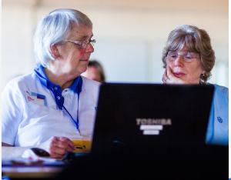
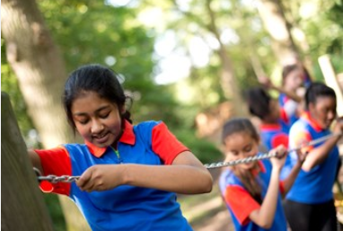
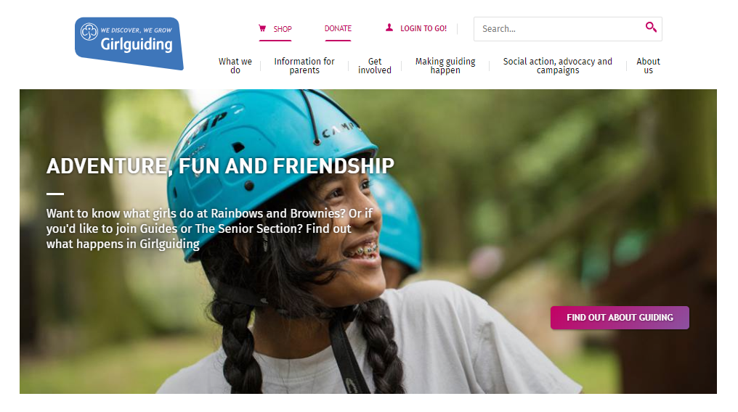
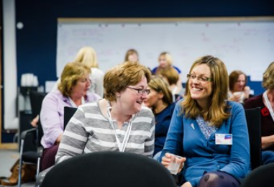
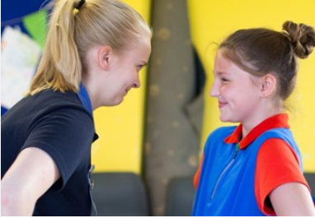
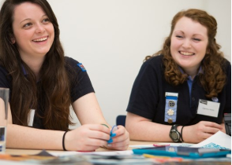
More resources and training
E-learning & webinars
Give it a go!
www.girlguiding.org.uk
Other local events
Guidance notes
for leaders
Chat to
other leaders
20

