Slide 1




Awards
Insert your name here!
Today’s trainer:
Notes:
This training session is about the awards that are part of the Girlguiding programme.
You are welcome to adapt the training session to suit your venue, requirements, learner needs and the context of your training, ensuring you’re retaining the key learning points.
The accompanying training plan contains the key learning points and activities for each slide. In these PowerPoint trainer notes, you will find background context and/or suggested delivery ideas to help you as a trainer as appropriate.

Slide 2
Aim
To understand the different awards
that are available in the Girlguiding programme and what the
requirements are for achieving
these awards.
2

Slide 3
Objectives
By the end of the session participants will have:
Explored the requirements for Theme awards and top section awards, and the progression in complexity/requirements between sections.
Understood what additional award opportunities are available for young members to complete as part of the programme (the Commonwealth award and the Queen’s Guide award).
Considered why it is important to celebrate girl achievements and ideas for how a unit might do this.
3

Slide 4
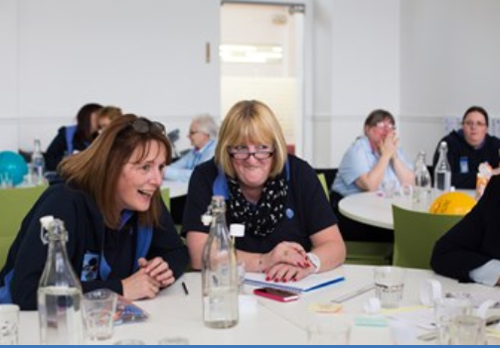
Activity
Work together to decide if the pictures given to you represent an award, badge or qualification.
4

Slide 5




What awards are available?
Section Theme awards
(six per section)
Top section awards
(three per section)
Commonwealth award
Queen’s Guide award
5

Slide 6

Theme awards
Six awards to match
the six themes for each section
6
Notes:
Additional information for trainers:
It should be possible to achieve all six Theme awards within a section if a girl wants to – but it may not be if she is only there for a year. For help with supporting girls during the change over year (academic years 18/19 and 19/20) and transition arrangements, leaders can download a handout from the Girlguiding website.

Slide 7
Number of unit meeting activity
hours required
3
4
5
5
Rainbows
Brownies
Guides
Rangers
7
7

Slide 8
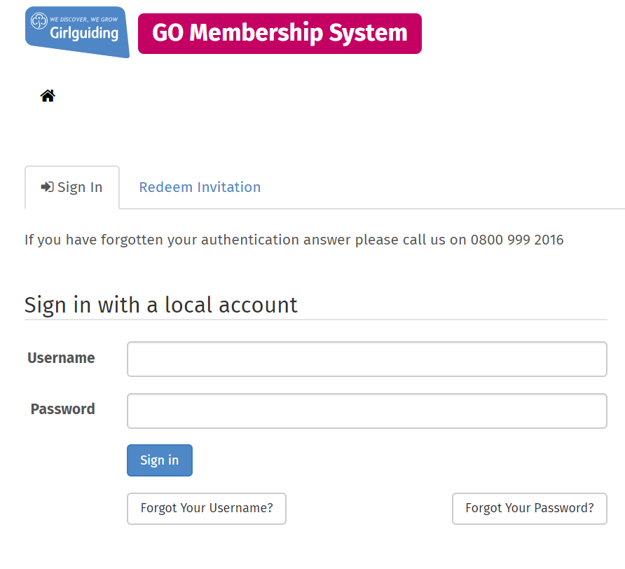
Leader recording
8

Slide 9
Activity
Using the programme imagery provided, work in groups to map out a Theme award journey for a girl in each section.
9
Notes:
Suggested delivery ideas for trainers
There are lots of creative ways that you can help leaders to remember what girls need to do to achieve a Theme award. The card sort activity is one example, below is another example. You may have your own!
Get participants up and moving – give each participant an envelope with a part of a Theme award in it (an interest badge, skills builder stage or unit meeting activity hours). Ask participants to find the other parts needed to make a Theme award and to make a human chain representing the journey to achieving one!

Slide 10
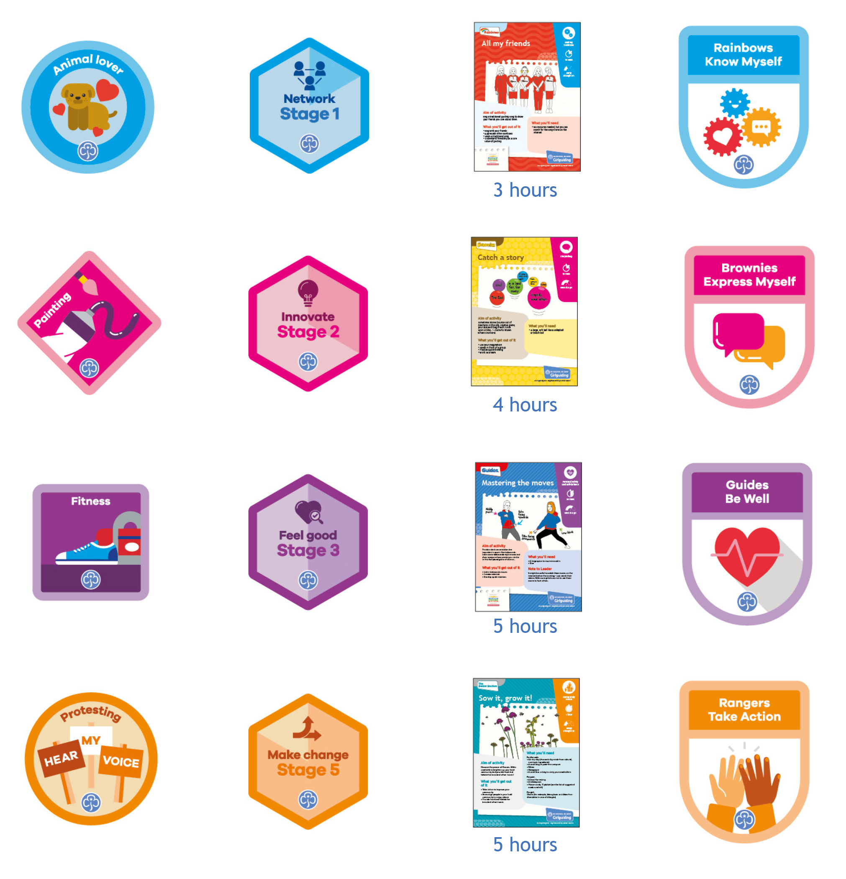
Activity answers
+
+
=
+
+
=
+
+
=
+
+
=
10

Slide 11
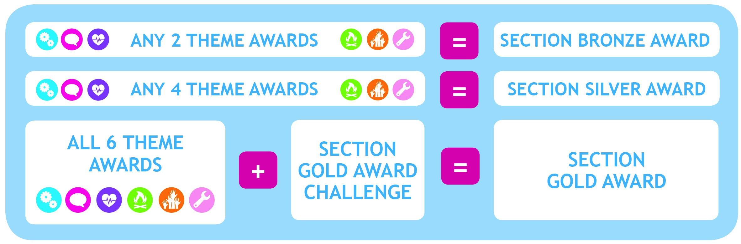
Top section awards
11

Slide 12
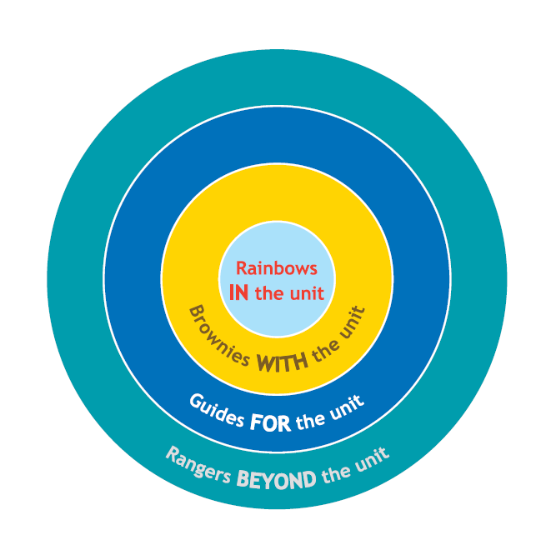
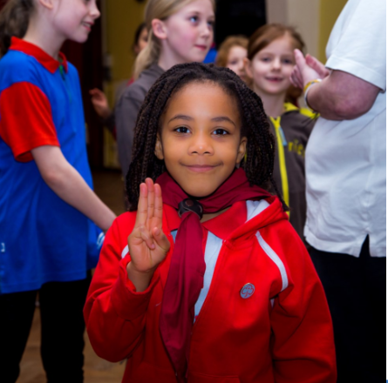
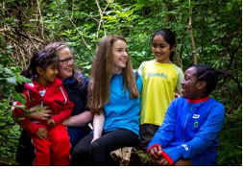
The section Gold award challenge
Part 1
Part 2
Part 3
12

Slide 13
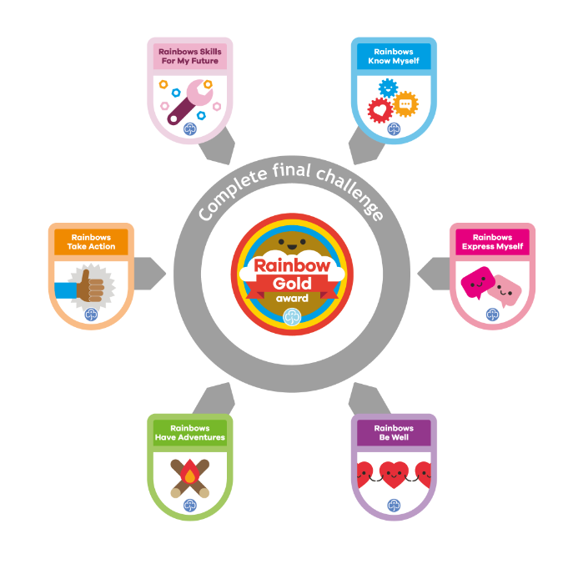
The Rainbow Gold award challenge
Part 1
The Promise.
Part 2
Girls tell their unit about the special things they have tried and learned at Rainbows.
Part 3
Girls get ready for life at Brownies!
13

Slide 14
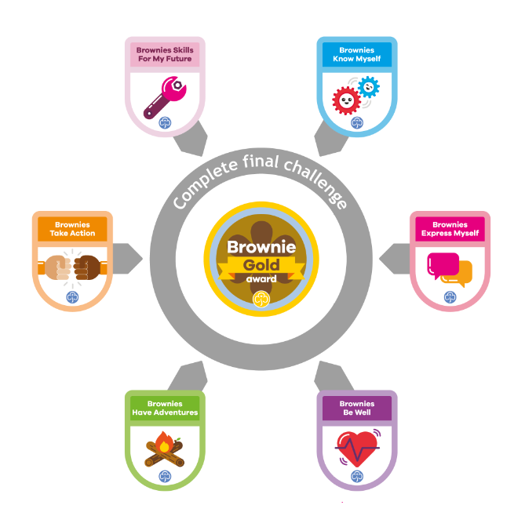
The Brownie Gold award challenge
Part 1
The Promise.
Part 2
Girls organise a Brownie meeting activity or create something special for the unit.
Part 3
Girls get ready for life at Guides!
14

Slide 15
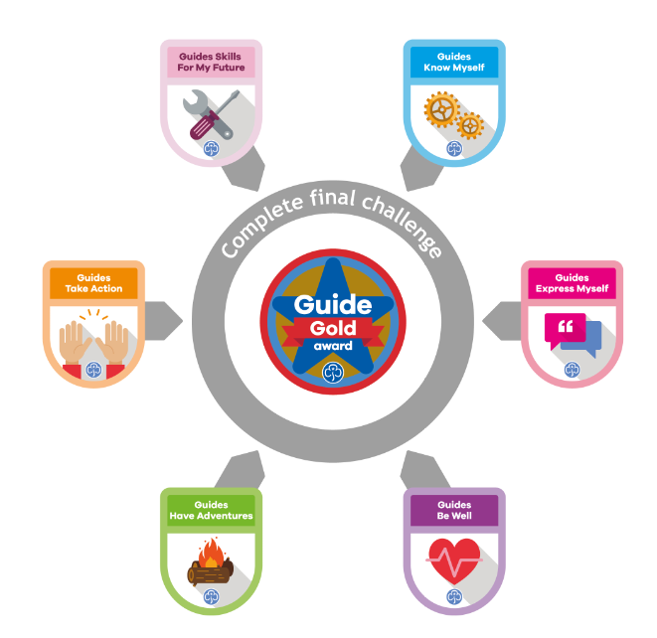
The Guide Gold award challenge
Part 1
The Promise.
Part 2
Girls do an outdoor activity or adventure that is new to them. They share that experience with the unit.
Part 3
Girls get ready for life at Rangers and/or help others to get ready for Brownies or Guides!
15

Slide 16
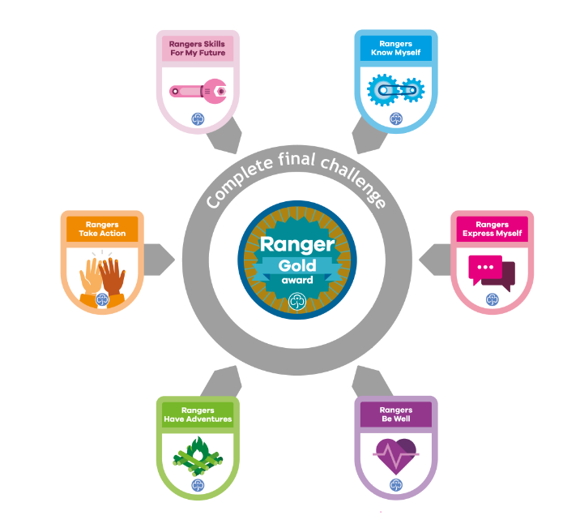
The Ranger Gold award challenge
Part 1
The Promise.
Part 2
Girls demonstrate leadership skills by supporting their local community.
Part 3
Girls find out about opportunities for young adult members and understand the adult volunteer structure.
16
Notes:
Information for trainers:

Slide 17
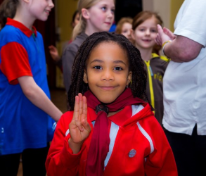
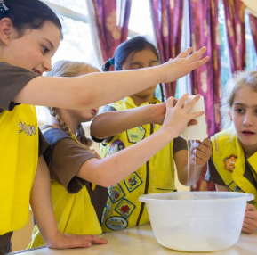
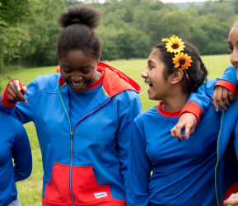
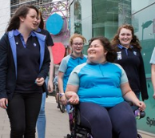
Scenarios
17
Notes:
Additional information for trainers
Potential answers to scenarios:
Scenario 1:
Think laterally and creatively for this one
The Brownie could skype into a Guide unit for an evening (this might be the only option for a BGO Brownie or lone).
A Commissioner could ask another Guide unit within the county to liaise with the Brownie to set a photo shoot of their meeting – the Brownie could request what photos to take.
The Brownie could conduct a letter exchange with a county Guide unit.
The Brownie could experience Guide activities on a county camp as a day visitor.
The Brownie could read up on Guides in the Guide handbook and write/record a report on what it is like to be a Guide. Guides could review her report and let her know what she missed.
Scenario 2:
The answer here lies in getting the Ranger to think broadly on other ways she can pursue her Ranger Gold award. It is something to strive for, it is to show her at her best, so encourage her to be her best.
The leader could encourage the Ranger to reflect on what would truly challenge her.
She could look at ways other Ranger units pursue Ranger Gold awards and pick one of those ideas.
The unit leader could coach her into thinking of new ways to achieve goals.
As she’s already done a petition before, she could create a mind map to list the different ways she could achieve her goal, then pick a way.
The whole Ranger unit could do a 90 second Post-it race, thinking of many different ways, writing each on a Post-it note, then the Ranger going for her Ranger Gold award could pick her favourite.
Scenario 3:
Adventure should not be off putting, but it is understandable if a Guide has not done it before. There are lots of ways to get involved in a really welcoming way.
The unit leader could arrange for the county outdoors adviser to come in and run an adventure evening with all the Guides, so our Guide feels more at ease.
Coach the Guide into thinking of all the ways the Guide Gold award will help her in life.
The Guide could look at a county website or newsletter, or Making Adventure Easy to join in with fellow Guides in a country/region or national event.
Scenario 4
The Rainbow needs to take the lead, but, of course, the unit leaders are all there to encourage her.
Speak to the Rainbows unit to think of ideas for Part 3, and have the Rainbow pick her favourite.
Encourage the Rainbow to look at the Brownie handbook to see all the exciting things Brownies do.
Encourage the Rainbow to pick out of the Brownie Badge book which Brownie badges she would do.
Have some Brownies visit the unit to talk about what it is like at Brownies.
Have the Rainbow then visit the Brownies to a taster evening.

Slide 18
The Commonwealth award
Open to 13+ Guides and Rangers.
Aim is for girls to discover more about the Commonwealth that they are part of.
Mix of compulsory and optional challenges
on a variety of topics, including
community action, the history of
guiding and others.
18
Notes:
Additional information for trainers:
More information about the Commonwealth award can be found here: www.girlguiding.org.uk/what-we-do/our-programme-and-activities/the-senior-section-programme/commonwealth-award

Slide 19
The Queen’s Guide award
For members between their 16th & 26th birthdays.
Takes up to three years.
Highest award in guiding.
Five challenges:
  Service in guiding.
  Outdoor challenge.
  Personal skill development.
  Community action.
  Residential.
19
Notes:
Information for trainers:
More information can be found in the Queen’s Guide resource: https://www.girlguiding.org.uk/what-we-do/our-badges-and-activities/badge-finder/queens-guide-award/
There are other opportunities also available to girls, including Duke of Edinburgh Award, permits, peer education, etc. More information about these opportunities can be found on the Girlguiding website.

Slide 20
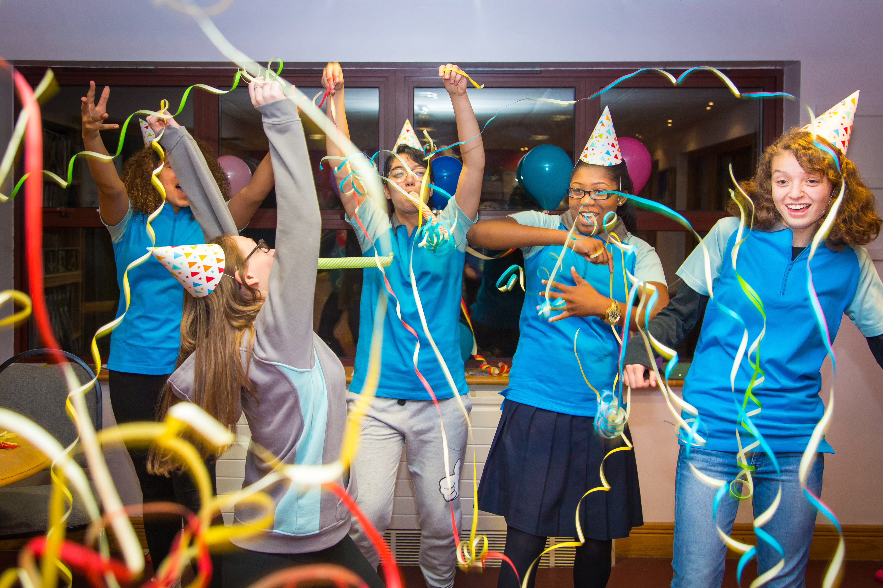
Celebrate!
20

Slide 21

Moment of reflection
21
Notes:
Suggested delivery ideas for trainers
This is a moment for participants to pause and consider all they’ve heard and discussed during the training. Below is a list of questions that may help participants to reflect:
Write three new things you learnt.
What was the main surprise?
What will you implement first?
What is next for you? Write it down or tell the person next to you?
Write a postcard to yourself with the three key things you learnt.
Take a photo of your favourite activity or resource.
Tweet #EveryGirl what you’ve learnt today @Girlguiding
Share on your local Facebook page your excitement at what you’ve learnt.
Think what you would say to another leader about this module.

Slide 22
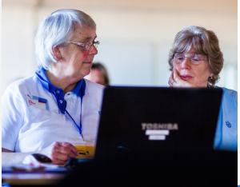
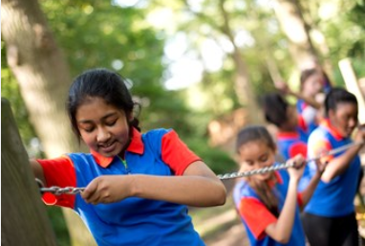
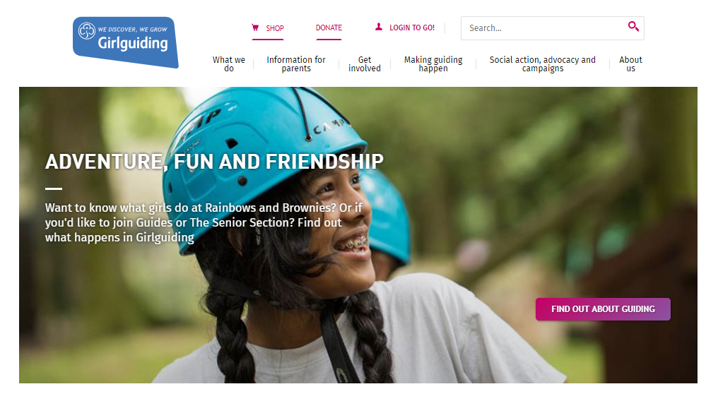
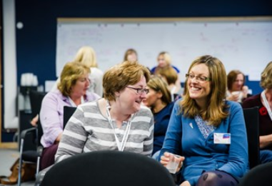
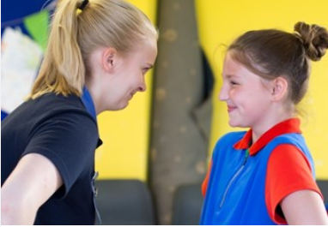
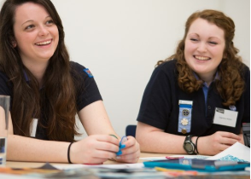
More resources and training
E-learning & webinars
Give it a go!
www.girlguiding.org.uk
Other local events
Guidance notes
for leaders
Chat to
other leaders
22

