Slide 1
1st Response
Todays trainer: [insert name here]
Notes:
The accompanying training plan contains the key learning points and activities for each slide. In these PowerPoint trainer notes you will find background context and/or suggested delivery ideas to help you as a trainer as appropriate.
- Load slides (first 5 will be designed as ‘scrolling’ for the start. Remind people to get a notebook/pen, a few notes about using Zoom (or other platform) webinars (the features on there) - Play music - Start admitting people into the webinar - Chat with people in the chat bar / or chat in person depending on the size of group. A mix of both would be good, so they can test equipment and platform functions.

Slide 2
Using Zoom today on laptop or PC
These buttons are usually found by going to the bottom of your screen
Click here to turn your video and sound on and off
Click here to show the Participant list and Yes/No emoticons
Click here to show the Chat box
Any problems, try logging in and out of the training; we will let you back in!
Notes:
Load slides (first 5 will be designed as ‘scrolling’ for the start. Remind people to get a notebook/pen, a few notes about using Zoom (or other platform) webinars (the features on there) - Play music - Start admitting people into the webinar - Chat with people in the chat bar / or chat in person depending on the size of group. A mix of both would be good, so they can test equipment and platform functions.
Explain that each person in this training will still need to meet face to face with a trainer to complete the practical elements. Once this is done, it can be recorded on GO. There will be videos to access during the presentation showing these practical elements. Check participants received the links – if not send over in the chat.

Slide 3
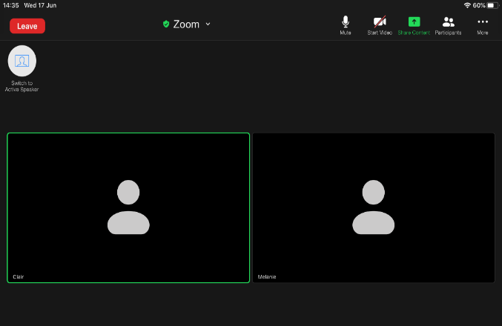
Using Zoom today on ipad
Click anywhere on the screen and this menu bar will be visible at the top.
Click here to show the Participant list and Yes/No emoticons
Click here to turn your video and sound on and off
Any problems, try logging in and out of the training; we will let you back in!
Any problems, try logging in and out of the training; we will let you back in!

Slide 4
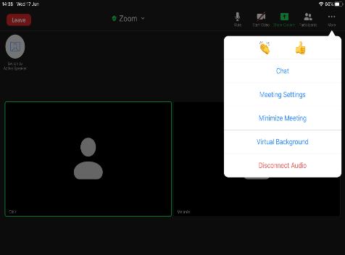
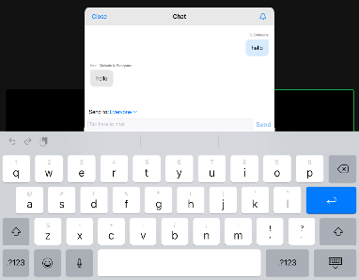
Using Zoom today on ipad
On the right of the menu bar, you have the … more option. Click … to see these drop down menu options:
Click the chat option. Chat allows you to communicate with others in the meeting without interrupting the speaker.

Slide 5
Using Zoom today on ipad
Click on the black beneath the whiteboard and a pencil will appear with the name of the person who created the whiteboard.
The pencil will expand to show the menu for typing or drawing on the whiteboard.
Click T for text to type on the whiteboard

Slide 6
Session 3 Major illness
Asthma
Anaphylaxis
Heart attack
Stroke
Seizures
Diabetes
Sepsis/Meningitis
Notes:
Timing: 3 minute
Introduce the major illness session and inform the participants of the syllabus areas you will cover in the first session. Trainers should explain how the session will work in terms practicing and demonstrating practical first aid knowledge. Preparing the participants with any support or items they may need to aid them with this virtually should be communicated through the pre course information. Highlight here which areas of the syllabus can be viewed by a trainer face to face.
Activity – use the emoticons to confirm participants can hear the trainer(for example "Using the emoticons or reactions, please let me know if you are ready to start?"
Ask the question "What are you hoping to take away from today in addition to completing this session?" - this could be done in CHAT or verbally, depending on the system. Use the responses to pull the key elements out from the objectives without reading them out.
Introduce the Major illness session and inform the participants of the syllabus areas you will cover in the first session. Ask participants what they think they will be covering in the Trauma and Injury section and add anything missed.
Trauma and injury Key Topics:
Asthma
Anaphylaxis
Heart attack
Stroke
Seizures
Diabetes
Sepsis/Meningitis
Trainers notes:
Introduce the major illness session and inform the participants of the syllabus areas you will cover in the first session.
Objectives:
1. To be able to understand the symptoms and signs for:
Asthma
Anaphylaxis
Heart Attack
Stroke
Seizures
Diabetes
Sepsis / Meningitis
2. To understand the planning and preparation needed for members with known conditions / illnesses.
3. To know where to look for help and advice from other sources related to these conditions / illnesses.
Outcomes
Understand the symptoms and signs that mean you need to seek professional medical advice and know how to provide immediate First Aid treatment in particular helping patient to use their own emergency medication for:
Asthma
Anaphylaxis *
Heart attack
Stroke
Seizures
Diabetes
Sepsis/Meningitis
With a focus on the major illness syllabus areas. Ask the participants which major illnesses they would be confident dealing with.
It is important to acknowledge that some may be attending first aid training for the first time, and others may be refreshing their knowledge and understanding.
For those who have attended first aid training before - Ask how the training they had been on before prepared them for an accident or incident.
For those new to first aid - ask then what they are hoping to achieve training.

Slide 7
How confident are you feeling about being a first aider at Girlguiding?
1 2 3 4 5
Notes:
Timings: 2 minutes
Create a quick poll – this can be done if you are using software that allows for a poll option, or if it allows for participants to annotate on a slide. If neither options are available you can ask people to use the chat function. Trainer 2 can do this whilst trainer 1 is talking.​
​
Acknowledge where people are at the moment and explain the importance of the training.​
You can use the scale for a few questions – such knowledge confidence or skill confidence

Slide 8
Notes:
Timings: 5 minutes
With a focus on the major illness syllabus areas. Ask the participants what 1st Aid scenarios they would currently feel confident dealing with.
It is important to acknowledge that some may be attending first aid training for the first time, and others may be refreshing their knowledge and understanding.
For those who have attended first aid training before - Ask how the training they had been on before prepared them for an accident or incident.
For those new to first aid - ask then what they are hoping to achieve training.
If you are using a platform with a whiteboard feature, this will be a good place to catch this information. If not, general conversation or using the text box will work too. There are areas further in the training that require interaction, so it’s important to get them ready and into the training early.

Slide 9
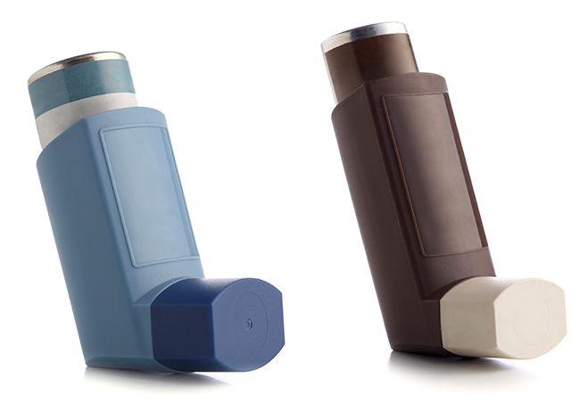
Asthma
What is asthma?
What are the signs and symptoms:?
Notes:
Trainers Notes:
Timings: 8 minutes
Asthma
Asthma – share any useful links in the chat with participants. Ask participants if they can highlight the signs and symptoms of an asthma attack.
Important to touch on the common uses for inhalers or when they may be needed in a unit meeting, activity or residential.
What do participants know about Asthma?
Asthma is a chronic (long-term) condition in which the muscles of the air passages go into spasm making the airways narrow and causing the patient to have difficulty in breathing.
Signs and symptoms
Difficulty breathing – short sentences and whispering
Wheezing
Coughing
Distress and anxiety
Grey-blue tinge to lips, earlobes and nailbed
Exhaustion in a severe attack

Slide 10
Asthma
One puff of reliever inhaler every 30-60 seconds for up to 10 puffs
Use spacer device if available
Call for help if no improvement after 10 puffs. The 10 puff routine can be repeated after a few minutes if ambulance hasn’t arrived
Notes:
Trainers notes
Timings: 7 minutes
Read out the scenarios and post them in the chat and discuss what they would do either in small break out rooms and feed back or as a group together. This can be verbal or through the chat. You can either split into 2 and cover both scenarios or choose just one. Trainer 2 to share these in the chat box so everyone can see.
1. A member who is asthmatic participates in a game of basketball but forgets to take their medication before the game. During the game the player becomes very distressed, has difficulty breathing and begins to cough and wheeze.
2. During a wet and cold sponsored walk with the Guides your friend begins wheezing. Within minutes she is breathing rapidly, coughing and suffering from chest tightness. She is also having difficulty speaking and answering your questions
Treatment
One puff of reliever inhaler every 30-60 seconds for up to 10 puffs. Use spacer device if available. Call for help if no improvement after 10 puffs. The 10 puff routine can be repeated after a few minutes if ambulance hasn’t arrived.
Some people will have a combined reliever and preventer inhaler – they should use this during an asthma attack

Slide 11
Asthma
Red flags
Notes:
Trainers notes:
Timings: 2 minutes
Red Flags’
Call 999/112 for medical help if:
Reliever inhaler not easing attack
Patient is becoming exhausted
Patient is too breathless to speak
Patient cannot complete full sentences

Slide 12
Anaphylaxis
Anaphylaxis is a severe allergic reaction affecting the whole body. It may develop within seconds or minutes of coming into contact with a trigger and can be fatal.
Notes:
Trainers Notes:
Timings: 10 minutes
Scenario – ask participants to read the scenario and discuss what they would do either in small break out rooms and feed back or as a group together. This can be verbal or through the chat
Anaphylaxis is a severe allergic reaction affecting the whole body. It may develop within seconds or minutes of coming into contact with a trigger and can be fatal.
Signs and symptoms:
Red itchy rash
Red itchy eyes
Swelling of hands feet or face
Abdominal pain, vomiting and diarrhoea
Wheezing and difficulty breathing
Swelling of tongue or throat
Agitation and feeling of terror
Shock

Slide 13
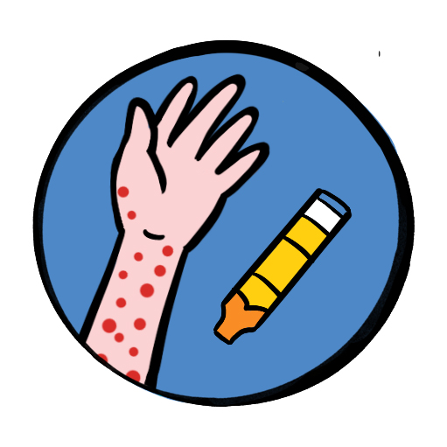
Anaphylaxis
Treatment
Patients need emergency treatment with adrenaline
Call for help – 999/112
If the patient has an adrenaline auto-injector – help them to use it
If symptoms not improving after 5 mins or they return – give second dose of adrenaline
Notes:
Trainers notes
Timings: 4 minutes
Treatment
Patients need emergency treatment with adrenaline
Call for help – 999/112
If the patient has an adrenaline auto-injector – help them to use it.
If symptoms not improving after 5 mins or they return – give second dose of adrenaline
Anyone receiving adrenaline treatment must be taken to hospital.
There are several types of adrenaline auto injectors available in the UK. All deliver ‘adrenaline’ (also referred to as ‘epinephrine’). All types are prescription only medicines, and need to be prescribed by an allergy specialist. The dose of adrenaline required is dependent on the age and weight of the person requiring the adrenaline auto injector device, and will be prescribed by the clinician. Each adrenaline auto injector device will differ in appearance and the availability of the dose/strength available in that particular brand.

Slide 14
Heart attack
Feeling lightheaded or dizzy
Sweating
Shortness of breath
Feeling sick (nausea) or being sick (vomiting)
An overwhelming sense of anxiety (similar to having a panic attack)
Coughing or wheezing
Notes:
Trainers notes
Timings: 12 minutes
https://www.youtube.com/watch?v=gDwt7dD3awc - *Please make sure you have sent this link to the participants beforehand. Post in the chat for ease of access*
What is a heart attack?
Chest pain sensation of pressure, tightness or squeezing in the centre of your chest and in other parts of the body – it can feel as if the pain is travelling from your chest to your arms (usually the left arm is affected, but it can affect both arms), jaw, neck, back and tummy (abdomen)
Signs and symptoms
Feeling lightheaded or dizzy
Sweating
Shortness of breath
Feeling sick (nausea) or being sick (vomiting)
An overwhelming sense of anxiety (similar to having a panic attack)
coughing or wheezing
Although the chest pain is often severe, some people may only experience minor pain, similar to indigestion. In some cases, there may not be any chest pain at all, especially in women, older people, and people who have diabetes.
It's the overall pattern of symptoms that helps to determine whether you are having a heart attack.
Treatment and positioning
If the casualty is still conscious, sit them up, supporting them from behind with their knees slightly bent (the ‘W’ position).
Send for urgent medical help.
Monitor them carefully and give 300mg aspirin to adults who are showing signs and symptoms of a heart attack. Do not give if chest pain due to trauma. Do not give to under 16s, those with severe allergy to aspirin, those with known stomach problems, or those with severe asthma. It is shown that given early, survival rates are better and there are no increased side effects
If the casualty is known to have angina and has medication for it, they can be helped to use it as instructed on the prescription Constantly monitor their level of response, circulation and breathing until help arrives.
If they lose consciousness, put them in the recovery position if still breathing normally.
If breathing deteriorates, begin CPR
If the casualty is thought to be having a heart attack, or has breathing difficulties or chest injuries, they should ideally be supported in the half sitting (‘W’) position.
NEVER give aspirin to children.

Slide 15
Notes:
Timings: 8 minutes
Heart Attack
Scenarios – ask participants to read the scenarios and discuss what they would do either in small break out rooms and feed back or as a group together. This can be verbal or through the chat. You can either split into 2 and cover both scenarios or choose just one. Trainer 2 to share these in the chat box so everyone can see.
1. At the district fun day an eight year old runs to tell you that there is an adult in the bathroom complaining of chest pain and going blue. What do you do? All the other leaders are at the camp fire circle at the other side of the site.
2. A Trefoil Guild/SASU member is helping at your Rainbow/Beaver Unit/Coloney. They starts to have chest pain which radiates to her left arm and they feels pressure in her chest. They become very agitated and panicky and has tingling in her fingers and around their mouth. They feels a bit sick and short of breath after 10 mins of chest pain. They are sweating profusely, dizzy and cold and clammy to touch. What do you do?

Slide 16
Notes:
Timings: 5 minutes
Encourage participants to take a break away from the screen

Slide 17
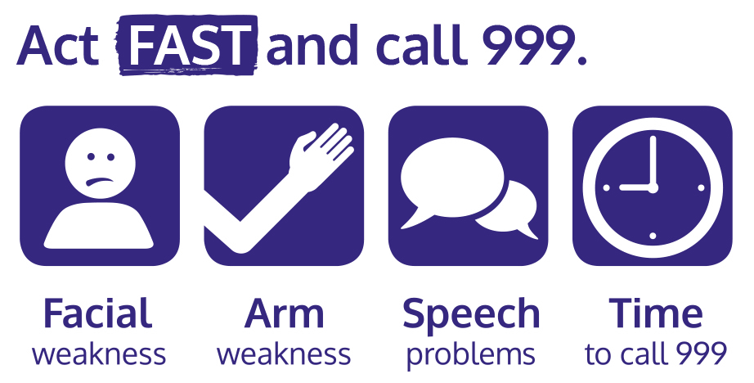
Stroke
Notes:
Trainers Notes:
Timings 13 minutes
Scenario – Read the scenario and post in the chat and discuss what they would do either in small break out rooms and feed back or as a group together. This can be verbal or through the chat.
Include how to use a stroke assessment system to decrease the time to recognition and definitive treatment for individuals with suspected acute stroke. First aiders must be trained in the use of FAST (Face, Arm, Speech Time).
https://www.youtube.com/watch?v=PhH9a0kIwmk *Please make sure you have sent this link to the participants beforehand. Post in the chat for ease of access*
A stroke is a medical emergency when the blood supply to the brain is disrupted. The majority of strokes are caused by a clot in a blood vessel that blocks the flow of blood to part of the brain. Some strokes are the result of a ruptured blood vessel that causes bleeding into the brain.
A transient ischaemic attack, or TIA, is sometimes called a mini-stroke. It is similar to a full stroke but the symptoms last for a short while, improve and disappear.
Face ‒ look at their face and ask them to smile. Are they only able to smile on one side of their mouth? If yes, this is not normal.
Arms ‒ ask them to raise both arms. Are they only able to lift one arm? If yes, this is not normal.
Speech ‒ ask them to speak. Are they struggling to speak clearly? If yes, this is not normal.
Time ‒ if the answer to any of these three questions is yes, then it is time to call 999 or 112 for medical help and say you think the casualty is having a stroke

Slide 18
Seizures
symptoms and treatment
Notes:
Trainers Notes:
Timing: 9 minutes
Scenarios – ask participants to read the scenarios and discuss what they would do either in small break out rooms and feed back or as a group together. This can be verbal or through the chat. You can either split into 2 and cover both scenarios or choose just one. Trainer 2 to share these in the chat box so everyone can see.
A Brownie you know well approaches you looking vague and a bit confused. She is behaving characteristically oddly and is slow to respond to your questioning. She admits to missing a meal during the day’s hike. You notice she looks pale, cold and sweaty and is breathing rapidly.
You are at a meeting when someone tells you that their friend, aged 12, is not feeling well and needs help. You see she is wearing a diabetic ID bracelet.
A seizure – or convulsion or fit – consists of involuntary contractions of many of the muscles in the body, due to a disturbance in the electrical activity of the brain. The most common cause of seizures is epilepsy. Epilepsy is a chronic condition and patients often take medication to prevent or reduce seizures. Other causes include head injury, lack of oxygen to the brain, excess of alcohol or drugs, fever in young children.
Symptoms and signs
Sudden loss of responsiveness
Patient becomes rigid and arches back
Breathing may be noisy and become difficult, lips may show a grey-blue tinge – cyanosis
Uncontrollable jerking and shaking, called a "fit" may lose bladder control
Most seizures terminate within a few minutes
After a seizure the patient may feel tired and fall into a deep sleep.
Some people have a form of epilepsy known as absence seizures during which they appear distant and unaware of their surroundings. You may notice slight or localised twitching or jerking of lips, eyelids, head or limbs.
Treatment
Make space around patient and move bystanders out of the way.
Remove any potentially dangerous items such as hot drinks or sharp objects
Note what time fit started
Do not move patient unless they are in immediate danger
When the fit has stopped, check airway and breathing and place into recovery position.
Note how long seizure lasted.
Call for emergency help if:
There are repeated seizures or if this is first seizure
The seizure continues for more than 5 minutes
The patient is unresponsive for more than 10 minutes

Slide 19
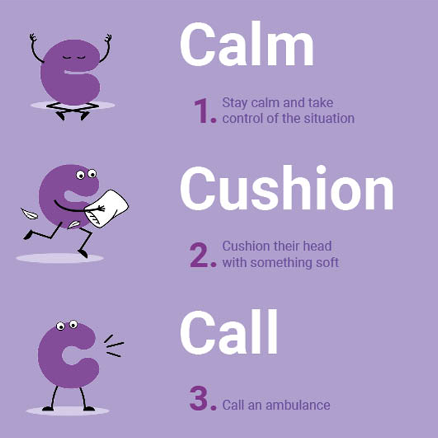
Seizures
The most common cause of seizures is epilepsy. Epilepsy is a chronic condition and patients often take medication to prevent or reduce seizures. Other causes include head injury, lack of oxygen to the brain, excess of alcohol or drugs, fever in young children
Notes:
Trainers notes
Timings 2 minutes
Epilepsy Society 3 c’s ca- The charity’s new campaign gives people three simple but key instructions to remember in an emergency: “Calm, Cushion, Call” Campaign

Slide 20
Diabetes
A chronic (long-term) condition in which the body fails to produce sufficient insulin, which is a hormone that controls blood sugar level. This can result in higher than normal blood sugar (hyperglycaemia) or lower than normal blood sugar (hypoglycaemia or hypo)
Notes:
Trainers Notes:
Timings: 6 minutes over next 2 slides
Trainers to also discuss in the group any experience of members with diabetes, ask for input from participants
Diabetes – this is a chronic (long-term) condition in which the body fails to produce sufficient insulin, which is a hormone that controls blood sugar level. This can result in higher than normal blood sugar (hyperglycaemia) or lower than normal blood sugar (hypoglycaemia or hypo).

Slide 21
Diabetes
Hypoglycaemia is the emergency. If a patient with diabetes is unwell giving them sugar will rapidly restore blood sugar, and is unlikely to do harm in hyperglycaemia. The need is to act urgently rather than trying to decide.
Notes:
Trainers notes
Hypoglycaemia is the emergency. If a patient with diabetes is unwell giving them sugar will rapidly restore blood sugar, and is unlikely to do harm in hyperglycaemia. The need is to act urgently rather than trying to decide.
Signs and Symptoms
A history of diabetes – some people may recognise a “Hypo” coming
Weakness, fainting, hunger
Confusion, being irrational
Sweaty with clammy skin
Rapid pulse
Decreasing level of responsiveness
Evidence of medical warning device – or carrying glucose gel or sweets
Treatment
Give sugar.
Patient may have their own emergency supplies (think about a healthcare plan)
If not give – 15-20g glucose – 150ml of non-diet fizzy drink, 3 jelly babies, 3 sugar lumps.
If the casualty feels better –help them to check their own blood sugar
If not improving –call for medical help.
If unresponsive – put into recovery position and monitor.

Slide 22
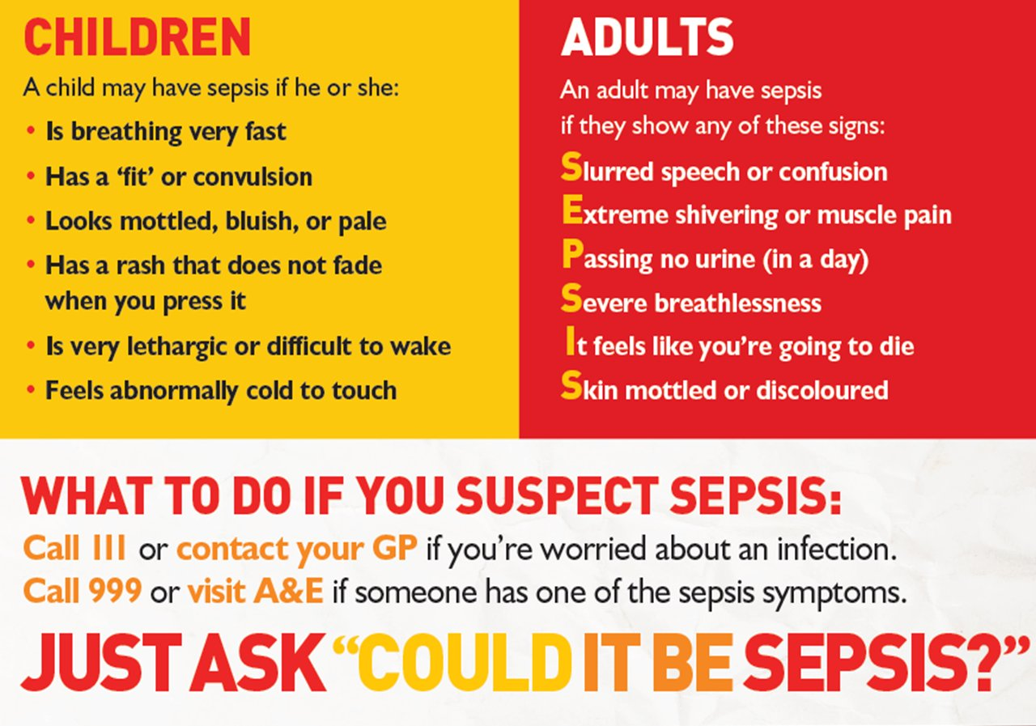
Sepsis
Notes:
Trainers Notes:
Timings 7 minutes
Sepsis (also known as blood poisoning) is the immune system’s overreaction to an infection or injury. Normally our immune system fights infection – but sometimes, for reasons we don’t yet understand, it attacks our body’s own organs and tissues. If not treated immediately
Signs and symptoms (Children)
Breathing very fast
Has a ‘fit’ or convulsion
Looks mottled, bluish or pale
Has a rash that does not fade when you press it
Is very lethargic or difficult to wake
Feels abnormally cold to touch
They may not have all these symptoms.
Signs and symptoms (Adult)
Slurred speech of confusion
Extreme shivering or muscle pain
Passing no urine (in a day)
Severe breathlessness
It feels like you’re going to due
Skin mottled or discoloured
Sometimes symptoms can be vague and can be like other conditions, including flu or chest infection.
Image: The Sepsis Trust

Slide 23
Meningitis
Signs and symptoms
raised body temperature
vomiting
feeling very unwell
severe headache
photophobia (dislike of light)
stiff or rigid neck
a lowering level of consciousness if untreated
rash of small purple spots or bruises (when pressed against a glass they do not disappear). This is a late sign and may not even appear.
Notes:
Trainers notes
Timings 7 minutes
Meningitis
Although it is not a common condition, you should be aware of meningitis.
Meningitis is an infection of the protective membranes that surround the brain and spinal cord (meninges).
It can affect anyone, but is most common in babies, young children, teenagers and young adults.
Signs and symptoms
raised body temperature
vomiting
feeling very unwell
severe headache
photophobia (dislike of light)
stiff or rigid neck
a lowering level of consciousness if untreated
rash of small purple spots or bruises (when pressed against a glass they do not disappear). This is a late sign and may not even appear.
If you have any suspicion that someone might have meningitis, seek urgent medical advice.

Slide 24
Q + A
Notes:
Timings: 5 minutes
Any questions? This may include questions that could have come up in the chat during the training, make sure you check.

Slide 25
How confident are you feeling about being a first aider at Girlguiding?
1 2 3 4 5
Notes:
Timings: 3 minutes
Back to the first question - Create a quick poll – this can be done if you are using software that allows for a poll option, or if it allows for participants to annotate on a slide. If neither option is available you can ask people to use the chat function. Trainer 2 can do this whilst trainer 1 is talking.​
​
This is a good way to test what people have learnt throughout the course and their confidence levels now.
You can use the scale for a few questions – such knowledge confidence or skill confidence

Slide 26
Summary and reflection
Notes:
Summary / Reflection
Timings: 4 minutes
Ask participants if they think we met the session outcomes and for them to feedback what in particular they have learnt today or will take away from this section of the course.
Trainers notes:
Were these learning outcomes met?
Outcomes
Understand the symptoms and signs that mean you need to seek professional medical advice and know how to provide immediate First Aid treatment in particular helping patient to use their own emergency medication for:
Asthma
Anaphylaxis *
Heart attack
Stroke
Seizures
Diabetes
Sepsis/Meningitis
Unless otherwise stated (as identified by * or **) items can be delivered in a theoretical way, using trainer delivered or video content.
Items identified with * can be delivered in either theory or practical methods, recognising that a variety of factors may make this not possible, where possbile practical activities would be encouraged.

