Slide 1
1st Response
Todays trainer: [insert name here]
Notes:
The accompanying training plan contains the key learning points and activities for each slide. In these PowerPoint trainer notes you will find background context and/or suggested delivery ideas to help you as a trainer as appropriate.
Trainers Notes:
Outline the structure of the session - You may be delivering this as a standalone module (2hours) or as part of a full day of training (6 hours).
If delivering as virtual training all notes and trainers’ instructions can be found on the webinar PowerPoint

Slide 2
Using Zoom today on laptop or PC
These buttons are usually found by going to the bottom of your screen
Click here to turn your video and sound on and off
Click here to show the Participant list and Yes/No emoticons
Click here to show the Chat box
Any problems, try logging in and out of the training; we will let you back in!
Notes:
Load slides (first 5 will be designed as ‘scrolling’ for the start. Remind people to get a notebook/pen, a few notes about using Zoom (or other platform) webinars (the features on there) - Play music - Start admitting people into the webinar - Chat with people in the chat bar / or chat in person depending on the size of group. A mix of both would be good, so they can test equipment and platform functions.
Explain that each person in this training will still need to meet face to face with a trainer to complete the practical elements. Once this is done, it can be recorded on GO. There will be videos to access during the presentation showing these practical elements. Check participants received the links – if not send over in the chat.

Slide 3
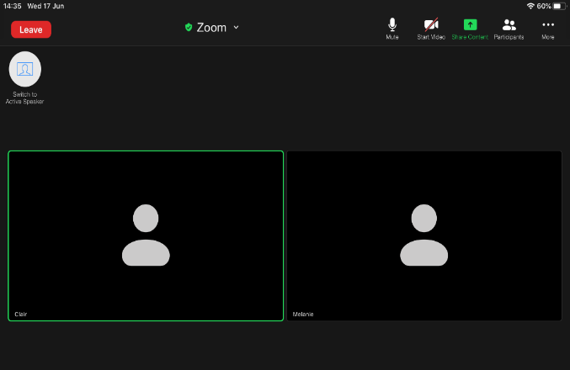
Using Zoom today on ipad
Click anywhere on the screen and this menu bar will be visible at the top.
Click here to show the Participant list and Yes/No emoticons
Click here to turn your video and sound on and off
Any problems, try logging in and out of the training; we will let you back in!
Any problems, try logging in and out of the training; we will let you back in!

Slide 4
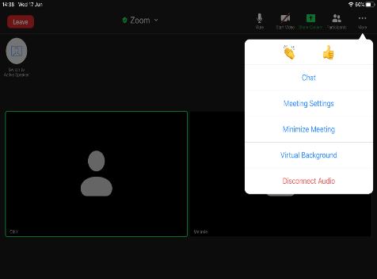
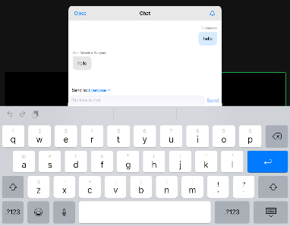
Using Zoom today on ipad
On the right of the menu bar, you have the … more option. Click … to see these drop down menu options:
Click the chat option. Chat allows you to communicate with others in the meeting without interrupting the speaker.

Slide 5
Using Zoom today on ipad
Click on the black beneath the whiteboard and a pencil will appear with the name of the person who created the whiteboard.
The pencil will expand to show the menu for typing or drawing on the whiteboard.
Click T for text to type on the whiteboard

Slide 6
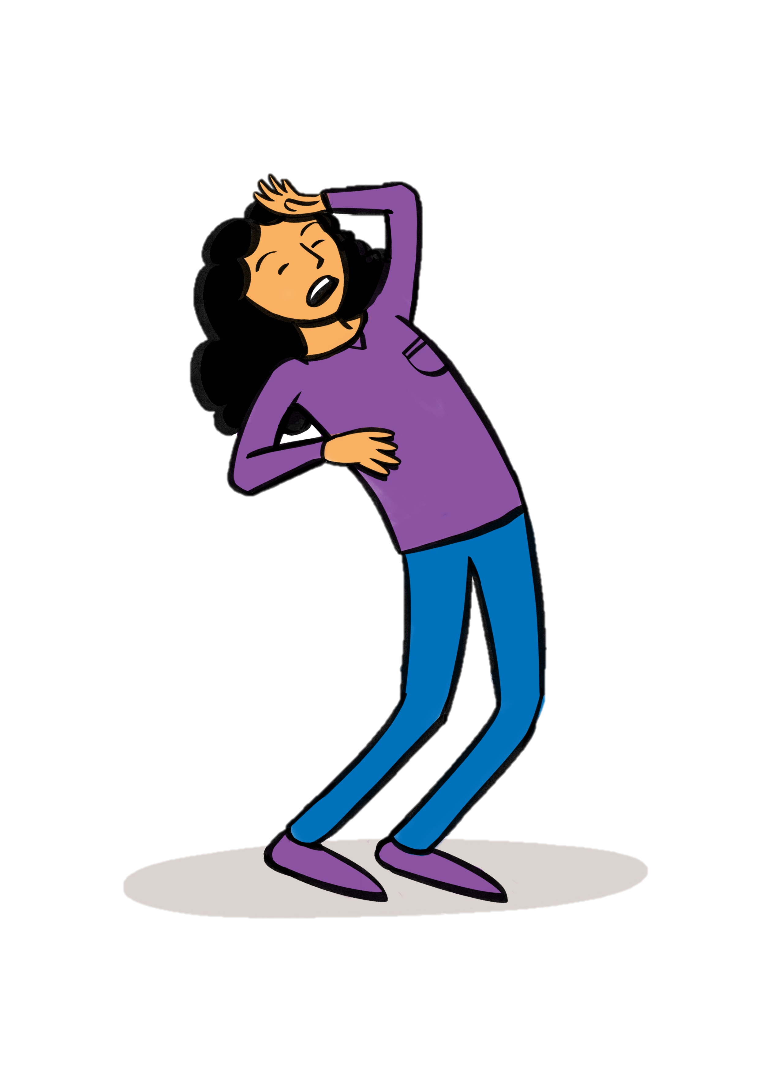
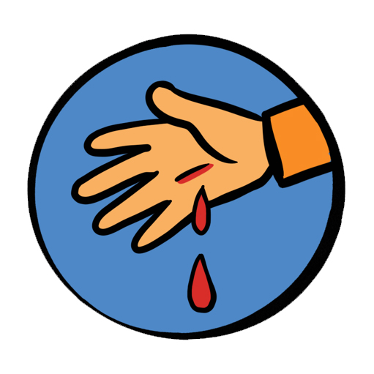
Session 2 Trauma and injury
Shock
Bleeding
Fractures and sprains
Ticks
Head injury
Dental incidents
Burns
Notes:
Timing: 3 minute
Introduce the trauma and injury session and inform the participants of the syllabus areas you will cover in the first session. Trainers should explain how the session will work in terms practicing and demonstrating practical first aid knowledge. Preparing the participants with any support or items they may need to aid them with this virtually should be communicated through the pre course information.
Activity – use the emoticons to confirm participants can hear the trainer(for example "Using the emoticons or reactions, please let me know if you are ready to start?"
Ask the question "What are you hoping to take away from today in addition to completing this module?" - this could be done in CHAT or verbally, depending on the system. Use the responses to pull the key elements out from the objectives without reading them out
Unless otherwise stated (as identified by * or **) items can be delivered in a theoretical way, using trainer delivered or video content.
Items identified with * can be delivered in either theory or practical methods, recognising that a variety of factors may make this not possible, where possible practical activities would be encouraged.
Items identified with ** must be demonstrated practically by the participants (although those who are not able to do this may instruct others in doing the skill), and with a combination of trainer delivered, video and practical teaching methods to aid with learning.
This session covers the following topics:
Shock
Bleeding*
Fractures and sprains *
Head injury
Dental incidents
Burns
Objectives:
Recognise the signs, and symptoms and understand what action needs to be taken when presented with:
Shock
Bleeding
Fractures and sprains
Head injuries
Dental incidents
Burns
Outcomes:
Know where to seek advice and recognise what action needs to be taken when presented with one of the following traumas or injuries.
Shock
Bleeding *
Fractures and sprains *
Head injury
Dental incidents
Burns
With a focus on the Trauma and Injury syllabus areas. Ask the participants what first aid scenarios they would currently feel confident dealing with.
It is important to acknowledge that some may be attending first aid training for the first time, and others may be refreshing their knowledge and understanding.
For those who have attended first aid training before - Ask how the training they had been on before prepared them for an accident or incident.
For those new to first aid - ask then what they are hoping to achieve training.

Slide 7
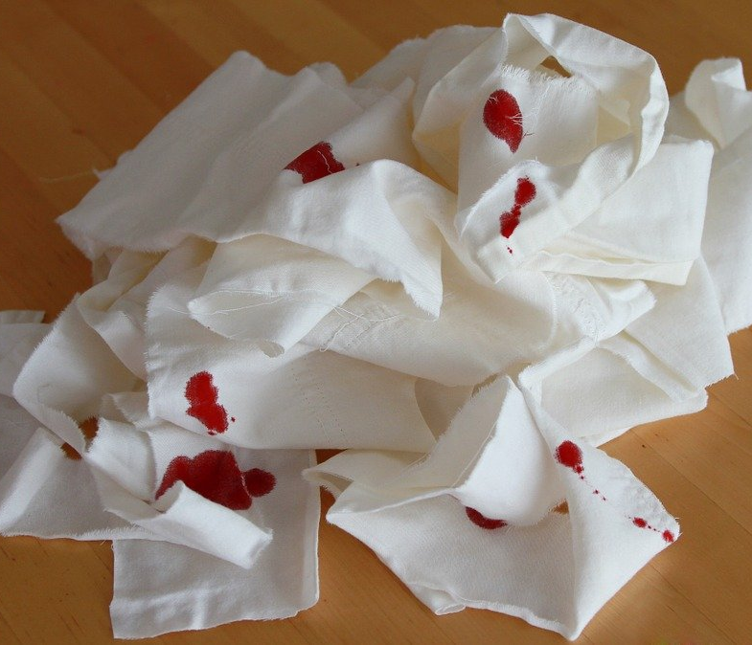
Notes:
Timings: 5 minutes
With a focus on the Trauma and Injury syllabus areas. Ask the participants what 1st Aid scenarios they would currently feel confident dealing with.
It is important to acknowledge that some may be attending first aid training for the first time, and others may be refreshing their knowledge and understanding.
For those who have attended first aid training before - Ask how the training they had been on before prepared them for an accident or incident.
For those new to first aid - ask then what they are hoping to achieve training.
If you are using a platform with a whiteboard feature, this will be a good place to catch this information. If not, general conversation or using the text box will work too. There are areas further in the training that require interaction, so it’s important to get them ready and into the training early.

Slide 8
Where to get help and how to get there
Think risk assessment
Notes:
Trainers notes
Timings: 5 minutes
This may involve sending someone to telephone for the emergency services or letting a parent/carer know that a minor incident (eg grazed knee) has taken place.
In a serious emergency, it is important to get help as quickly as possible. Either phone yourself or ask someone you trust to call 999 or 112. The call handler will ask you a set of questions to ensure you get the help you need. It is important to be able to give an accurate location.
You may need to know the postcode, know local landmarks or use the What3words app.
In less urgent situations (including for conditions e.g ticks, insect bites, headache, that were previously covered in 1st Response course) there are other places you can look for help:
NHS 111 service – by phone. They will ask questions to ensure you are directed to the correct help. They can call a 999 ambulance, or help book an out of hours GP appointment or direct you to an urgent dentist.
NHS 111 website
Local minor injury unit
Pharmacy
Resources on GG Learning Platform
An up to date first aid manual (recommended Dorling Kindersley - authorised manual of St John Ambulance, St Andrew’s First Aid and the British Red Cross)
Consider whether in a less urgent situation an alternative method of transport could be used instead of an emergency ambulance. This may include calling parents/carers to take patient in their car

Slide 9
Shock
Shock is a life-threatening condition when the circulatory system fails and the vital organs fail to get an adequate supply of oxygen.
Notes:
Trainers notes:
Timings: 4minutes
What is shock?
Shock is a life-threatening condition when the circulatory system fails and the vital organs fail to get an adequate supply of oxygen.
Ask participants what they think causes shock? Ask them to feedback either verbally or in the chat.
If you are using a whiteboard feature, you could use that during this exercise.
The answers are on the next slide.

Slide 10
Causes of shock
Severe blood loss is most common cause.
Loss of other fluids – diarrhoea and vomiting, burns.
Heart attack or heart failure
Septic shock – overwhelming infection
Anaphylaxis
Spinal Cord Injury – neurogenic shock
Notes:
Trainers notes
Timings: 3 minutes
After participants have shared ideas, cover all the signs and symptoms, causes and treatment of shock.
If you are using a whiteboard feature, you could use that during this exercise.
Causes of shock
Severe blood loss is most common cause
Loss of other fluids – diarrhoea and vomiting, burns
Heart attack or heart failure
Septic shock – overwhelming infection
Anaphylaxis
Spinal Cord Injury – neurogenic shock

Slide 11
Symptoms of shock
Pale, cold, clammy skin
Weak, dizzy, light headed
Nausea or vomiting
Thirsty
Yawning
Rapid, weak pulse
Anxiety or irrational behaviour
Rapid, shallow breathing
Dropping levels of responsiveness
Cardiac arrest
Notes:
Timings: 5 minutes
St Johns Ambulance shock video - https://www.youtube.com/watch?v=61urGQrmeNM
*Please make sure you have sent this link to the participants beforehand. Post in the chat for ease of access*
Signs and symptoms of shock
Pale, cold, clammy skin
Weak, dizzy, light-headed
Nausea or vomiting
Thirsty
Yawning
Rapid, weak pulse
Anxiety or irrational behaviour
Rapid, shallow breathing
Dropping levels of responsiveness
Cardiac arrest

Slide 12
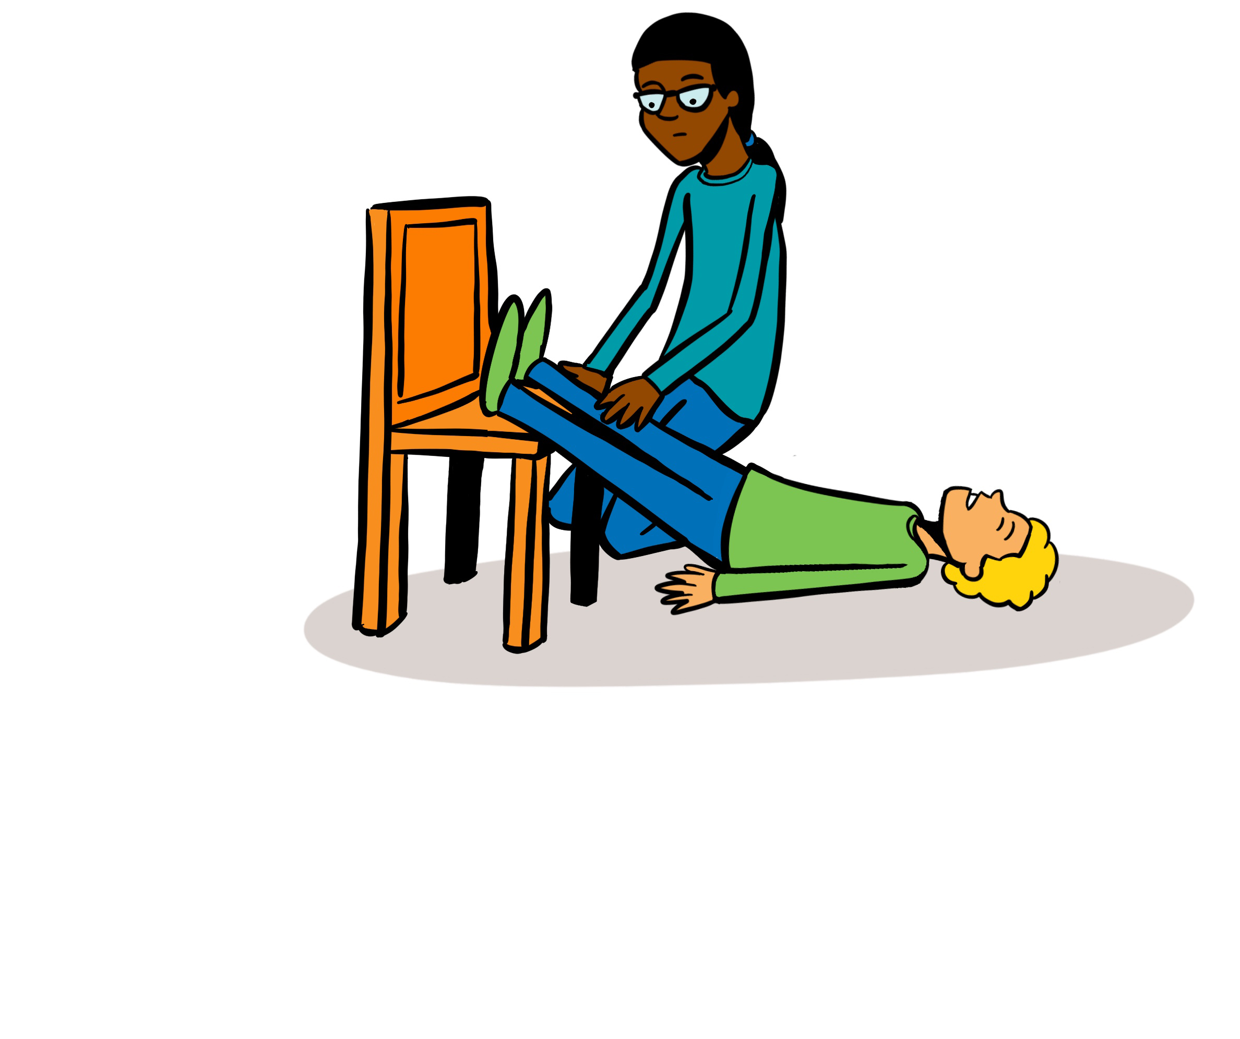
Treatment of shock
Notes:
Timings: 5 minutes
Treatment of shock
Treat any possible cause of shock e.g. severe bleeding, anaphylaxis.
Lie casualty down on rug or blanket if possible as this will help keep them warm.
Elevate the casualty’s legs to help improve blood supply to major organs.
Keep the casualty warm with blankets etc.
Do not allow casualty to eat or drink in case an anaesthetic is needed. If thirsty, they may moisten their lips with water.
Call 999/112 and tell the call handler that the patient is suffering from shock

Slide 13
Severe bleeding treatment
Apply direct pressure
Remember PPE
Notes:
Timings – 5 minutes
Trainers Notes:
Severe bleeding – treatment
Apply direct pressure over the wound with your fingers using a sterile dressing or clean non-fluffy pad.
If there is an object in the wound, apply pressure on either side of the object.
Apply a dressing and hold it in place with a bandage. Apply one additional dressing on top of the first if the blood comes through.
If it continues to come through remove all dressings and apply new ones.
Check that bandages on the limbs are not too tight by feeling the area below the bandage (the extremities). If this area is cold or blue, loosen the bandage slightly.
Call for help – 999/112.
* Remember PPE *

Slide 14
Bleeding – nose
Apply pressure to the lower part of the nose
Notes:
Trainers notes:
Timings – 5 minutes
This topic can be delivered in either theory or practical methods, recognising that a variety of factors may make this not possible, where possible practical activities would be encouraged and demonstrated to a trainer
Nosebleeds
Nosebleeds are fairly common and may be caused by a blow to the nose, picking, sneezing or blowing it. Nosebleeds can lead to considerable loss of blood which, if swallowed, may cause vomiting.
What to do:
Apply firm pressure just below the firm part of the nose (you may have to do this for a younger casualty).
Get them to sit down and lean forward. If possible, protect their clothing with a cloth or
bowl.
Try to make sure they do not breathe through their nose, speak, swallow, cough, spit or sniff.
Apply the pressure to their nose for ten minutes. If the bleeding still has not stopped, continue this for a further ten minutes.
When the bleeding has stopped, advise them to rest, to avoid exertion and not to pick or blow their nose for a few hours.
If the nosebleed persists for longer than 30 minutes, take them to hospital.
Avoid hot drinks for 24 hours once the bleeding has stopped

Slide 15
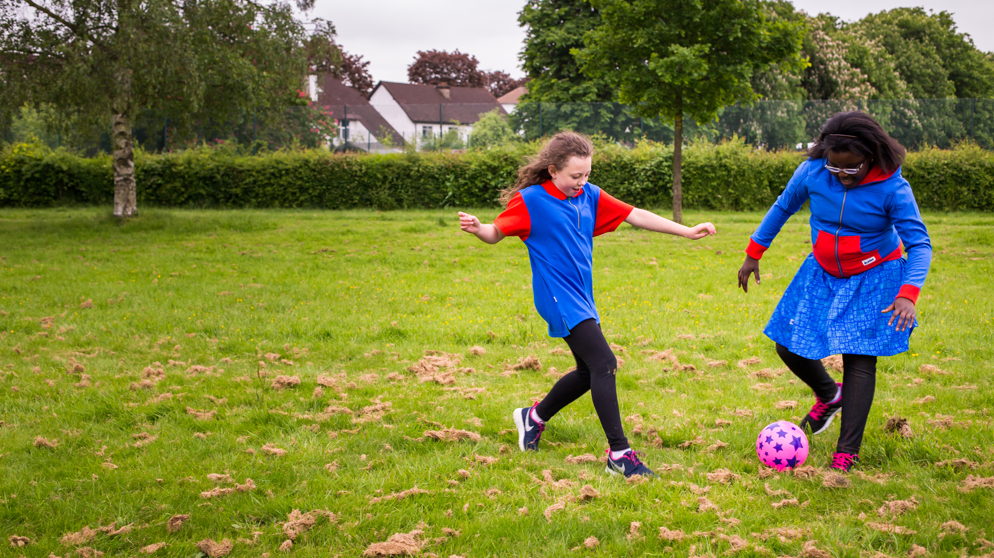
Notes:
Timings: 7 minutes
Bleeding
Scenario – Read the scenario to the participants and also put it in the chat – ask participants to discuss what they would do either in small break out rooms and feed back or as a group together. This can be verbal or through the chat
A Guide playing football gets tackled by the opponent illegally and causes a significant laceration to their knee. The child is bleeding profusely from the wound.

Slide 16
Internal bleeding
Notes:
Trainers notes
Timings 3 minutes
Internal Bleeding
Internal bleeding can be difficult to identify. A casualty who is bleeding internally may have either a history of injury or a medical condition. You may be able to identify internal bleeding by:
external signs of injury, such as bruising
signs of bleeding from an orifice (eg ears, mouth, nose)
recognising symptoms of shock, which may be the only sign of internal bleeding.
What to do:
Place the casualty in the most comfortable position – the recovery position if they are unconscious– and treat for shock.
Get the casualty to hospital as soon as possible. Do not waste time trying to identify the cause or attempting to treat it.

Slide 17
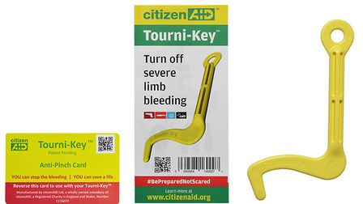
Tourniquets
Notes:
Trainers notes
Timings: 5 minutes
There are some rare but potential situations in which the area around an incident has been sealed off for safety, and medical and rescue services are unable to enter. An example of this would be the Manchester Arena bombing or some natural disasters. In these situations first aiders may need to control life threatening bleeding until help arrives by using a tourniquet.
Citizen Aid have both an app and a tourniquet kit giving excellent advice on what to do in these situations. If you feel in your risk assessment that you may potentially be in a situation like this – then you could prepare yourself beforehand by looking through this advice.

Slide 18
Burns
“Cool the burns but warm the patient”
20 minutes of cooling with cool water
Notes:
Trainers Notes:
Timings – 2 minutes
Useful link: https://www.britishburnassociation.org/wp-content/uploads/2017/06/BBA-First-Aid-Guideline-24.7.18.pdf
Burns can be caused by dry heat, friction, radiation (including sunrays), hot liquids, steam and chemicals.
What to do:
Immediately cool the skin with cold water for at least 20 minutes or until the pain stops.
Once cooled, lay cling film ideally or if not, a clean dry dressing.
If possible, immediately remove jewellery, watches or other restrictions as the area can swell very quickly.
Be prepared for shock to develop and lay the casualty down if you can.
Do not burst blisters.
Leave on any clothing which has stuck to the body. If possible gently remove rings, watches or shoes before swelling occurs.
Do not apply anything but water. Special dressings, sprays and gels are not recommended.
Do not apply adhesive dressings.
Chemical burns
Some industrial and domestic chemicals can burn the skin. When going to the aid of someone with chemical burns it is vital to ensure your own safety first. If possible, note the name of the chemical.
What to do:
Wash the affected area for at least 20 minutes, with the flow of water running away from the casualty. Take care not to splash the chemical on to yourself or the casualty.
Chemical burns around the mouth and throat can cause swelling, which can restrict or close the airway, therefore:
loosen clothing around the neck
give a conscious casualty sips (not more) of cold water
be prepared to start CPR but remember to protect your mouth from the chemical by using a resuscitation face shield.
Get urgent medical help.
Sunburn
Although sunburn is a common condition, it can be quite serious. It can be prevented by wearing a sun hat and clothes made of natural fibres that cover the whole body, and by using appropriate sun protection cream.
What to do:
Move the casualty into a shaded area.
Cool the sunburnt area by sponging or showering it with cold water or get the casualty to soak in a cool bath for at least ten minutes.
Seek medical aid if there is extensive blistering or skin damage

Slide 19
Burns
Seek urgent medical attention if:
The patient is a child
The burn is deep
The burn affects face, hands, feet or genitals
All burns that go all the way around a limb
Burns that are greater than the size of the patient’s hand.
Notes:
Trainers notes
Timings – 5 minutes
Burns
Scenario – Read the scenario to the participants and also put it in the chat – ask participants to discuss what they would do either in small break out rooms and feed back or as a group together. This can be verbal or through the chat
A 12 year old shouts from the kitchen area at camp and tells you help is needed. Another Guide/Scout has been burned by hot oil on his/her hand and wrist from the frying pan. The patrol are all screaming and the gas fire is still on.
Seek urgent medical attention if:
The patient is a child
The burn is deep
The burn affects face, hands, feet or genitals
All burns that go all the way around a limb
Superficial burn if larger than 5 palms of the casualty.
Partial/full thickness burns that are larger than 1 palm of patient
Burns caused by tar, oil, fat, chemicals or electricity

Slide 20
Notes:
Timings: 5 minutes
Encourage participants to take a break away from the screen

Slide 21
Notes:
Timings: 10 minutes
ask participants to read the scenarios and discuss what they would do either in small break out rooms and feed back or as a group together. This can be verbal or through the chat. You can either split into 2 and cover both scenarios or choose just one. Trainer 2 to share these in the chat box so everyone can see.
1. Whilst trying judo at an activity day a child, aged nine, is thrown to the mat and suffers an open fracture of both bones in the forearm. There is significant bleeding from the wound. The child begins to complain of feeling light-headed, the skin is pale and feels cool and clammy, and the pulse becomes rapid and weak.
2. A young person has tripped on an uneven path during a sponsored walk and has hurt their forearm. They claim they landed on the sharp edge of a broken stone. When you approach them they look distressed and in pain. They are supporting their arm, which looks deformed and there is a wound that is bleeding. There is no exposed bone. Once a bandage is placed on the wound the bleeding continues to ooze through the bandage.

Slide 22
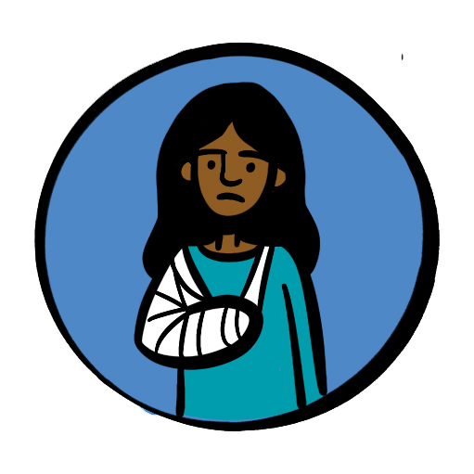
Fractures
Signs and Symptoms:
Pain or difficulty moving the area/limb
Tenderness around the area
Deformity, swelling and bruising around the fracture area (a lump or bump)
Shock
Bone breaking through the skin
Awareness of grating of bones together
Shortening, bending and twisting of limb
Notes:
Trainers Notes:
Timings: 10 minutes (for the next 2 slides)
This topic can be delivered in either theory or practical methods, recognising that a variety of factors may make this not possible, where possible practical activities would be encouraged and demonstrated to a trainer.
Signs and Symptoms:
Pain or difficulty moving the area/limb
Tenderness around the area
Deformity, swelling and bruising around the fracture area (a lump or bump)
Shock
Bone breaking through the skin
Awareness of grating of bones together
Shortening, bending and twisting of limb

Slide 23
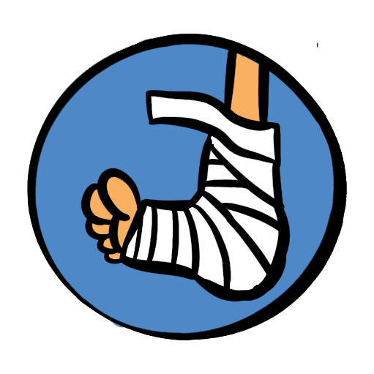
Fractures
It is easy to miss a fracture if the signs are subtle.
Have a low threshold for seeking medical advice and getting an Xray.
Notes:
Trainers notes
Immobilise in the position found with as little movement as possible and apply a sling or splint.
Seek medical help – it is common for fractures to be “missed”
Arrange transport for further assessment, if in severe pain –call 999/112.

Slide 24
Spinal injuries
Notes:
Trainers notes
Timings: 3 minutes
Consider the potential of spinal injury in the following circumstances: Falling from a height e.g. a ladder, falling awkwardly whilst trampolining or doing gymnastics, diving into a shallow pool and hitting the bottom, falling from a horse or motorbike, collapsed rugby scrum, high speed motor accident, a heavy object falling across the back, injury to the face or head.
Do not move the patient. If the patient is unresponsive you may need to open the airway whilst avoiding moving the neck.
If there is potential injury to the neck a responsive patient should be able to protect themselves. If unresponsive then manual stabilisation can be carried out but only if you have been trained to do so.

Slide 25
Sprains
R.I.C.E
Notes:
Trainers Notes:
Timings: 10 minutes
This topic can be delivered in either theory or practical methods, recognising that a variety of factors may make this not possible, where possible practical activities would be encouraged and demonstrated to a trainer.
This is a very common injury – participants may have lots of questions or past experience which they would like to share.
If practicing during the virtual learning, please indicate in advance if participants need to bring anything to the training to support this.
Sprains
A soft tissue injury occurs when a ligament or tendon around a joint has been torn or pulled. This sort of injury can often give similar symptoms to a fracture. If you are in any doubt, treat as a fracture. Remember RICE in caring for a soft tissue injury.
R – Rest the injured part.
I – Apply Ice (not directly to the skin) or a cold compress.
C – Provide Comfortable support – soft padding and a bandage support.
E – Elevate the limb
ice application only applied for maximum of 20 minutes
If an accident occurs when you are away from help, such as on a hike, it may be applicable to use added protection – this may include the tightening of high top boots (hiking boots) etc to prevent further (or worsening of the) injury. This is most applicable in relatively minor sprains/strains
Additional information can be found here: https://cks.nice.org.uk/topics/sprains-strains/management/management/

Slide 26
Ticks and Lyme disease Ticks bites can cause Lyme disease. It is important to know how to avoid ticks know how to check yourself or others what action to take if you have been bitten know the symptoms to look out for.
Notes:
Trainers’ Notes:
Ticks can transmit bacteria that cause diseases such as Lyme disease. Lyme disease can cause serious problems such as nerve damage and arthritis. Not all tick bites can lead to illness, but it is important to know how to avoid tick bites and what to do if somebody gets bitten, as prevention and early detection are crucial.
Ticks are often found in dense vegetation or long grass, and climb onto people as they brush past them. They bite to attach to the skin and start to feed on the blood. Avoid coming into contact with them - walk on paths to avoid brushing vegetation, wear light coloured clothing so that ticks can be easily spotted and brushed off. Repellents such as DEET are also effective.
People don’t always know they’ve been bitten so it is important to check thoroughly. Look over clothes or body for any ticks to brush off. Ticks prefer warm moist places such as groin area, waist, arm pits, behind the knee or along the hairline. You’re looking out for anything as tiny as a freckle or speck of dirt. This will need to be handled sensitively and appropriately in a residential setting.
Symptoms of Lyme disease can include flu-like symptoms, fatigue, muscle and joint pain. Most people develop a characteristic rash called erythema migrans. If these symptoms develop after a period of time outdoors it is important to see your GP. It is easily treated with a course of antibiotics in the early stages.
Public Health Wales have a very good factsheet that can be found on the resources area of Learning Platform.

Slide 27
Head injury
Head injuries are very common but can occasionally become very serious.
For this reason, the casualty’s parent/carer or person they live with must be informed of even an apparently minor bump to the head, since symptoms can be delayed.
Notes:
Trainers Notes:
Timing 10 minutes (for the next 2 slides)
Ask participants what they think are the signs of a head injury needing medical help.
Trainers to support any questions that come in and explain these symptoms and what they might look like.
If you are using a whiteboard feature, you could use that during this exercise.
Head injuries are very common but can become very serious. For this reason, the casualty’s parent/carer or person they live with must be informed of even an apparently minor bump to the head, since symptoms can be delayed. All head injuries must be taken seriously.

Slide 28
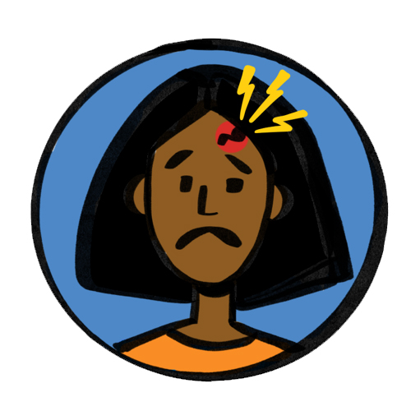
Head injury
Seek medical help if
Persistent headache
Increasing drowsiness
Confusion, loss of balance, loss of memory
Difficulty speaking
Difficulty walking
Vomiting episodes after the injury has occurred
Double vision or strange movement of the eyes
Seizures
Patient is aged over 65
Patient has had previous brain surgery
Patient is on anti-coagulation/anti-clotting medication
Notes:
Trainers notes
What to do:
Seek medical help if:
Signs of worsening injury
Increasing drowsiness
Persistent headache
Confusion, loss of balance, loss of memory
Difficulty speaking
Difficulty walking
Vomiting episodes after the injury has occurred
Double vision or strange movement of the eyes
Seizures
Patient is aged over 65
Patient has had previous brain surgery
Patient is on anti-coagulation/anti-clotting medication
There is no responsible person to keep an eye on the patient
Assess using AVPU:
A: patient is alert – eyes open and responds to questions
V: patient responds to verbal commands and questions
P: responds to pain eg pinching of earlobe - painful stimulus should be pressure based
U: unresponsive to any stimulus

Slide 29
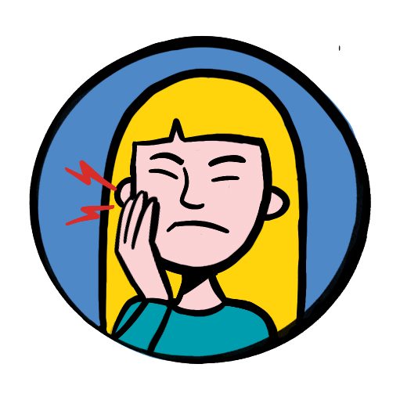
Dental
Emergency first aid
How to get help
Notes:
Trainers notes
Timings: 7 minutes
Emergency 1st Aid will be required if:
An adult tooth is knocked out
What to do?
Only touch the tooth at the crown. Avoid touching the roots as this may damage cells. Can re-implant immediately or wrap in cling film or put in cow’s milk, oral rehydration salts or saliva, or saliva soaked gauze. Tap water and saline are not recommended.

Slide 30
Q + A
Notes:
Allow time for any questions on the topics covered
Timings – 5 minutes

Slide 31
Summary and reflection
Notes:
Summary / Reflection
Timings 3 minutes
Ask participants if they think we met the session outcomes and for them to feedback what in particular they have learnt today or will take away from this section of the course.
Trainers notes:
Were these learning outcomes met?
Know where to seek advice and recognise what action needs to be taken when presented with one of the following traumas or injuries.
Shock
Bleeding *
Fractures and sprains *
Head injury
Dental incidents
Burns
Unless otherwise stated (as identified by * or **) items can be delivered in a theoretical way, using trainer delivered or video content.
Items identified with * can be delivered in either theory or practical methods, recognising that a variety of factors may make this not possible, where possbile practical activities would be encouraged.

