Slide 1
1st Response
Todays trainer: [insert name here]
Notes:
The accompanying training plan contains the key learning points and activities for each slide. In these PowerPoint trainer notes you will find background context and/or suggested delivery ideas to help you as a trainer as appropriate.
Trainers Notes:
Outline the structure of the session - You may be delivering this as a standalone module (2hours) or as part of a full day of training (6 hours).
If delivering as virtual training all notes and trainers’ instructions can be found on the webinar PowerPoint

Slide 2
Aim
This course aims to cover the knowledge and skills necessary to enable members of Girlguiding and The Scouts to provide basic first aid and ensure safe management of a first aid incident.
Notes:
Trainers Notes:
The above aims, objectives and learning outcomes are for the full course. Each session will have it’s own aims, objectives and outcomes.

Slide 3
Objectives
By the end of the training participants will have had the opportunity to be:
provided with simple first aid information which is relevant to their role.
helped to build confidence and skills in coping with emergency and first aid situations.
equipped with the knowledge needed to manage these emergencies.
Notes:
Trainers Notes:
The above aims, objectives and learning outcomes are for the full course. Each session will have it’s own aims, objectives and outcomes.

Slide 4
Learning Outcomes
Participants will have the skills and knowledge to enable them to keep Girlguiding / Scouting members as safe as possible while they are in our care.

Slide 5
How confident are you feeling about being a first aider?
1 2 3 4 5
Notes:
Acknowledge where people are at the moment and explain the importance of the training.​
You can use the scale for a few questions – such knowledge confidence or skill confidence.
With a focus on the Life Support syllabus areas. Ask the participants what first aid scenarios they would currently feel confident dealing with.
It is important to acknowledge that some may be attending first aid training for the first time, and others may be refreshing their knowledge and understanding.
For those who have attended first aid training before - Ask how the training they had been on before prepared them for an accident or incident.
For those new to first aid - ask then what they are hoping to achieve training.

Slide 6
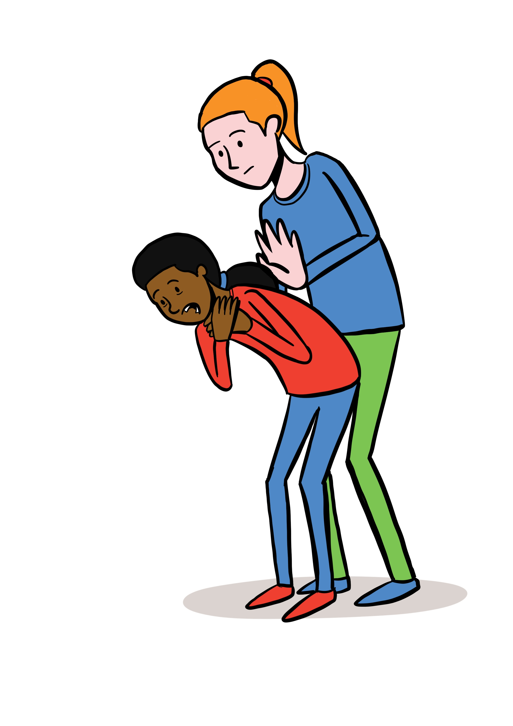
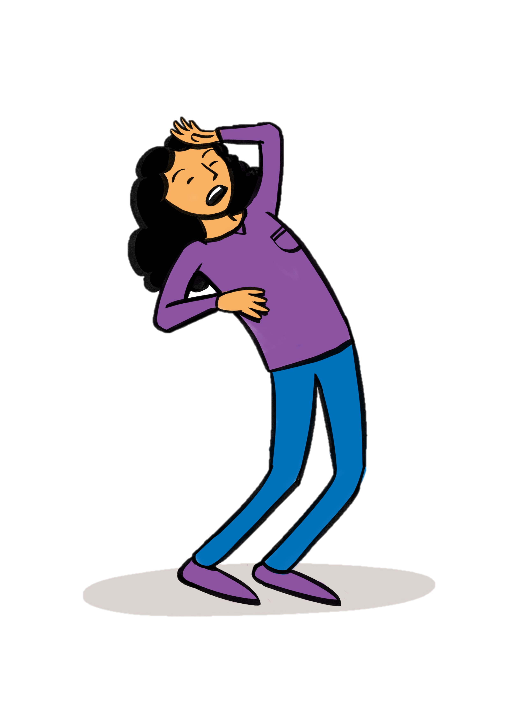
Session 1 Life Support
Safe Approach
Primary Survey and ABC assessment
Adult CPR
Child CPR
AED
Choking
Unresponsiveness
Recovery position
Notes:
Trainers notes:
Introduce the life support session and inform the participants of the syllabus areas you will cover in the first session. Ask participants what they think they will be covering in the life support section and add anything missed.
Unless otherwise stated (as identified by * or **) items can be delivered in a theoretical way, using trainer delivered or video content.
Items identified with * can be delivered in either theory or practical methods, recognising that a variety of factors may make this not possible, where possible practical activities would be encouraged.
Items identified with ** must be demonstrated practically by the participants (although those who are not able to do this may instruct others in doing the skill), and with a combination of trainer delivered, video and practical teaching methods to aid with learning.
Life Support Key Topics:
Safe Approach **
Primary Survey and ABC assessment
Adult CPR**
Child CPR **
AED **
Choking *
Unresponsiveness
Recovery position *
Objectives
Introduce the participants to the theory and practical sides of the life support topics of first aid and discuss when each area may be needed.
Allow participants to practice and demonstrate their knowledge of life support.
Allow participants to practice and demonstrate their skills in performing (or instructing) elements of life support. .
Outcomes
Know and demonstrate :
Use of AED (automated external defibrillator) **
Choking *
Causes and level of unresponsiveness
Recovery / safe airway position *
Know and demonstrate (or instruct a trainer) your skill in performing :
Approach to and assessment of a scene/incident **
CPR for an adult **
CPR for a child **

Slide 7
Safe approach
Infection control
Call for help
Electricity
Traffic
Stay calm
"shake and shout"
Reassure others
Initial assessment
Notes:
This must be demonstrated practically by the participants (although those who are not able to do this may instruct others in doing the skill), and with a combination of trainer delivered, video and practical teaching methods to aid with learning.
Trainers Notes:
1. Arrival at an incident
Assess the situation quickly and calmly:
Safety: Are you or they in any danger? Is it safe for you to go up to them?
Scene: What caused the accident or situation? How many casualties are there?
Situation: What are the environmental factors involved? Ages of casualties? Are the injuries life threatening?
2. Protect yourself and them from any further danger:
Always protect yourself first - never put yourself at risk
Only move them to safety if leaving them would cause them more harm
If you can’t make an area safe, call 999 for emergency help
3. Prevent infection between you and them:
Wash your hands or use alcohol gel
Wear disposable gloves or use the casualty’s hand to hold a wound if necessary
Don currently appropriate PPE – gloves, apron, mask and goggles or visor.
4. Comfort and reassure:
Stay calm and take charge of the situation
Introduce yourself to them to help gain their trust
Explain what’s happening and why using appropriate language to the age of the person.
Say what you’re going to do before you do it - Ask them if this is ok and wait for a response if they’re able to.
5. Arrange for the right kind of care:
Call 999 for an ambulance if you think it’s serious
Take or send them to hospital if it’s a serious condition but is unlikely to get worse
Suggest they see their doctor if they’re concerned about a less serious condition
Advise them to go home to rest, but to seek help if they feel worse as long as someone else will be at home with them. If this is a head injury, concerns for a concussion especially if they live alone, advise that they will need to find someone to stay with them
Stay with them until you can leave them in the right care
Inform parents/carers of what has happened
6. Record keeping:
Complete reports to include:
Details of the incident
Location
Date and time of incident
Who was involved
What was done
Who was notified

Slide 8
D R A B C
S T A R T
A N G E
R
E S P O N S
E
I R W A Y
R E A T H I N G
P
R

Slide 9
Is their airway open and clear?
Are they breathing normally? Look, listen and feel to check they’re breathing- do this for no more than 10 seconds
Primary survey and initial assessment
Are there any signs of severe bleeding?
Notes:
This must be demonstrated practically by the participants (although those who are not able to do this may instruct others in doing the skill), and with a combination of trainer delivered, video and practical teaching methods to aid with learning.
Link to St Johns ambulance Primary Survey video - https://www.youtube.com/watch?v=ea1RJUOiNfQ&feature=youtu.be use this video if you have internet connection to support practical.
Trainers Notes:
Danger:
If someone needs help, before you go up to them check – is it safe?
Look and listen for danger to you or to them. If there is danger, make it safe first.
Do not move the casualty unless they are in danger.
Response:
Ask a direct question and wait for a response: ‘Are you alright?’ or: ‘Open your eyes for me please!’
If they don’t respond, gently shake their shoulders, or with a child (aged 1-puberty) - tap their shoulder.
If they still don’t respond, then presume they’re unresponsive and move on to assessing airways. Someone who is unresponsive should always take priority so you should treat them first and as quickly as possible.
Airways:
CHECK is their airway open and clear?
If their airway is open and clear, move on to assess breathing. If airway appears blocked assess for the following - are they responsive or unresponsive?
Unresponsive casualty: If they’re unresponsive, tilt their head and lift their chin to open their airway.
*Current advice within Covid-19 pandemic is to place a towel or item of clothing or facemask/covering over patient’s nose and mouth to prevent droplet spread whilst assessing*
Only move to Breathing – once their airway is open and clear.
Breathing:
Are they breathing normally? Look, listen and feel to check their breathing- do this for no more than 10 seconds
*Current advice during Covid-19 pandemic is to assess breathing at arm’s length rather than putting rescuer’s face close to patient’s face.*
If they are breathing normally, place them in the recovery position
If breathing is not normal, immediately start CPR.
If they’re unresponsive and not breathing – this is a cardiac arrest. call 999/112 for an ambulance, or get someone else to call if possible, and start CPR.
A short period of seizure like movements can occur at the start of a cardiac arrest. Assess the casualty after the seizure has stopped. If unresponsive with abnormal breathing – start CPR
NB ‘Agonal breathing’ can sound like gasping, snorting, gurgling, moaning or laboured breathing, and happens after a cardiac arrest. It is NOT ‘normal’ breathing; andimmediately following cardiac arrest, blood flow to the brain is reduced to virtually zero. This may cause a seizure-like episode that can be confused with epilepsy. In the event agonal gasps occur start CPR.
Circulation:
CHECK Are there any signs of severe bleeding?
If they’re bleeding severely, control the bleeding with your gloved fingers, dressing or clothing, call 999/112 for an ambulance and treat them to reduce the risk of them going into shock.
If they aren’t bleeding and are conscious, and you have dealt with any life-threatening conditions, then you can move on to the Secondary Survey, to check for any other injuries or illnesses.

Slide 10
CPR- Adult
Notes:
This must be demonstrated practically by the participants (although those who are not able to do this may instruct others in doing the skill), and with a combination of trainer delivered, video and practical teaching methods to aid with learning.
https://www.youtube.com/watch?v=7S6v3VK5Uao
CPR Man video - use this video if you have internet connection to support practical.
Trainers Notes:
Basic life support for child post puberty or adult
Call 999 or 112 for an ambulance or get someone else to do it.
Perform CPR - cardiopulmonary resuscitation. This involves giving someone chest compressions and rescue breaths to keep their heart and circulation going.
If they start breathing normally again, stop CPR and put them in the recovery position.
How to give chest compressions:
Kneel down beside the casualty on the floor level with their chest.
Place the heel of one hand towards the end of their breastbone, in the centre of their chest.
Place the heel of your other hand on top of the first hand and interlock your fingers, making sure you keep the fingers off the ribs.
Lean over the casualty, with your arms straight, pressing down vertically on the breastbone, and press the chest down by 5-6cm.
Release the pressure without removing your hands from their chest. Allow the chest to come back up fully – this is one compression.
Repeat 30 times, at a rate of about twice a second (100-120/min)
If there is more than 1 rescuer, alternate the rescuer giving chest compressions every 1-2 minutes to prevent fatigue.
Make no more than 2 attempts to achieve rescue breaths before continuing chest compressions
*Current advice: Use 1 manikin per person and change lungs, if you feel able to do rescue breaths – consider using a faceshield or pocket mask if you know how to, or just stick with compression only CPR. This has been shown to be almost as effective as full CPR in the early stages of cardiac arrest. Use appropriate PPE.

Slide 11
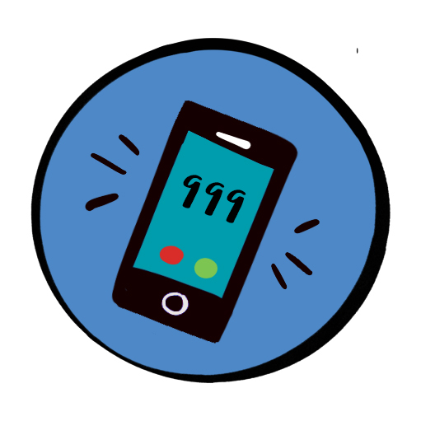
Notes:
Trainers notes
Send someone to call for help and to bring back an AED. If you are alone, call for help yourself and put your phone on speaker phone so the call handler can assist you

Slide 12
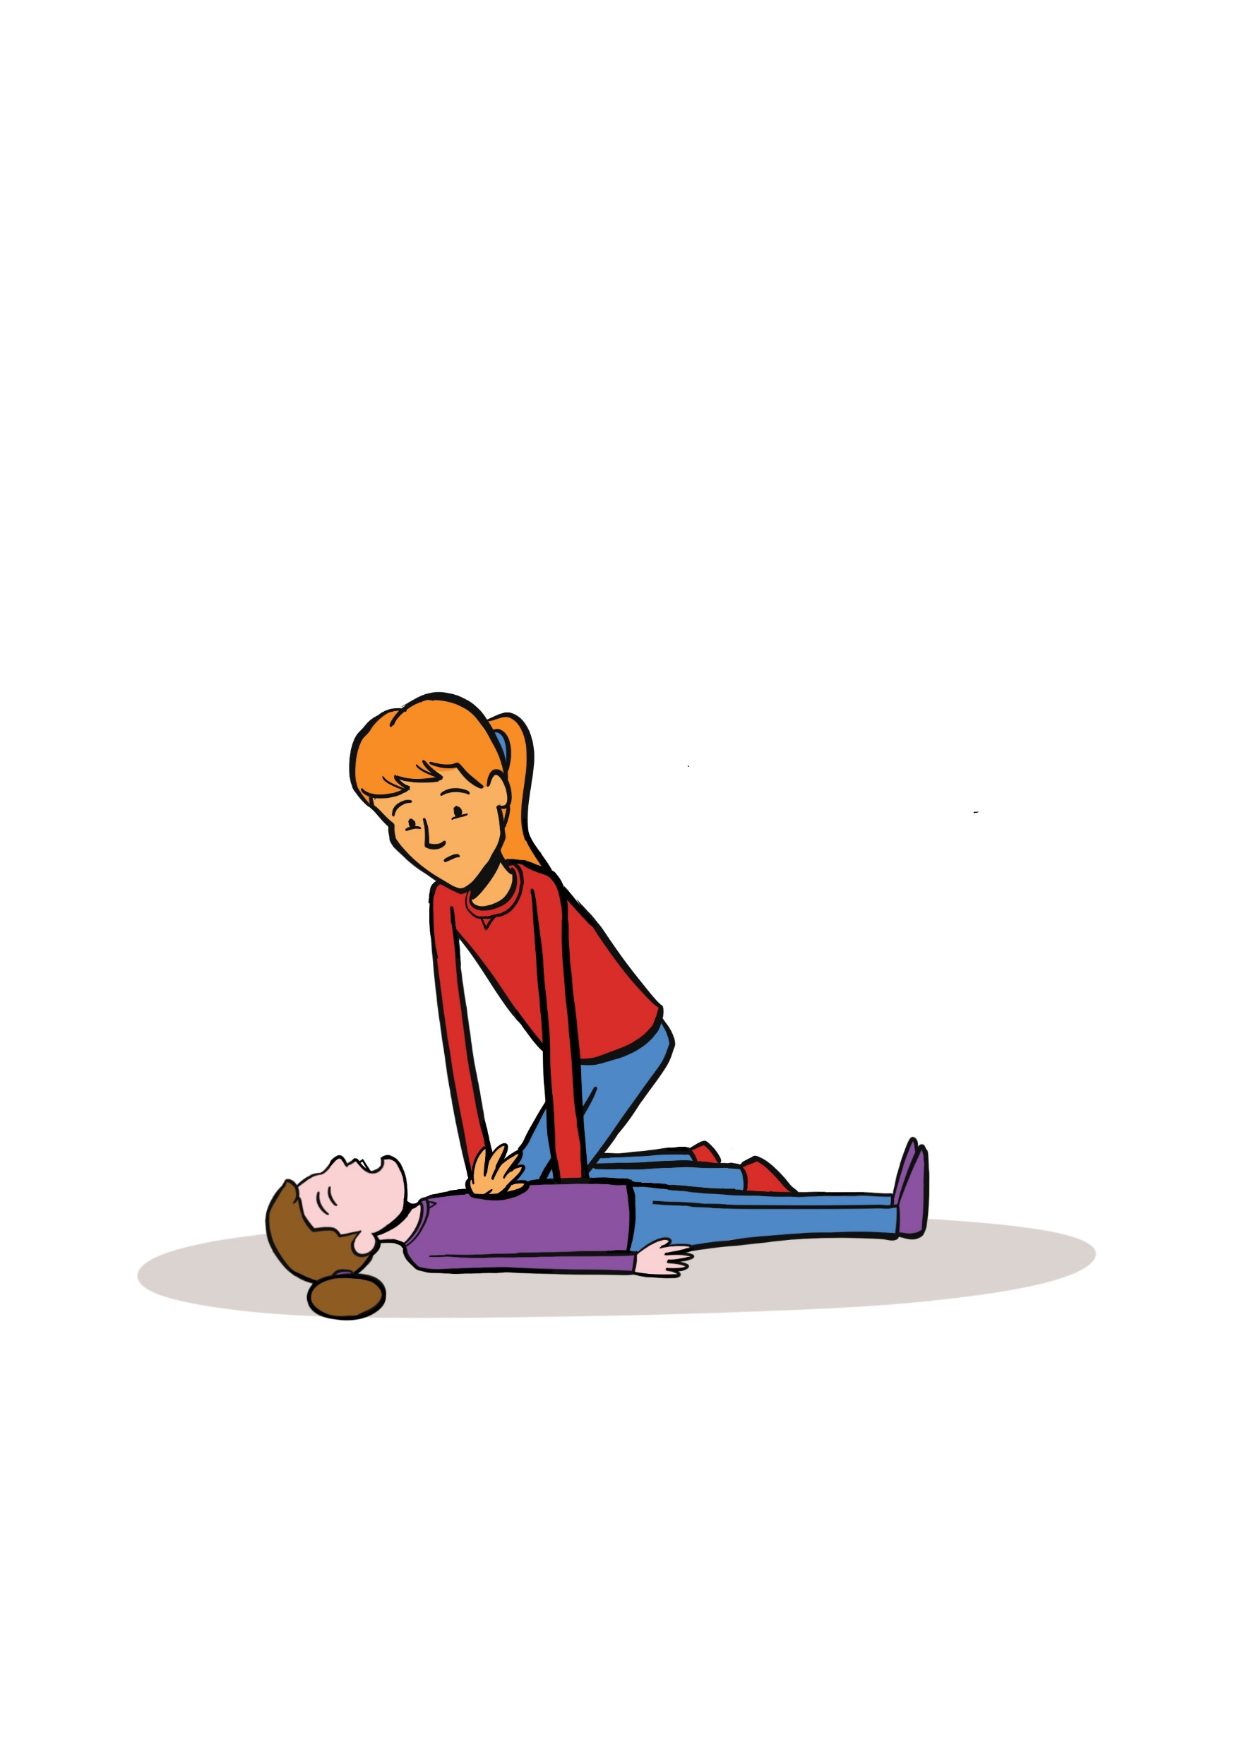
Airway
Head tilt – chin lift
Remember to open airway when assessing breathing and giving rescue breaths.
Notes:
Emphasis on the key areas

Slide 13
Rescue breaths
Give if you are
able or willing
Notes:
Emphasis on the key areas
Make no more than 2 attempts to achieve rescue breaths before continuing chest compressions
Avoid during Covid-19 pandemic

Slide 14
Chest compressions
30:2 Chest compressions to rescue breaths
1/3 depth of chest
Rate of 100-120/min
Chest compression only CPR may be as effective as CPR with rescue breaths
Notes:
Emphasis on the key areas
If there is more than 1 rescuer, alternate the rescuer giving chest compressions every 1-2 minutes to prevent fatigue

Slide 15
CPR - children
More likely to be a respiratory cause
Give 5 rescue breaths
30:2 compressions to rescue breaths
Notes:
This must be demonstrated practically by the participants (although those who are not able to do this may instruct others in doing the skill), and with a combination of trainer delivered, video and practical teaching methods to aid with learning.
Link to St Johns ambulance Child CPR video https://www.youtube.com/watch?v=0aV9NS0ogiM - use this video if you have internet connection to support practical.
Trainers Notes:
Basic life support for child.
A child is between 1 and 18 years of age.
Note: we are teaching the sequence for lay rescuers- the adult sequence with paediatric modifications. (Healthcare professionals may have been trained to perform a different sequence.)
Check for response by gently stimulating child and asking –“are you alright?”
If unresponsive – shout for help.
Turn child onto back and open airway using a head tilt and chin lift.
Look, listen and feel for breathing for up to 10 seconds.
Simultaneously look for signs of life – movement, coughing.
Give 5 rescue breaths.
If there are no signs of life – start chest compressions.
Rate 100-120 per minute
Depth of 1/3 of chest - approx. 5cm for a child.
Ratio of 30 chest compressions to 2 rescue breaths.
If you have to leave to get help -perform 1 minute of CPR before going for help.

Slide 16
Use of AED
Notes:
This must be demonstrated practically by the participants (although those who are not able to do this may instruct others in doing the skill), and with a combination of trainer delivered, video and practical teaching methods to aid with learning.
Link to St Johns ambulance AED video https://www.youtube.com/watch?v=UFvL7wTFzl0 - use this video if you have internet connection to support practical.

Slide 17
Really easy to use without training
Listen to the verbal prompts
Use at any point after confirming cardiac arrest
These really do save lives!
AED
Notes:
Trainers Notes:
The most common cause of cardiac arrest is an abnormal rhythm of the heart, known as ventricular fibrillation.
A machine called an AED can be used on adults and children over 1 year to correct the heart rhythm by giving it an electric shock.
AEDs can be used safely and effectively with no prior training.
When the AED is brought continue CPR whilst pads are applied, if possible.
Clothing, including bras will need to be removed or cut away. If the chest is hairy it may be necessary to shave it. If the patient is sweaty, dry the chest.
The AED will give you a series of visual and verbal prompts as soon as it is switched on.
Make sure that no-one is touching the patient because this will interfere with the AED readings and there is a risk of electric shock.
Use adult pads for adults and children aged 8 years and upwards. Use paediatric pads for children aged 1-8 years. Pads can be placed in the same position as an adult for larger children. For smaller children place on pad on the back and one on the chest. Do not use for children under 1.
Cover nipple piercings with a plaster and remove medication patches before using an AED.

Slide 18
Choking
Notes:
This can be delivered in either theory or practical methods, recognising that a variety of factors may make this not possible, where possible practical activities would be encouraged.
Introduce choking scenario
Link to choking video from St Johns Ambulance https://www.youtube.com/watch?v=PA9hpOnvtCk&t=4s

Slide 19
Choking
Encourage coughing
5 back blows
5 abdominal thrusts
Call for emergency help
Repeat back blows and abdominal thrusts.
Notes:
Trainers Notes:
If you think someone is choking, ask them: ‘Are you choking?’ to check they’re not suffering from something else. Can they speak, cry, cough or breathe? If they can, they should be able to clear their throat on their own by coughing, so encourage them to cough.
If they can’t cough or make any noise, take the following action:
Cough it out
Encourage them to cough a couple of times. If this doesn't clear the obstruction, support their upper body with one hand and help them lean forward.
Slap it out
If coughing doesn’t work, help the casualty bend forward.
Use the heel of your hand to give up to five sharp back blows between their shoulder blades.
Check their mouth to see if there’s anything in there and, if there is, get them to pick it out.
Squeeze it out
If back blows don’t work, give up to five abdominal thrusts.
To do this:
Stand behind them.
Link your hands between their tummy button and the bottom of their chest, with your lower hand clenched in a fist.
Pull sharply inwards and upwards.
Repeat up to five times.
Call for help
If they’re still choking, call 999 or 112 for medical help.
Once you’ve called, continue steps 2 and 3 – back blows and abdominal thrusts – until what’s in there has cleared, help arrives or they become unresponsive.
If they become unresponsive at any stage, open their airway and check their breathing.
If they’re not breathing, start chest compressions and rescue breaths (CPR). If the patient becomes unresponsive the throat muscles may relax and the airway open enough to allow rescue breaths.
However the Resuscitation Council does also advise “it may be difficult to carry out abdominal thrusts in a choking individual who is very obese, and abdominal thrusts should not be performed on a pregnant person. If you are enable to encircle the person’s abdomen, you should stand behind the individual, as for abdominal thrusts, but position your hands somewhat higher, over the lower end of the sternum (breastbone). Pull hard into the chest with quick thrusts.”

Slide 20
What are the causes of unresponsiveness?
Notes:
Trainers Notes
Use this slide to gather thoughts from participants

Slide 21
Causes of Unresponsiveness
Fainting
Shock
Head Injury
Seizures
Stroke
Diabetes
Asphyxia
Drowning
Chocking
Asthma
Notes:
Trainers Notes
Causes of unresponsiveness
Fainting
Shock
Head Injury
Seizures
Stroke
Diabetes
Asphyxia
Drowning
Chocking
Asthma

Slide 22
Recovery position
Safe Airway position
Continue to assess
Keep warm
Notes:
This can be delivered in either theory or practical methods, recognising that a variety of factors may make this not possible, where possible practical activities would be encouraged.
After performing a primary survey – adults and children with a reduced level of responsiveness who do not meet the criteria for starting CPR should be put in the recovery position. Casualties should be closely monitored and should be returned to lying on their backs if they deteriorate.
Ask Participants if any of them know the stages of the recovery position. Try and get as many participants as possible feeding into this.
https://www.youtube.com/watch?v=GmqXqwSV3bo#action=share – St Johns Ambulance recovery position video – use this video if you have internet connection to support practical.
Trainers Notes:
This will keep their airway open.
Kneel down next to them on the floor. The next steps are for if you find the casualty lying on their back. If you find them lying on their side or their front you may not need all these steps. However please move them as safely as possible into the recovery position using relevant steps below.
Check casualty’s pockets for any objects on the side they will be laying on – remove sharp objects.
Place their arm nearest you at a right angle to their body, with their palm facing upwards.
Bring their other arm and place it across their chest so the back of their hand is against their cheek nearest you, and hold it there.
With your other hand, lift their far knee and pull it up until their foot is flat on the floor.
Carefully pull on their bent knee and roll them towards you.
Once you’ve done this, the top arm should be supporting the head and the bent leg should be on the floor to stop them from rolling over too far. Ensure hip and knee are at right angles.
Cover casualty with a blanket if possible.
Once you’ve put them safely into the recovery position, call 999 or 112 for medical help. Until help arrives, keep checking the casualty's breathing.
If they stop breathing at any point, call 999 or 112 straight away and give them CPR.
If you think the casualty could have a spinal injury, keep their neck as still as possible. Instead of tilting their neck, use the jaw thrust technique: place your hands on either side of their face and with your fingertips gently lift the jaw to open the airway, avoiding any movement of their neck.

Slide 23
Q + A
Notes:
Allow time for any questions on the topics covered

Slide 24
Next steps
Notes:
Trainer to add detail of practical training if not in this session or any future training dates if you are running this in smaller 2 hour long sessions.
If running as a full course, with practical you can delete this slide.

Slide 25
Summary and reflection
Notes:
Summary / Reflection
Ask participants if they think we met the session outcomes and for them to feedback what in particular they have learnt today or will take away from the course.
Recap the need for participants to meet with a training 1-2-1 or in small groups to complete the practical elements if you have not done this in the session.
Trainers notes
Recap the key learning from the topics covered.
Did we cover the learning outcomes?
Demonstrate their knowledge of
Use of AED (automated external defibrillator)
Choking
Causes and level of unresponsiveness
Recovery / safe airway position
Demonstrate (or instruct a trainer) your skill in performing and your knowledge of
Approach and assessment
CPR for an adult
CPR for a child

Slide 26
Notes:
If delivering a full 6 hour course, please take a break here.

Slide 27
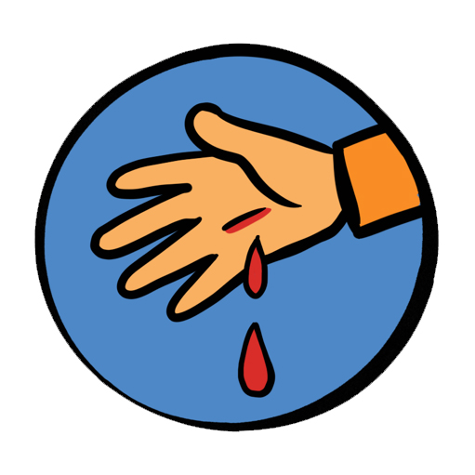
Session 2 Trauma and injury
Shock
Bleeding
Fractures and sprains
Ticks
Head injury
Dental incidents
Burns
Notes:
Trainers notes
Introduce the Trauma and Injury session and inform the participants of the syllabus areas you will cover in the first session. Ask participants what they think they will be covering in the Trauma and Injury section and add anything missed.
Unless otherwise stated (as identified by * or **) items can be delivered in a theoretical way, using trainer delivered or video content.
Items identified with * can be delivered in either theory or practical methods, recognising that a variety of factors may make this not possible, where possible practical activities would be encouraged.
Items identified with ** must be demonstrated practically by the participants (although those who are not able to do this may instruct others in doing the skill), and with a combination of trainer delivered, video and practical teaching methods to aid with learning.
This session covers the following topics:
Shock
Bleeding*
Fractures and sprains *
Head injury
Dental incidents
Burns
Objectives:
Recognise the signs, and symptoms and understand what action needs to be taken when presented with:
Shock
Bleeding
Fractures and sprains
Head injuries
Dental incidents
Burns
Outcomes:
Know where to seek advice and recognise what action needs to be taken when presented with one of the following traumas or injuries.
Shock
Bleeding *
Fractures and sprains *
Head injury
Dental incidents
Burns
With a focus on the Trauma and Injury syllabus areas. Ask the participants what first aid scenarios they would currently feel confident dealing with.
It is important to acknowledge that some may be attending first aid training for the first time, and others may be refreshing their knowledge and understanding.
For those who have attended first aid training before - Ask how the training they had been on before prepared them for an accident or incident.
For those new to first aid - ask then what they are hoping to achieve training.

Slide 28
Where to get help and how to get there
Think risk assessment
Notes:
Trainers notes
This may involve sending someone to telephone for the emergency services or letting a parent/carer know that a minor incident (eg grazed knee) has taken place.
In a serious emergency, it is important to get help as quickly as possible. Either phone yourself or ask someone you trust to call 999 or 112. The call handler will ask you a set of questions to ensure you get the help you need. It is important to be able to give an accurate location.
You may need to know the postcode, know local landmarks or use the What3words app.
In less urgent situations (including for conditions e.g ticks, insect bites, headache, that were previously covered in 1st Response course) there are other places you can look for help:
NHS 111 service – by phone. They will ask questions to ensure you are directed to the correct help. They can call a 999 ambulance, or help book an out of hours GP appointment or direct you to an urgent dentist.
NHS 111 website
Local minor injury unit
Pharmacy
Resources on GG Learning Platform
An up to date first aid manual (recommended Dorling Kindersley - authorised manual of St John Ambulance, St Andrew’s First Aid and the British Red Cross)
Consider whether in a less urgent situation an alternative method of transport could be used instead of an emergency ambulance. This may include calling parents/carers to take patient in their car

Slide 29
Shock
Shock is a life-threatening condition when the circulatory system fails and the vital organs fail to get an adequate supply of oxygen.
Notes:
Trainers notes:
What is shock?
Shock is a life-threatening condition when the circulatory system fails and the vital organs fail to get an adequate supply of oxygen.

Slide 30
Causes of shock
Severe blood loss is most common cause.
Loss of other fluids – diarrhoea and vomiting, burns.
Heart attack or heart failure
Septic shock – overwhelming infection
Anaphylaxis
Spinal Cord Injury – neurogenic shock
Notes:
Trainers notes
Causes of shock
Severe blood loss is most common cause
Loss of other fluids – diarrhoea and vomiting, burns
Heart attack or heart failure
Septic shock – overwhelming infection
Anaphylaxis
Spinal Cord Injury – neurogenic shock

Slide 31
Symptoms of shock
Pale, cold, clammy skin
Weak, dizzy, light headed
Nausea or vomiting
Thirsty
Yawning
Rapid, weak pulse
Anxiety or irrational behaviour
Rapid, shallow breathing
Dropping levels of responsiveness
Cardiac arrest
Notes:
Trainers notes
Signs and symptoms of shock
Pale, cold, clammy skin
Weak, dizzy, light-headed
Nausea or vomiting
Thirsty
Yawning
Rapid, weak pulse
Anxiety or irrational behaviour
Rapid, shallow breathing
Dropping levels of responsiveness
Cardiac arrest

Slide 32
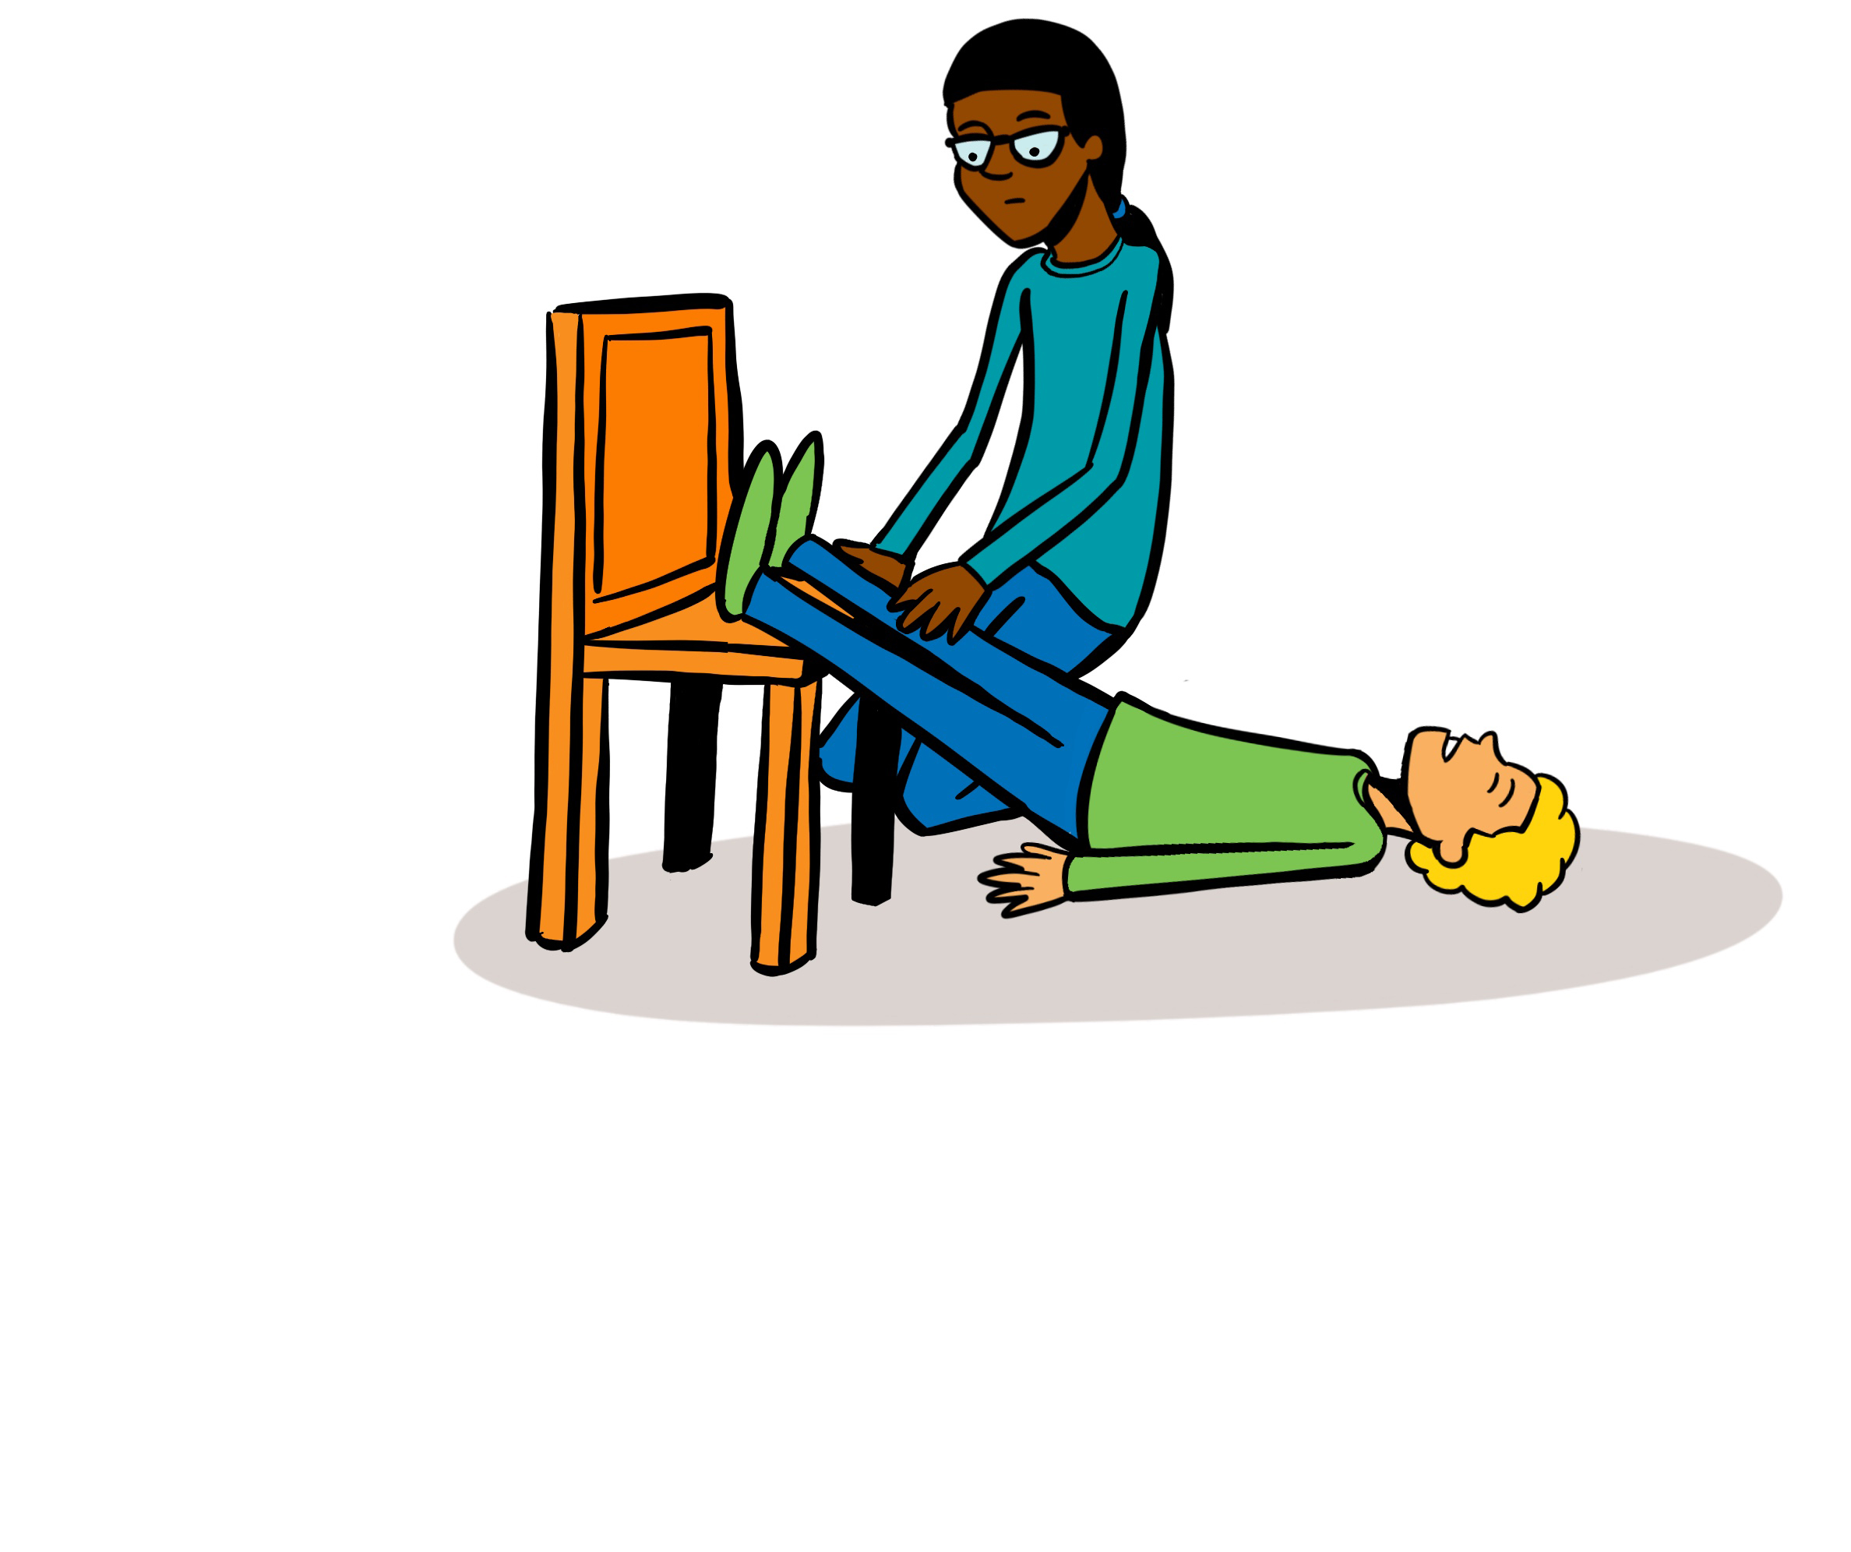
Treatment of shock
Notes:
Treatment of shock
Treat any possible cause of shock e.g. severe bleeding, anaphylaxis.
Lie casualty down on rug or blanket if possible as this will help keep them warm.
Elevate the casualty’s legs to help improve blood supply to major organs.
Keep the casualty warm with blankets etc.
Do not allow casualty to eat or drink in case an anaesthetic is needed. If thirsty, they may moisten their lips with water.
Call 999/112 and tell the call handler that the patient is suffering from shock

Slide 33
Severe bleeding treatment
Apply direct pressure
Remember PPE
Notes:
Trainers Notes:
Severe bleeding – treatment
Apply direct pressure over the wound with your fingers using a sterile dressing or clean non-fluffy pad.
If there is an object in the wound, apply pressure on either side of the object.
Apply a dressing and hold it in place with a bandage. Apply one additional dressing on top of the first if the blood comes through.
If it continues to come through remove all dressings and apply new ones.
Check that bandages on the limbs are not too tight by feeling the area below the bandage (the extremities). If this area is cold or blue, loosen the bandage slightly.
Call for help – 999/112.
* Remember PPE *

Slide 34
Bleeding – nose
Apply pressure to the lower part of the nose
Notes:
Trainers notes:
Nosebleeds
Nosebleeds are fairly common and may be caused by a blow to the nose, picking, sneezing or blowing it. Nosebleeds can lead to considerable loss of blood which, if swallowed, may cause vomiting.
What to do:
Apply firm pressure just below the firm part of the nose (you may have to do this for a younger casualty).
Get them to sit down and lean forward. If possible, protect their clothing with a cloth or
bowl.
Try to make sure they do not breathe through their nose, speak, swallow, cough, spit or sniff.
Apply the pressure to their nose for ten minutes. If the bleeding still has not stopped, continue this for a further ten minutes.
When the bleeding has stopped, advise them to rest, to avoid exertion and not to pick or blow their nose for a few hours.
If the nosebleed persists for longer than 30 minutes, take them to hospital.
Avoid hot drinks for 24 hours once the bleeding has stopped

Slide 35
Internal bleeding
Notes:
Trainers notes
Internal Bleeding
Internal bleeding can be difficult to identify. A casualty who is bleeding internally may have either a history of injury or a medical condition. You may be able to identify internal bleeding by:
external signs of injury, such as bruising
signs of bleeding from an orifice (eg ears, mouth, nose)
recognising symptoms of shock, which may be the only sign of internal bleeding.
What to do:
Place the casualty in the most comfortable position – the recovery position if they are unconscious– and treat for shock.
Get the casualty to hospital as soon as possible. Do not waste time trying to identify the cause or attempting to treat it.

Slide 36
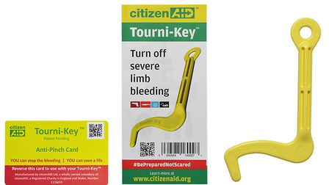
Tourniquets
Notes:
Trainers notes
There are some rare but potential situations in which the area around an incident has been sealed off for safety, and medical and rescue services are unable to enter. An example of this would be the Manchester Arena bombing or some natural disasters. In these situations first aiders may need to control life threatening bleeding until help arrives by using a tourniquet.
Citizen Aid have both an app and a tourniquet kit giving excellent advice on what to do in these situations. If you feel in your risk assessment that you may potentially be in a situation like this – then you could prepare yourself beforehand by looking through this advice.

Slide 37
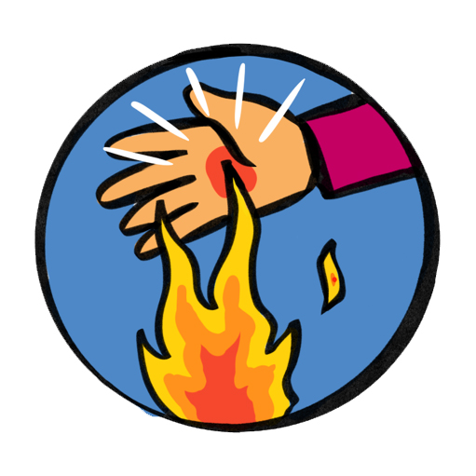
Burns
“Cool the burns but warm the patient”
20 minutes of cooling with cool water
Notes:
Trainers Notes:
Useful link: https://www.britishburnassociation.org/wp-content/uploads/2017/06/BBA-First-Aid-Guideline-24.7.18.pdf
Burns can be caused by dry heat, friction, radiation (including sunrays), hot liquids, steam and chemicals.
What to do:
Immediately cool the skin with cold water for at least 20 minutes or until the pain stops.
Once cooled, lay cling film ideally or if not, a clean dry dressing.
If possible, immediately remove jewellery, watches or other restrictions as the area can swell very quickly.
Be prepared for shock to develop and lay the casualty down if you can.
Do not burst blisters.
Leave on any clothing which has stuck to the body. If possible gently remove rings, watches or shoes before swelling occurs.
Do not apply anything but water. Special dressings, sprays and gels are not recommended.
Do not apply adhesive dressings.
Chemical burns
Some industrial and domestic chemicals can burn the skin. When going to the aid of someone with chemical burns it is vital to ensure your own safety first. If possible, note the name of the chemical.
What to do:
Wash the affected area for at least 20 minutes, with the flow of water running away from the casualty. Take care not to splash the chemical on to yourself or the casualty.
Chemical burns around the mouth and throat can cause swelling, which can restrict or close the airway, therefore:
loosen clothing around the neck
give a conscious casualty sips (not more) of cold water
be prepared to start CPR but remember to protect your mouth from the chemical by using a resuscitation face shield.
Get urgent medical help.
Sunburn
Although sunburn is a common condition, it can be quite serious. It can be prevented by wearing a sun hat and clothes made of natural fibres that cover the whole body, and by using appropriate sun protection cream.
What to do:
Move the casualty into a shaded area.
Cool the sunburnt area by sponging or showering it with cold water or get the casualty to soak in a cool bath for at least ten minutes.
Seek medical aid if there is extensive blistering or skin damage

Slide 38
Burns
Seek urgent medical attention if:
The patient is a child
The burn is deep
The burn affects face, hands, feet or genitals
All burns that go all the way around a limb
Burns that are greater than the size of the patient’s hand.
Notes:
Trainers notes
Seek urgent medical attention if:
The patient is a child
The burn is deep
The burn affects face, hands, feet or genitals
All burns that go all the way around a limb
Superficial burn if larger than 5 palms of the casualty.
Partial/full thickness burns that are larger than 1 palm of patient
Burns caused by tar, oil, fat, chemicals or electricity

Slide 39
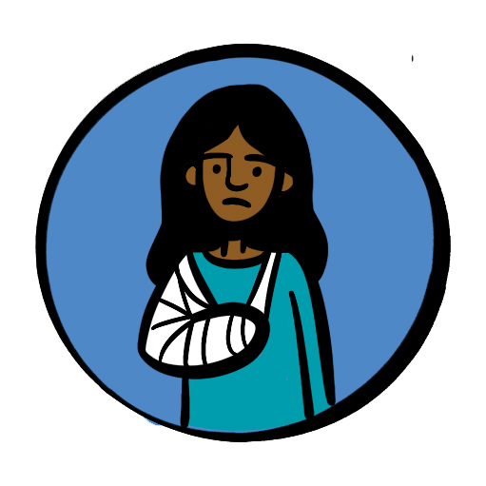
Fractures
Signs and Symptoms:
Pain or difficulty moving the area/limb
Tenderness around the area
Deformity, swelling and bruising around the fracture area (a lump or bump)
Shock
Bone breaking through the skin
Awareness of grating of bones together
Shortening, bending and twisting of limb
Notes:
Trainers Notes:
Signs and Symptoms:
Pain or difficulty moving the area/limb
Tenderness around the area
Deformity, swelling and bruising around the fracture area (a lump or bump)
Shock
Bone breaking through the skin
Awareness of grating of bones together
Shortening, bending and twisting of limb

Slide 40
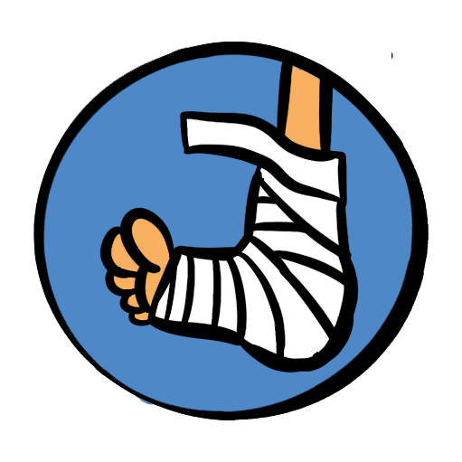
Fractures
It is easy to miss a fracture if the signs are subtle.
Have a low threshold for seeking medical advice and getting an Xray.
Notes:
Trainers notes
Immobilise in the position found with as little movement as possible and apply a sling or splint.
Seek medical help – it is common for fractures to be “missed”
Arrange transport for further assessment, if in severe pain –call 999/112.

Slide 41
Spinal injuries
Notes:
Trainers notes
Consider the potential of spinal injury in the following circumstances: Falling from a height e.g. a ladder, falling awkwardly whilst trampolining or doing gymnastics, diving into a shallow pool and hitting the bottom, falling from a horse or motorbike, collapsed rugby scrum, high speed motor accident, a heavy object falling across the back, injury to the face or head.
Do not move the patient. If the patient is unresponsive you may need to open the airway whilst avoiding moving the neck.
If there is potential injury to the neck a responsive patient should be able to protect themselves. If unresponsive then manual stabilisation can be carried out but only if you have been trained to do so.

Slide 42
Sprains
R.I.C.E
Notes:
Trainers Notes:
Sprains
A soft tissue injury occurs when a ligament or tendon around a joint has been torn or pulled. This sort of injury can often give similar symptoms to a fracture. If you are in any doubt, treat as a fracture. Remember RICE in caring for a soft tissue injury.
R – Rest the injured part.
I – Apply Ice (not directly to the skin) or a cold compress.
C – Provide Comfortable support – soft padding and a bandage support.
E – Elevate the limb
ice application only applied for maximum of 20 minutes
If an accident occurs when you are away from help, such as on a hike, it may be applicable to use added protection – this may include the tightening of high top boots (hiking boots) etc to prevent further (or worsening of the) injury. This is most applicable in relatively minor sprains/strains
Additional information can be found here: https://cks.nice.org.uk/topics/sprains-strains/management/management/

Slide 43
Ticks and Lyme disease Ticks bites can cause Lyme disease. It is important to know how to avoid ticks know how to check yourself or others what action to take if you have been bitten know the symptoms to look out for.
Notes:
Trainers’ Notes:
Ticks can transmit bacteria that cause diseases such as Lyme disease. Lyme disease can cause serious problems such as nerve damage and arthritis. Not all tick bites can lead to illness, but it is important to know how to avoid tick bites and what to do if somebody gets bitten, as prevention and early detection are crucial.
Ticks are often found in dense vegetation or long grass, and climb onto people as they brush past them. They bite to attach to the skin and start to feed on the blood. Avoid coming into contact with them - walk on paths to avoid brushing vegetation, wear light coloured clothing so that ticks can be easily spotted and brushed off. Repellents such as DEET are also effective.
People don’t always know they’ve been bitten so it is important to check thoroughly. Look over clothes or body for any ticks to brush off. Ticks prefer warm moist places such as groin area, waist, arm pits, behind the knee or along the hairline. You’re looking out for anything as tiny as a freckle or speck of dirt. This will need to be handled sensitively and appropriately in a residential setting.
Symptoms of Lyme disease can include flu-like symptoms, fatigue, muscle and joint pain. Most people develop a characteristic rash called erythema migrans. If these symptoms develop after a period of time outdoors it is important to see your GP. It is easily treated with a course of antibiotics in the early stages.
Public Health Wales have a very good factsheet that can be found on the resources area of Learning Platform.

Slide 44
Head injury
Head injuries are very common but can occasionally become very serious.
For this reason, the casualty’s parent/carer or person they live with must be informed of even an apparently minor bump to the head, since symptoms can be delayed.
Notes:
Trainers Notes:
Head injuries are very common but can become very serious. For this reason, the casualty’s parent/carer or person they live with must be informed of even an apparently minor bump to the head, since symptoms can be delayed. All head injuries must be taken seriously.

Slide 45
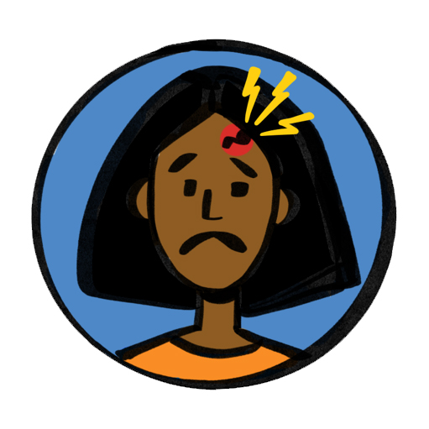
Head injury
Seek medical help if
Persistent headache
Increasing drowsiness
Confusion, loss of balance, loss of memory
Difficulty speaking
Difficulty walking
Vomiting episodes after the injury has occurred
Double vision or strange movement of the eyes
Seizures
Patient is aged over 65
Patient has had previous brain surgery
Patient is on anti-coagulation/anti-clotting medication
Notes:
Trainers notes
What to do:
Seek medical help if:
Signs of worsening injury
Increasing drowsiness
Persistent headache
Confusion, loss of balance, loss of memory
Difficulty speaking
Difficulty walking
Vomiting episodes after the injury has occurred
Double vision or strange movement of the eyes
Seizures
Patient is aged over 65
Patient has had previous brain surgery
Patient is on anti-coagulation/anti-clotting medication
There is no responsible person to keep an eye on the patient
Assess using AVPU:
A: patient is alert – eyes open and responds to questions
V: patient responds to verbal commands and questions
P: responds to pain eg pinching of earlobe - painful stimulus should be pressure based
U: unresponsive to any stimulus

Slide 46
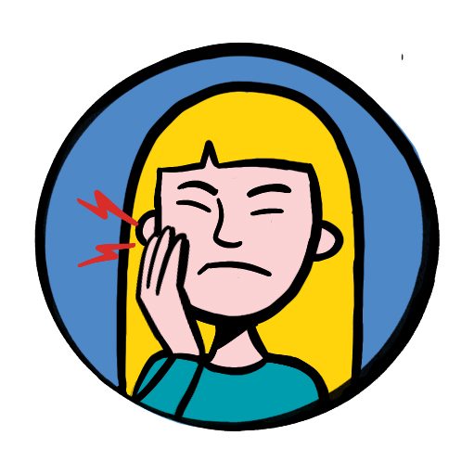
Dental
Emergency first aid
How to get help
Notes:
Trainers notes
Emergency 1st Aid will be required if:
An adult tooth is knocked out
What to do?
Only touch the tooth at the crown. Avoid touching the roots as this may damage cells. Can re-implant immediately or wrap in cling film or put in cow’s milk, oral rehydration salts or saliva, or saliva soaked gauze. Tap water and saline are not recommended.

Slide 47
Q + A
Notes:
Allow time for any questions on the topics covered

Slide 48
Summary and reflection
Notes:
Summary / Reflection
Ask participants if they think we met the session outcomes and for them to feedback what in particular they have learnt today or will take away from this section of the course.
Trainers notes:
Were these learning outcomes met?
Know where to seek advice and recognise what action needs to be taken when presented with one of the following traumas or injuries.
Shock
Bleeding *
Fractures and sprains *
Head injury
Dental incidents
Burns
Unless otherwise stated (as identified by * or **) items can be delivered in a theoretical way, using trainer delivered or video content.
Items identified with * can be delivered in either theory or practical methods, recognising that a variety of factors may make this not possible, where possbile practical activities would be encouraged.

Slide 49
Notes:
If delivering a full 6 hour course, please take a break here.

Slide 50
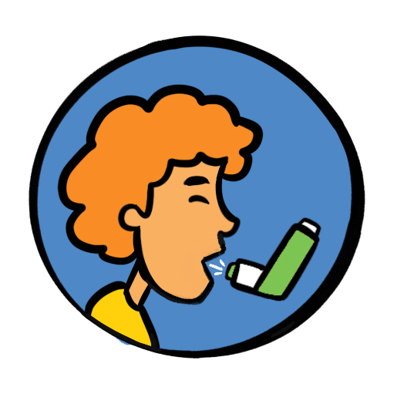
Session 3 Major illness
Asthma
Anaphylaxis
Heart attack
Stroke
Seizures
Diabetes
Sepsis/Meningitis
Notes:
Introduce the Major illness session and inform the participants of the syllabus areas you will cover in the first session. Ask participants what they think they will be covering in the Trauma and Injury section and add anything missed.
Trauma and injury Key Topics:
Asthma
Anaphylaxis
Heart attack
Stroke
Seizures
Diabetes
Sepsis/Meningitis
Trainers notes:
Introduce the major illness session and inform the participants of the syllabus areas you will cover in the first session.
Objectives:
1. To be able to understand the symptoms and signs for:
Asthma
Anaphylaxis
Heart Attack
Stroke
Seizures
Diabetes
Sepsis / Meningitis
2. To understand the planning and preparation needed for members with known conditions / illnesses.
3. To know where to look for help and advice from other sources related to these conditions / illnesses.
Outcomes
Understand the symptoms and signs that mean you need to seek professional medical advice and know how to provide immediate First Aid treatment in particular helping patient to use their own emergency medication for:
Asthma
Anaphylaxis *
Heart attack
Stroke
Seizures
Diabetes
Sepsis/Meningitis
With a focus on the major illness syllabus areas. Ask the participants which major illnesses they would be confident dealing with.
It is important to acknowledge that some may be attending first aid training for the first time, and others may be refreshing their knowledge and understanding.
For those who have attended first aid training before - Ask how the training they had been on before prepared them for an accident or incident.
For those new to first aid - ask then what they are hoping to achieve training.

Slide 51
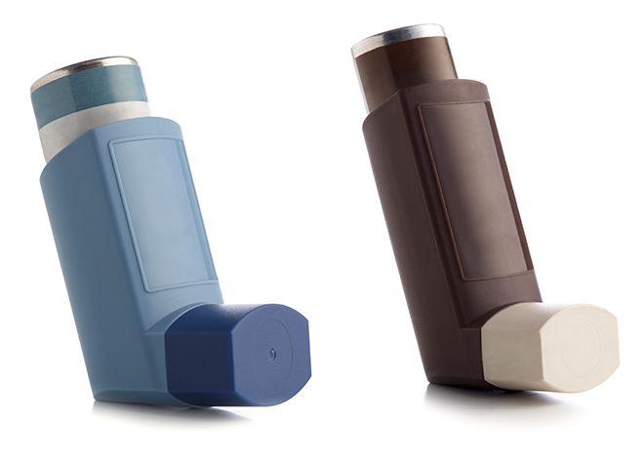
Asthma
What is asthma?
What are the signs and symptoms:?
Notes:
Trainers Notes:
What do participants know about Asthma?
Asthma is a chronic (long-term) condition in which the muscles of the air passages go into spasm making the airways narrow and causing the patient to have difficulty in breathing.
Signs and symptoms
Difficulty breathing – short sentences and whispering
Wheezing
Coughing
Distress and anxiety
Grey-blue tinge to lips, earlobes and nailbed
Exhaustion in a severe attack

Slide 52
Asthma
One puff of reliever inhaler every 30-60 seconds for up to 10 puffs
Use spacer device if available
Call for help if no improvement after 10 puffs. The 10 puff routine can be repeated after a few minutes if ambulance hasn’t arrived
Notes:
Trainers notes
Treatment
One puff of reliever inhaler every 30-60 seconds for up to 10 puffs. Use spacer device if available. Call for help if no improvement after 10 puffs. The 10 puff routine can be repeated after a few minutes if ambulance hasn’t arrived.
Some people will have a combined reliever and preventer inhaler – they should use this during an asthma attack

Slide 53
Asthma
Red flags
Notes:
Trainers notes:
Red Flags’
Call 999/112 for medical help if:
Reliever inhaler not easing attack
Patient is becoming exhausted
Patient is too breathless to speak
Patient cannot complete full sentences

Slide 54
Anaphylaxis
Anaphylaxis is a severe allergic reaction affecting the whole body. It may develop within seconds or minutes of coming into contact with a trigger and can be fatal.
Notes:
Trainers Notes:
Anaphylaxis is a severe allergic reaction affecting the whole body. It may develop within seconds or minutes of coming into contact with a trigger and can be fatal.
Signs and symptoms:
Red itchy rash
Red itchy eyes
Swelling of hands feet or face
Abdominal pain, vomiting and diarrhoea
Wheezing and difficulty breathing
Swelling of tongue or throat
Agitation and feeling of terror
Shock

Slide 55
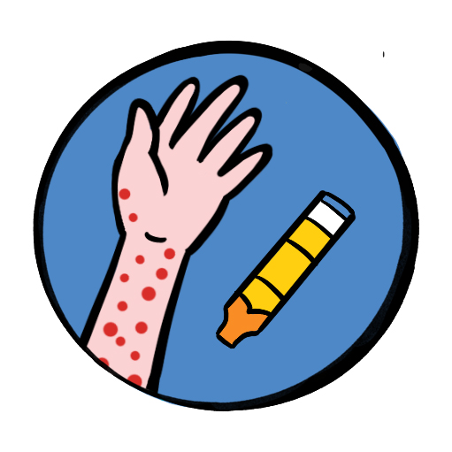
Anaphylaxis
Treatment
Patients need emergency treatment with adrenaline
Call for help – 999/112
If the patient has an adrenaline auto-injector – help them to use it
If symptoms not improving after 5 mins or they return – give second dose of adrenaline
Notes:
Trainers notes
Treatment
Patients need emergency treatment with adrenaline
Call for help – 999/112
If the patient has an adrenaline auto-injector – help them to use it.
If symptoms not improving after 5 mins or they return – give second dose of adrenaline
Anyone receiving adrenaline treatment must be taken to hospital.
There are several types of adrenaline auto injectors available in the UK. All deliver ‘adrenaline’ (also referred to as ‘epinephrine’). All types are prescription only medicines, and need to be prescribed by an allergy specialist. The dose of adrenaline required is dependent on the age and weight of the person requiring the adrenaline auto injector device, and will be prescribed by the clinician. Each adrenaline auto injector device will differ in appearance and the availability of the dose/strength available in that particular brand.

Slide 56
Heart attack
Feeling lightheaded or dizzy
Sweating
Shortness of breath
Feeling sick (nausea) or being sick (vomiting)
An overwhelming sense of anxiety (similar to having a panic attack)
Coughing or wheezing
Notes:
Trainers notes
What is a heart attack?
Chest pain sensation of pressure, tightness or squeezing in the centre of your chest and in other parts of the body – it can feel as if the pain is travelling from your chest to your arms (usually the left arm is affected, but it can affect both arms), jaw, neck, back and tummy (abdomen)
Signs and symptoms
Feeling lightheaded or dizzy
Sweating
Shortness of breath
Feeling sick (nausea) or being sick (vomiting)
An overwhelming sense of anxiety (similar to having a panic attack)
coughing or wheezing
Although the chest pain is often severe, some people may only experience minor pain, similar to indigestion. In some cases, there may not be any chest pain at all, especially in women, older people, and people who have diabetes.
It's the overall pattern of symptoms that helps to determine whether you are having a heart attack.
Treatment and positioning
If the casualty is still conscious, sit them up, supporting them from behind with their knees slightly bent (the ‘W’ position).
Send for urgent medical help.
Monitor them carefully and give 300mg aspirin to adults who are showing signs and symptoms of a heart attack. Do not give if chest pain due to trauma. Do not give to under 16s, those with severe allergy to aspirin, those with known stomach problems, or those with severe asthma. It is shown that given early, survival rates are better and there are no increased side effects
If the casualty is known to have angina and has medication for it, they can be helped to use it as instructed on the prescription Constantly monitor their level of response, circulation and breathing until help arrives.
If they lose consciousness, put them in the recovery position if still breathing normally.
If breathing deteriorates, begin CPR
If the casualty is thought to be having a heart attack, or has breathing difficulties or chest injuries, they should ideally be supported in the half sitting (‘W’) position.
NEVER give aspirin to children.

Slide 57
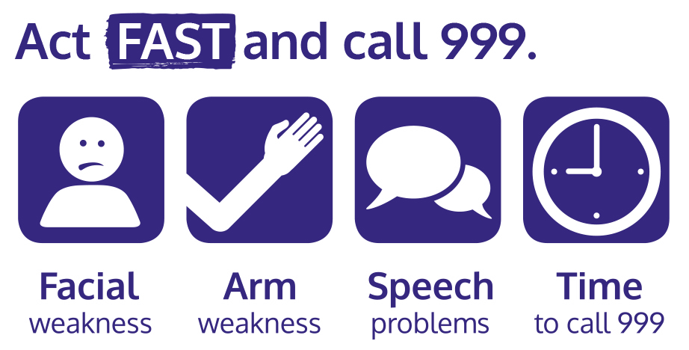
Stroke
Notes:
Trainers Notes:
A stroke is a medical emergency when the blood supply to the brain is disrupted. The majority of strokes are caused by a clot in a blood vessel that blocks the flow of blood to part of the brain. Some strokes are the result of a ruptured blood vessel that causes bleeding into the brain.
A transient ischaemic attack, or TIA, is sometimes called a mini-stroke. It is similar to a full stroke but the symptoms last for a short while, improve and disappear.
Face ‒ look at their face and ask them to smile. Are they only able to smile on one side of their mouth? If yes, this is not normal.
Arms ‒ ask them to raise both arms. Are they only able to lift one arm? If yes, this is not normal.
Speech ‒ ask them to speak. Are they struggling to speak clearly? If yes, this is not normal.
Time ‒ if the answer to any of these three questions is yes, then it is time to call 999 or 112 for medical help and say you think the casualty is having a stroke

Slide 58
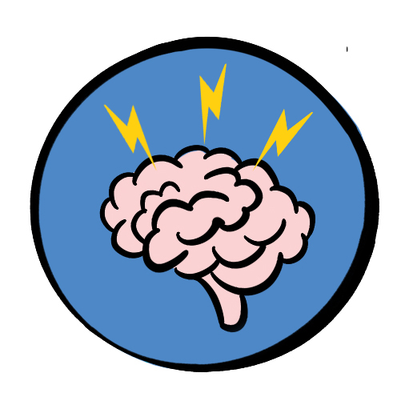
Seizures
symptoms and treatment
Notes:
Trainers Notes:
A seizure – or convulsion or fit – consists of involuntary contractions of many of the muscles in the body, due to a disturbance in the electrical activity of the brain. The most common cause of seizures is epilepsy. Epilepsy is a chronic condition and patients often take medication to prevent or reduce seizures. Other causes include head injury, lack of oxygen to the brain, excess of alcohol or drugs, fever in young children.
Symptoms and signs
Sudden loss of responsiveness
Patient becomes rigid and arches back
Breathing may be noisy and become difficult, lips may show a grey-blue tinge – cyanosis
Uncontrollable jerking and shaking, called a "fit" may lose bladder control
Most seizures terminate within a few minutes
After a seizure the patient may feel tired and fall into a deep sleep.
Some people have a form of epilepsy known as absence seizures during which they appear distant and unaware of their surroundings. You may notice slight or localised twitching or jerking of lips, eyelids, head or limbs.
Treatment
Make space around patient and move bystanders out of the way.
Remove any potentially dangerous items such as hot drinks or sharp objects
Note what time fit started
Do not move patient unless they are in immediate danger
When the fit has stopped, check airway and breathing and place into recovery position.
Note how long seizure lasted.
Call for emergency help if:
There are repeated seizures or if this is first seizure
The seizure continues for more than 5 minutes
The patient is unresponsive for more than 10 minutes

Slide 59
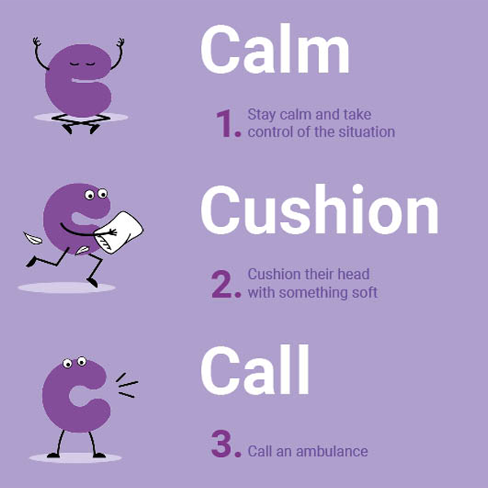
Seizures
The most common cause of seizures is epilepsy. Epilepsy is a chronic condition and patients often take medication to prevent or reduce seizures. Other causes include head injury, lack of oxygen to the brain, excess of alcohol or drugs, fever in young children
Notes:
Trainers notes
Epilepsy Society 3 c’s ca- The charity’s new campaign gives people three simple but key instructions to remember in an emergency: “Calm, Cushion, Call” Campaign

Slide 60
Diabetes
A chronic (long-term) condition in which the body fails to produce sufficient insulin, which is a hormone that controls blood sugar level. This can result in higher than normal blood sugar (hyperglycaemia) or lower than normal blood sugar (hypoglycaemia or hypo)
Notes:
Trainers Notes:
Diabetes – this is a chronic (long-term) condition in which the body fails to produce sufficient insulin, which is a hormone that controls blood sugar level. This can result in higher than normal blood sugar (hyperglycaemia) or lower than normal blood sugar (hypoglycaemia or hypo).

Slide 61
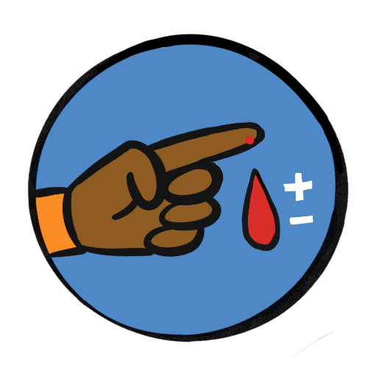
Diabetes
Hypoglycaemia is the emergency. If a patient with diabetes is unwell giving them sugar will rapidly restore blood sugar, and is unlikely to do harm in hyperglycaemia. The need is to act urgently rather than trying to decide.
Notes:
Trainers notes
Hypoglycaemia is the emergency. If a patient with diabetes is unwell giving them sugar will rapidly restore blood sugar, and is unlikely to do harm in hyperglycaemia. The need is to act urgently rather than trying to decide.
Signs and Symptoms
A history of diabetes – some people may recognise a “Hypo” coming
Weakness, fainting, hunger
Confusion, being irrational
Sweaty with clammy skin
Rapid pulse
Decreasing level of responsiveness
Evidence of medical warning device – or carrying glucose gel or sweets
Treatment
Give sugar.
Patient may have their own emergency supplies (think about a healthcare plan)
If not give – 15-20g glucose – 150ml of non-diet fizzy drink, 3 jelly babies, 3 sugar lumps.
If the casualty feels better –help them to check their own blood sugar
If not improving –call for medical help.
If unresponsive – put into recovery position and monitor.

Slide 62
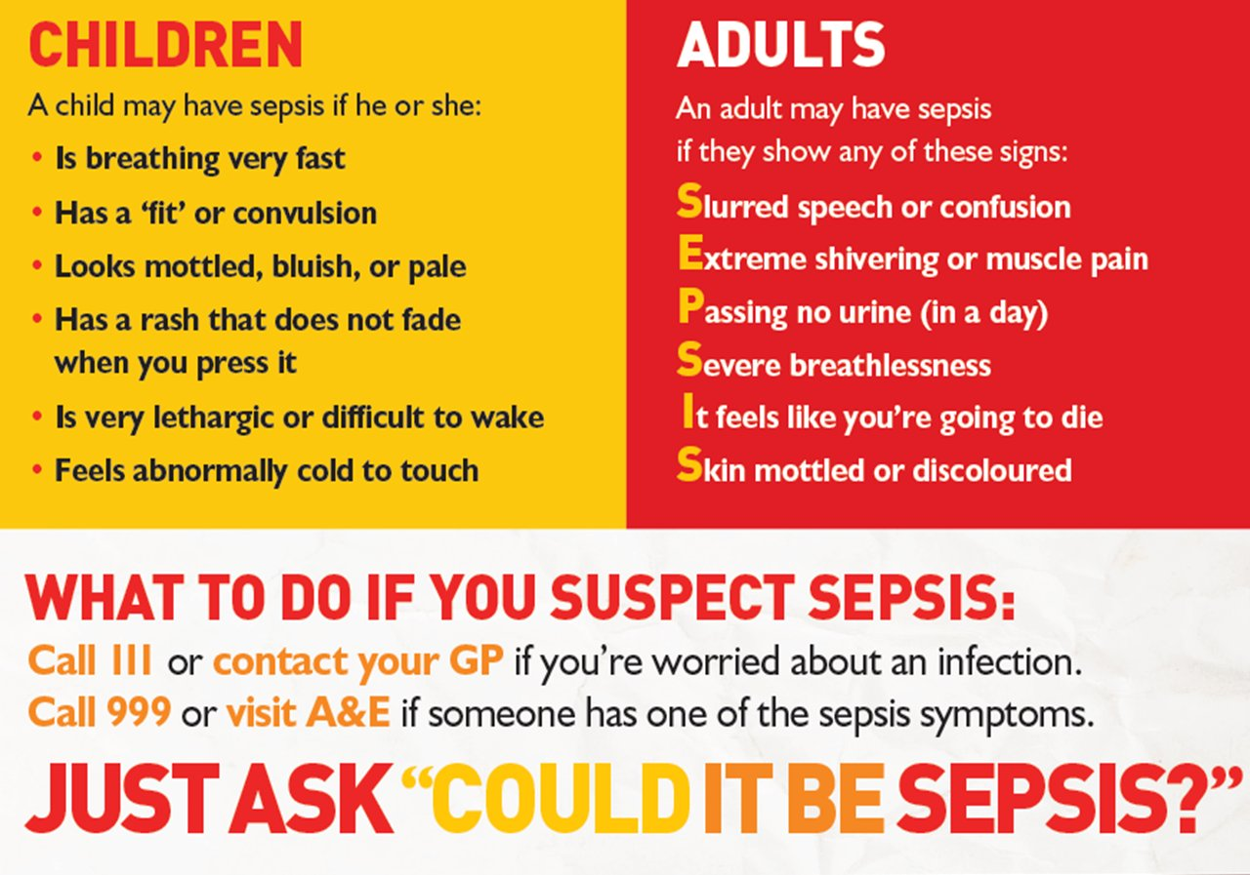
Sepsis
Notes:
Trainers Notes:
Sepsis (also known as blood poisoning) is the immune system’s overreaction to an infection or injury. Normally our immune system fights infection – but sometimes, for reasons we don’t yet understand, it attacks our body’s own organs and tissues. If not treated immediately
Signs and symptoms (Children)
Breathing very fast
Has a ‘fit’ or convulsion
Looks mottled, bluish or pale
Has a rash that does not fade when you press it
Is very lethargic or difficult to wake
Feels abnormally cold to touch
They may not have all these symptoms.
Signs and symptoms (Adult)
Slurred speech of confusion
Extreme shivering or muscle pain
Passing no urine (in a day)
Severe breathlessness
It feels like you’re going to due
Skin mottled or discoloured
Sometimes symptoms can be vague and can be like other conditions, including flu or chest infection.
Image: The Sepsis Trust

Slide 63
Meningitis
Signs and symptoms
raised body temperature
vomiting
feeling very unwell
severe headache
photophobia (dislike of light)
stiff or rigid neck
a lowering level of consciousness if untreated
rash of small purple spots or bruises (when pressed against a glass they do not disappear). This is a late sign and may not even appear.
Notes:
Trainers notes
Meningitis
Although it is not a common condition, you should be aware of meningitis.
Meningitis is an infection of the protective membranes that surround the brain and spinal cord (meninges).
It can affect anyone, but is most common in babies, young children, teenagers and young adults.
Signs and symptoms
raised body temperature
vomiting
feeling very unwell
severe headache
photophobia (dislike of light)
stiff or rigid neck
a lowering level of consciousness if untreated
rash of small purple spots or bruises (when pressed against a glass they do not disappear). This is a late sign and may not even appear.
If you have any suspicion that someone might have meningitis, seek urgent medical advice.

Slide 64
Q + A
Notes:
Allow time for any questions on the topics covered

Slide 65
How confident are you feeling about being a first aider?
1 2 3 4 5
Notes:
Back to the first question –
​
​
This is a good way to test what people have learnt throughout the course and their confidence levels now.
You can use the scale for a few questions – such knowledge confidence or skill confidence

Slide 66
Summary and reflection
Notes:
Summary / Reflection
Ask participants if they think we met the session outcomes and for them to feedback what in particular they have learnt today or will take away from this section of the course.
Trainers notes:
Were these learning outcomes met?
Outcomes
Understand the symptoms and signs that mean you need to seek professional medical advice and know how to provide immediate First Aid treatment in particular helping patient to use their own emergency medication for:
Asthma
Anaphylaxis *
Heart attack
Stroke
Seizures
Diabetes
Sepsis/Meningitis
Unless otherwise stated (as identified by * or **) items can be delivered in a theoretical way, using trainer delivered or video content.
Items identified with * can be delivered in either theory or practical methods, recognising that a variety of factors may make this not possible, where possbile practical activities would be encouraged.

