Slide 1
Step by step guide for using the volunteer recruitment tool
Updated May 2026
Notes:
Wanted to share a quick reminder of the agenda today:
Agenda from 3pm to 3:30pm
·Insights on paid volunteer recruitment activity and volunteers’ week - Lisa
·Present the 2025 top level communications plan - Becca
·Gather feedback - all
·Update on the Girlguiding on your cv resources, timings and how this will be shared – Becca
Can I get a quick feel of how people are feeling today before we start the call. Put a 1 to 5 in the chat about how you are feeling? 1 is – Yeah I am feeling fabulous and loving life in the sun . 5 is - I am here but my digital battery for calls is running low...

Slide 2
Contents
Click the slide number to go to that slide
Who is the volunteer recruitment tool for? (slide 4)
Where to access the volunteer recruitment tool (slide 5)
  Logging in to the volunteer recruitment tool: on a smaller screen (slide 6)
  Logging in to the volunteer recruitment tool: on a wider screen (slide 7)
Creating and managing opportunities as a volunteer recruiter (slide 8-22)
  Managing opportunities: filtering (slide 9)
  Managing opportunities: sorting (slide 10 – 11)
  Managing opportunities: editing (slide 12)
  Managing opportunities: navigating back (slide 13)
  Creating opportunities (slide 14 – 19)
  Unpublishing opportunities (slide 20)
  Editing opportunities once published (slide 21)

Slide 3
Contents cont.
Click the slide number to go to that slide
Promoting your opportunity via copying the link or printing (slide 22-27)
Searching and applying to volunteer (slide 27 – 34)
How to get help using the tool (slide 35-36)

Slide 4
Who is the volunteer recruitment tool for?
Who can use the tool to list opportunities?
Volunteers at county, district and division level with recruiter permissions on GO (commissioners and roles with level support access).
Who can apply for opportunities using the tool?
Anyone can apply for specific volunteer opportunities using the tool. People who already have an email address registered with GO will still need to express their interest, if they can't find a suitable opportunity, in the 'My Enquiries' area in GO. This includes:
Current or past parents/carers.
Current or past volunteers/young members looking for a new role.
People who've registered in the past.
Roles able to list opportunities
Please note that these roles already have the right access on GO. This is just a reminder
County commissioner
County commissioner designate
Assistant county commissioner
County administrator
County enquiry coordinator
County GO coordinator
County office member
County secretary
Deputy county commissioner
Division commissioner
Division commissioner designate
Assistant division commissioner
Division administrator
Division secretary
District commissioner
District commissioner designate
District administrator
District assistant
District secretary

Slide 5
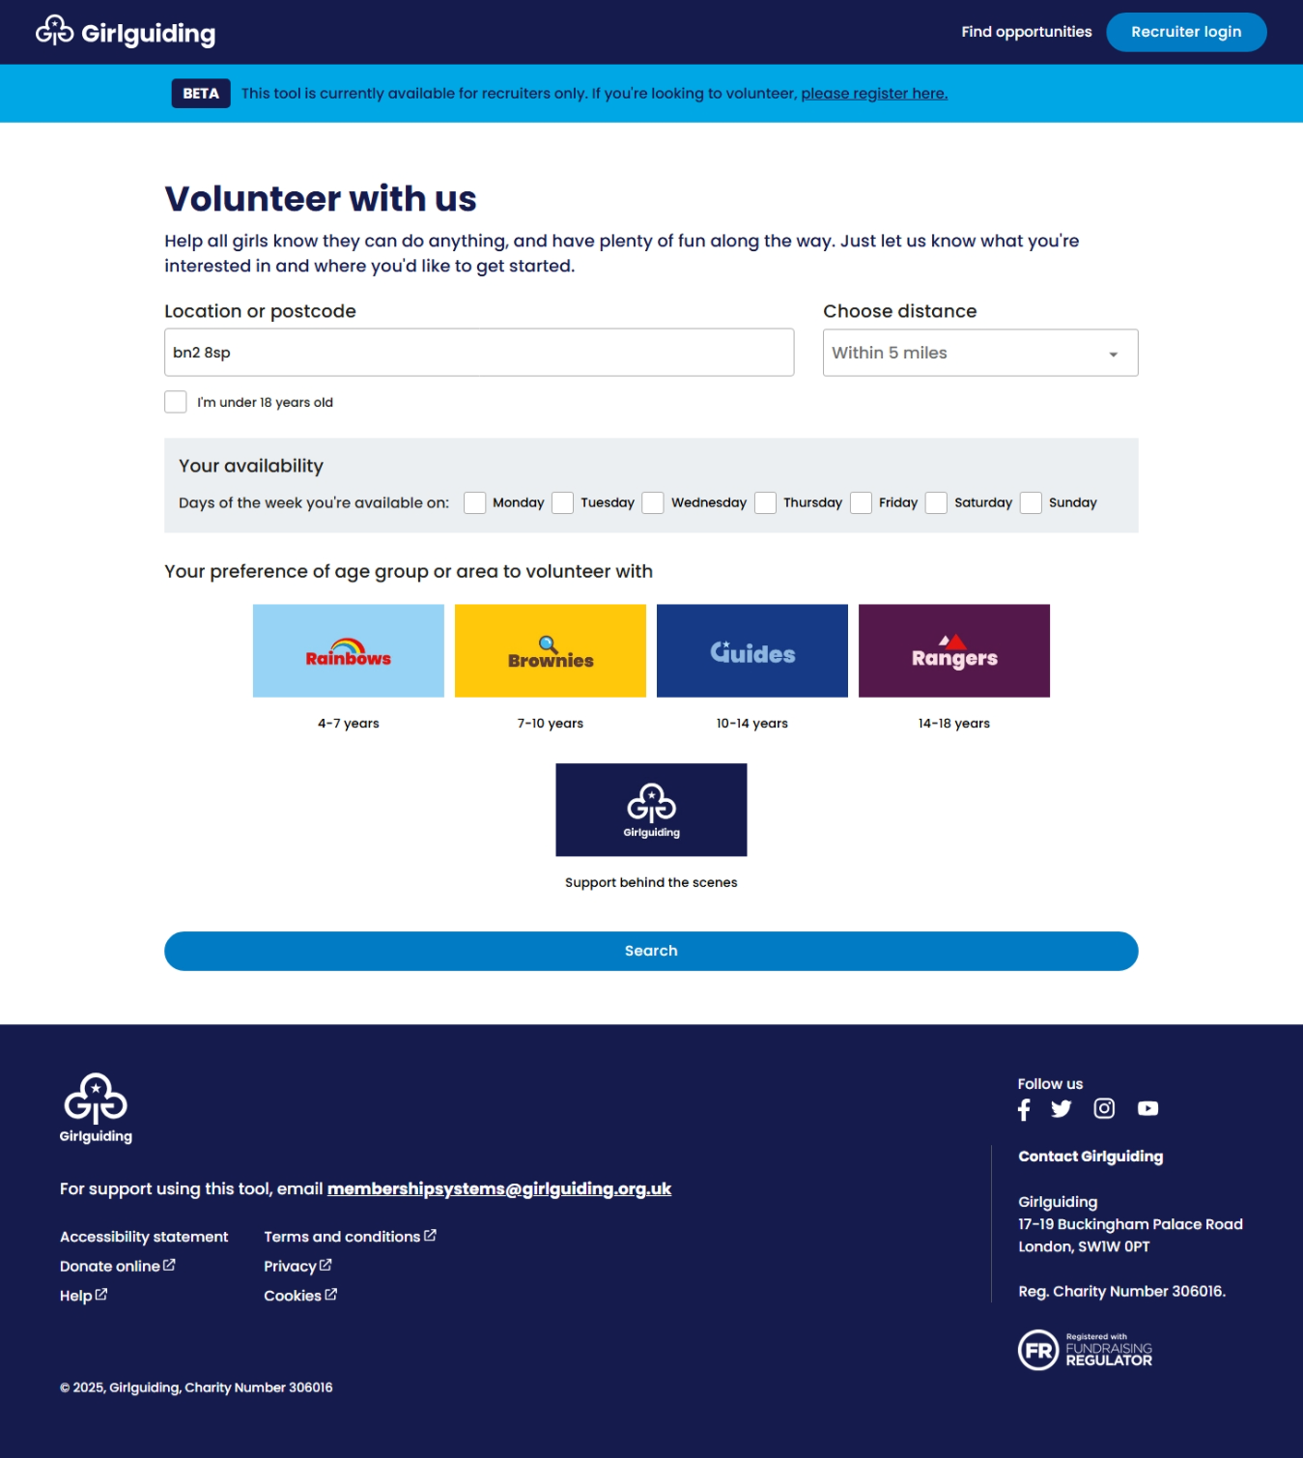
Where to access the volunteer recruitment tool
Head to volunteer.girlguiding.org.uk
Note:
We recommend recruiters using the tool on a bigger screen like desktop, laptop or tablet - like you would when using GO. We're working on making the tool more mobile-friendly.
You can also find a link to the tool from the 'Register to volunteer' page on our website.

Slide 6
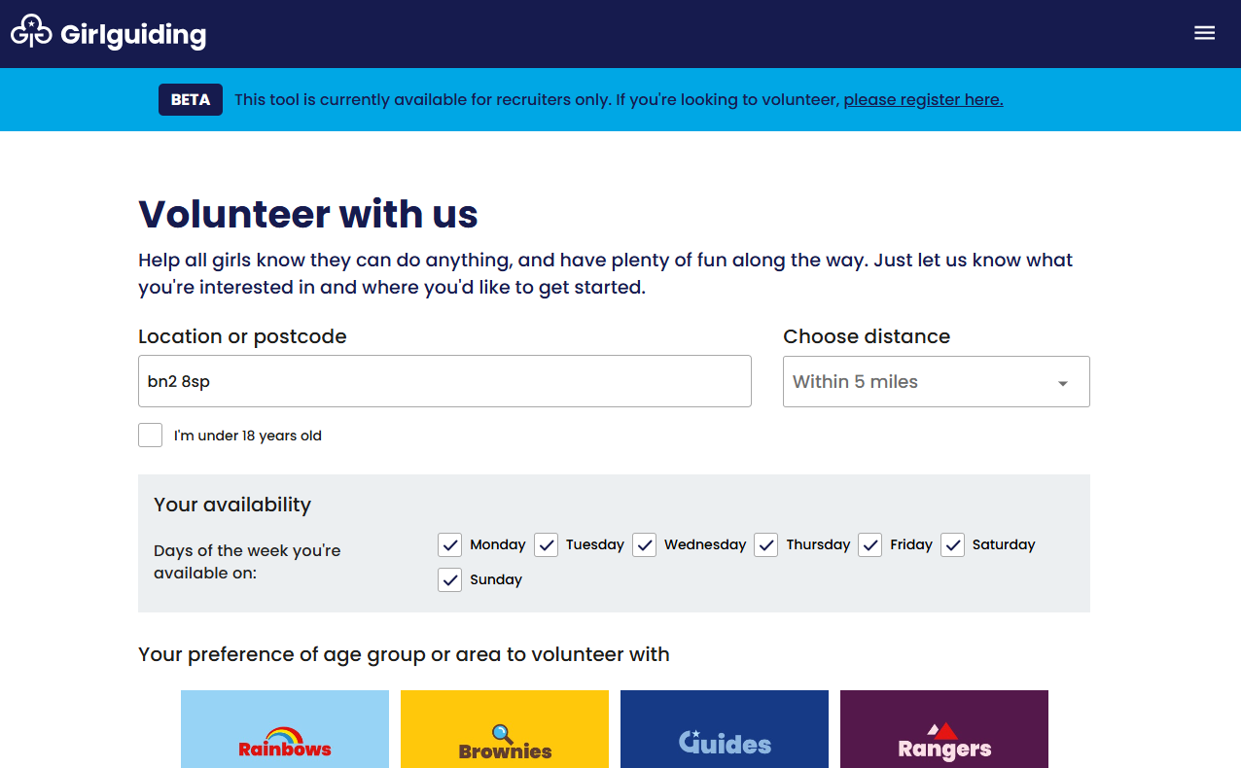
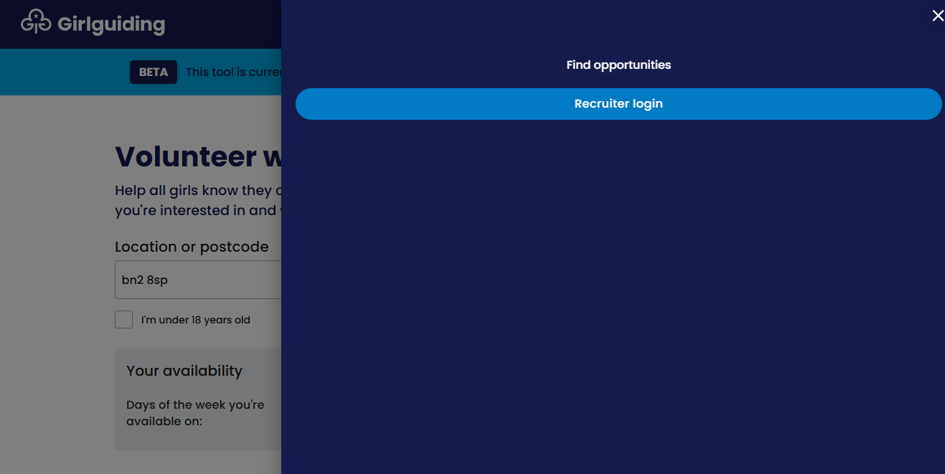
Logging in to the volunteer recruitment tool: on a smaller screen
Depending on the size of your screen, you'll have a slightly different view.
If you are using a smaller screen (iPad or tablet for example):
Click the 3 lines in the top right corner.
Select recruiter login from the menu.
Use the same login details you'd use to log into GO.
1.
2.

Slide 7
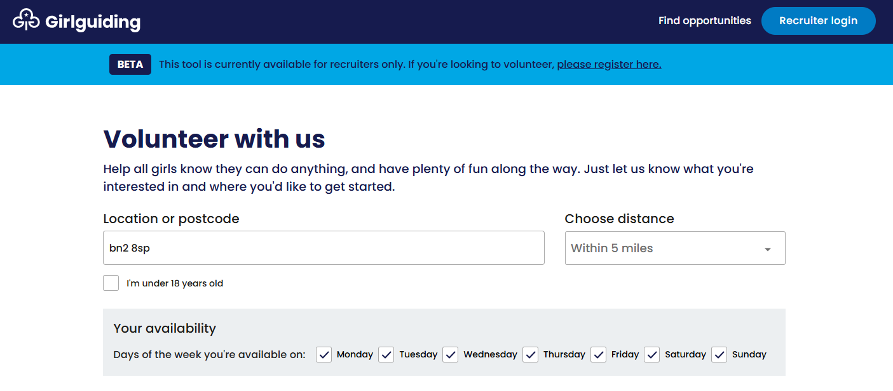
Logging in to the volunteer recruitment tool: on a wider screen
If you're using a wider screen (laptop or desktop for example):
Select 'Recruiter login' in the top righthand corner.
Use the same login details you'd use to log into GO.

Slide 8
Creating and managing opportunities as a volunteer recruiter

Slide 9
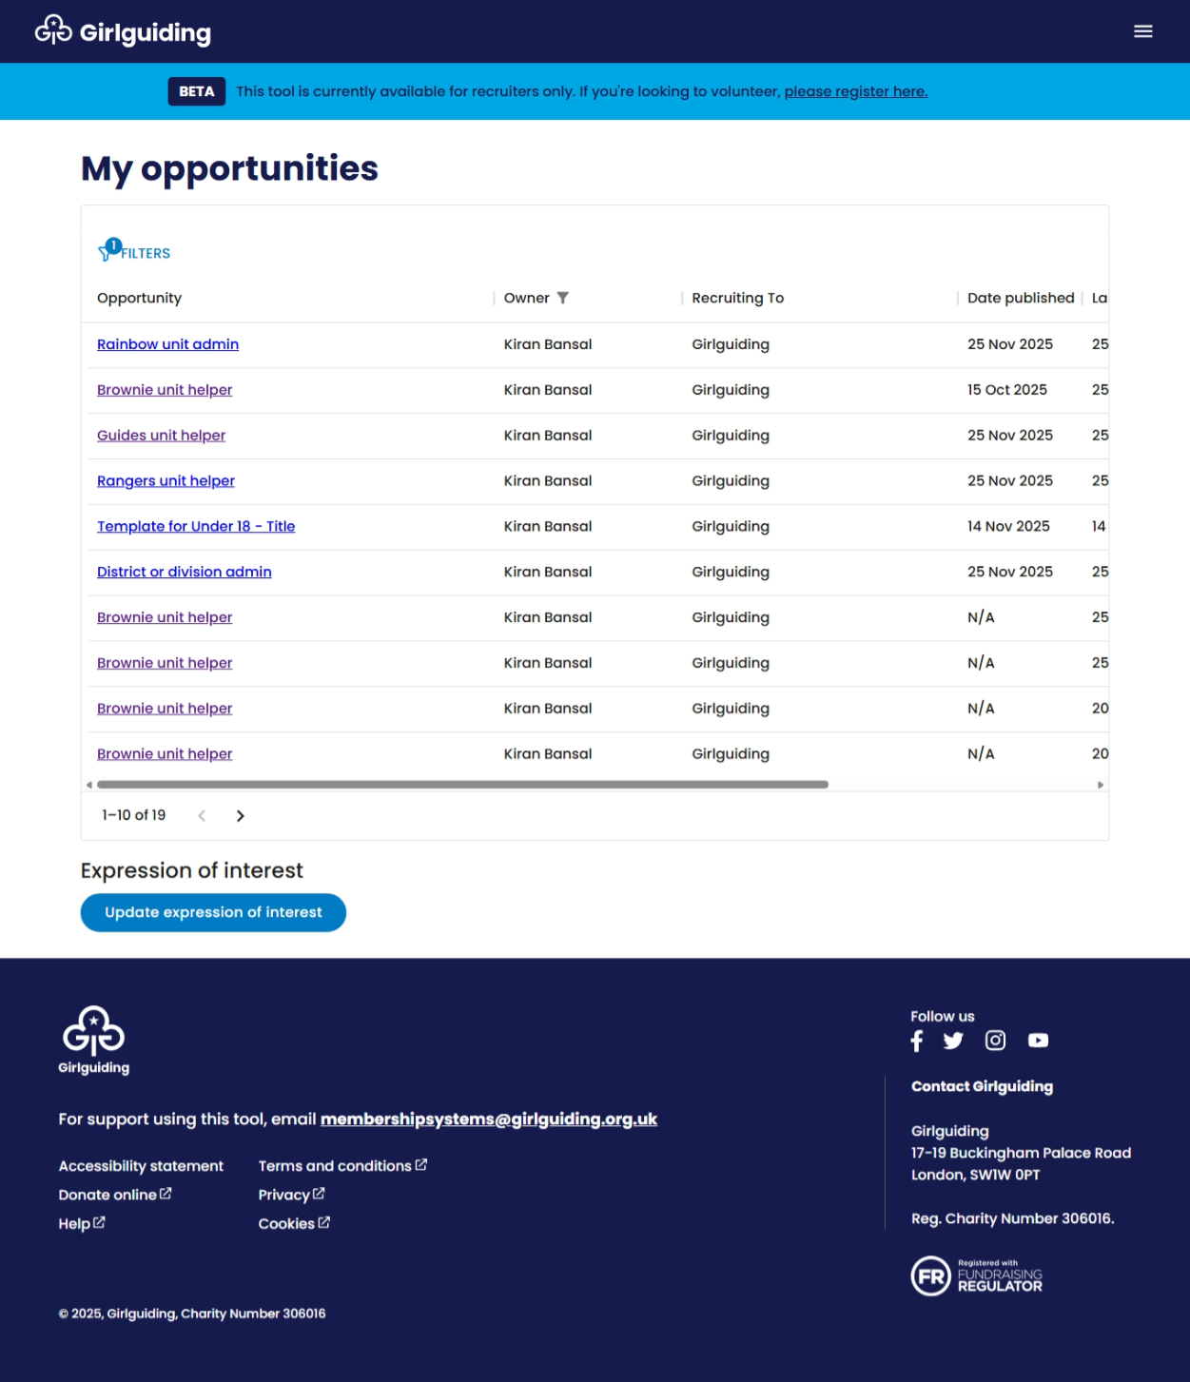
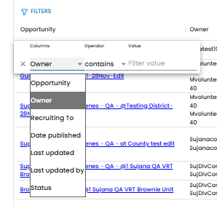
Managing opportunities: filtering
When you log in as a recruiter, you'll be taken to the ‘My opportunities’ page. Here you’ll be able to view and manage all opportunities that are listed in your level of guiding and below. For example, if you're a volunteer at county level you'll see all opportunities in your county, division volunteers will be able to see all opportunities in their division, and so on.
You can use filters to find and view specific opportunities.
1. To filter, click on the filters above opportunity. The below box will appear.
2. Then select how you would like to filter by clicking on the drop downs under columns and operator.
For example, if you want to find opportunities you've listed, select ‘owner’, ‘contains’ and type ‘[your name] in filter value or for opportunities in a specific unit select ‘recruiting to’, ‘contains’, and type [unit name] in filter value.

Slide 10
Managing opportunities: sorting
You can click on the column headings to sort the opportunities.
Clicking on ‘date published’ will reorder the column according to newest or oldest.
Clicking on ‘owner’ or ‘recruiting to’ will reorder the column according to alphabetical order.

Slide 11
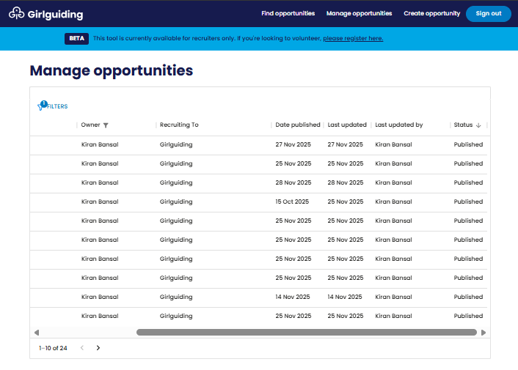
Managing opportunities: sorting
Depending on the size of the screen you're using, you can click and drag the scroll bar at the bottom to view more columns, like ‘Last updated’, ‘Last updated by’ and ‘Status’ (whether the opportunity is published, unpublished or in draft format.

Slide 12
Managing opportunities: editing
You can click on specific opportunities - this will open them up to edit or unpublish.

Slide 13
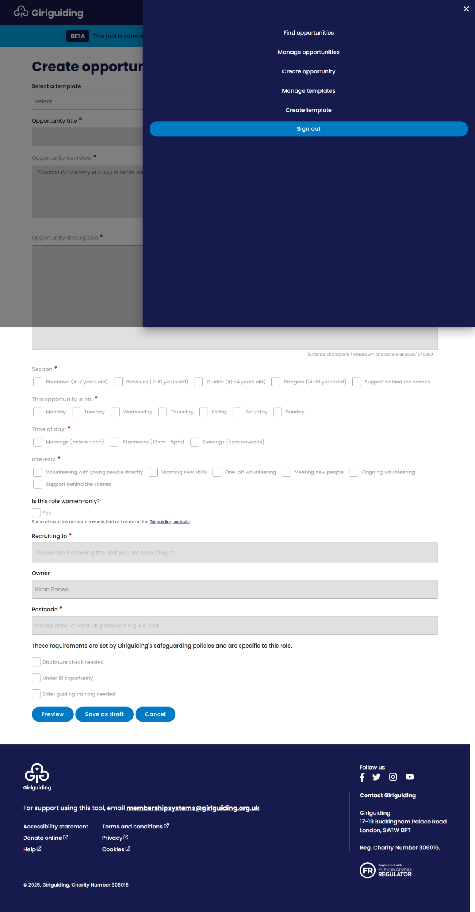
Managing opportunities: navigating back
If you need to navigate back to the ‘My opportunities’ page at any point when using the tool you can do this by:
1. If you’re on a larger screen click directly on ‘manage opportunities’ in the top right corner.
3. The 'My opportunities' page will show.
2. Or if you're on a smaller screen, click the 3 lines in the top righthand corner. Then click ‘Manage opportunities’ from the menu.

Slide 14
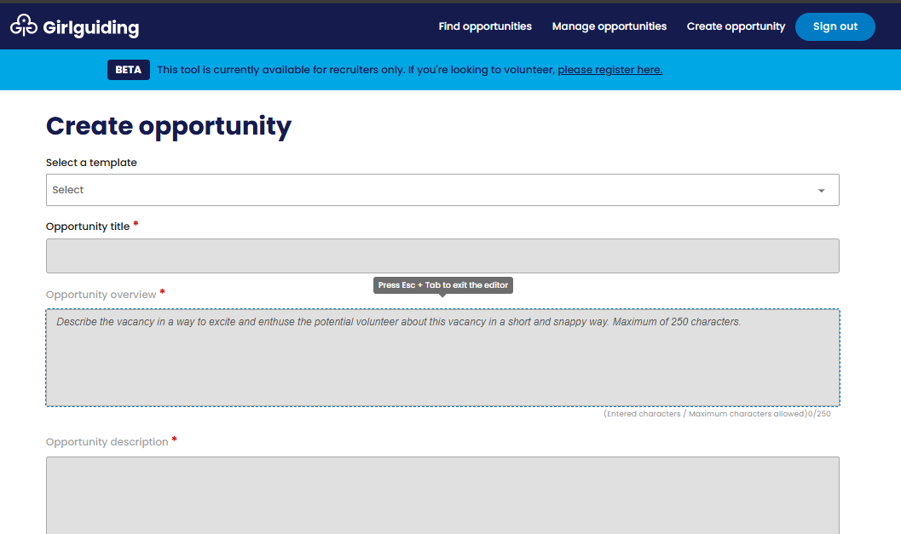
Creating opportunities
To create a new opportunity, follow these steps:
1. If you’re on a larger screen click directly on ‘Create opportunity’ in the top right corner.
3. Close the menu bar, or click anywhere outside of the menu bar, and you'll see the create opportunity page.
2. Or if you're on a smaller screen, click the 3 line icon in the top right corner. Then, click ‘create opportunity’ from the menu.

Slide 15
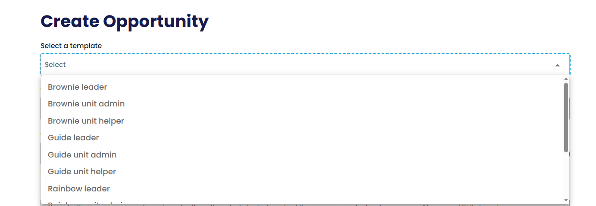
Creating opportunities
4. Click on the box under select a template, a dropdown will appear with pre-populated role templates to choose from.
5. Click on the role template you would like to use and edit. You can browse all templates available by clicking and dragging the scroll bar on the right.

Slide 16
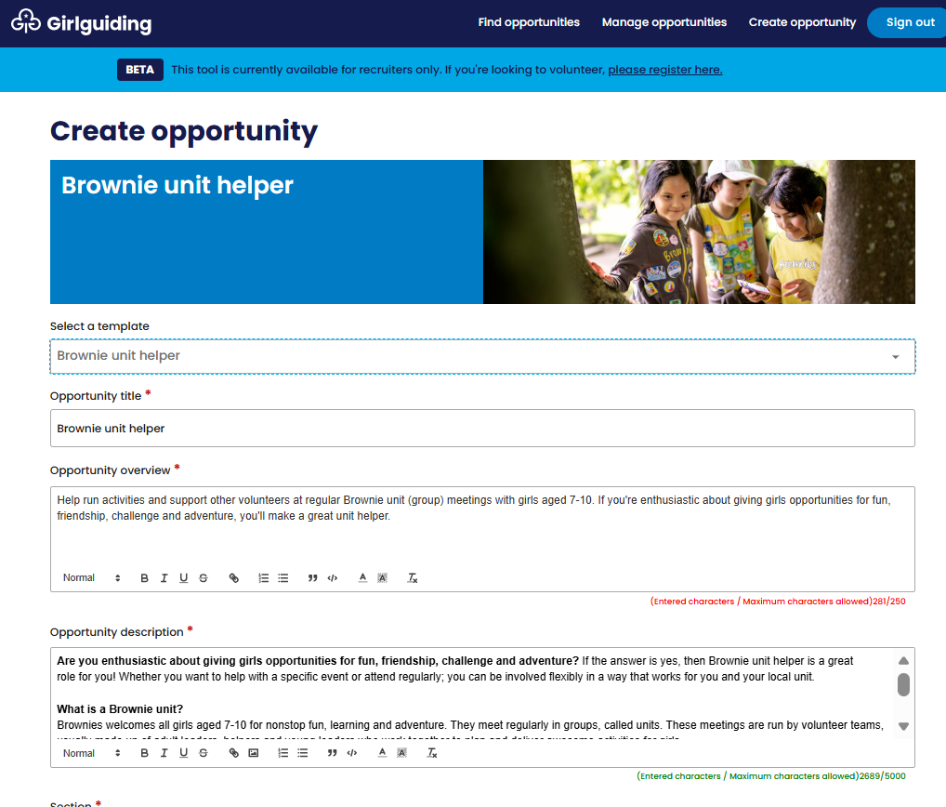
Creating opportunities
6. This will then pre-populate with a role template which you can edit to suit your needs.
You can edit the text as needed in the opportunity title, opportunity overview and opportunity description boxes. You’ll need to keep within the character limits highlighted below each box.
To view all text in the opportunity description box, you can do this by clicking and dragging the scroll bar on the right.
We’ve put together tips and guidance on how to edit your opportunities to get the most out of the tool.
Check tips and guidance

Slide 17
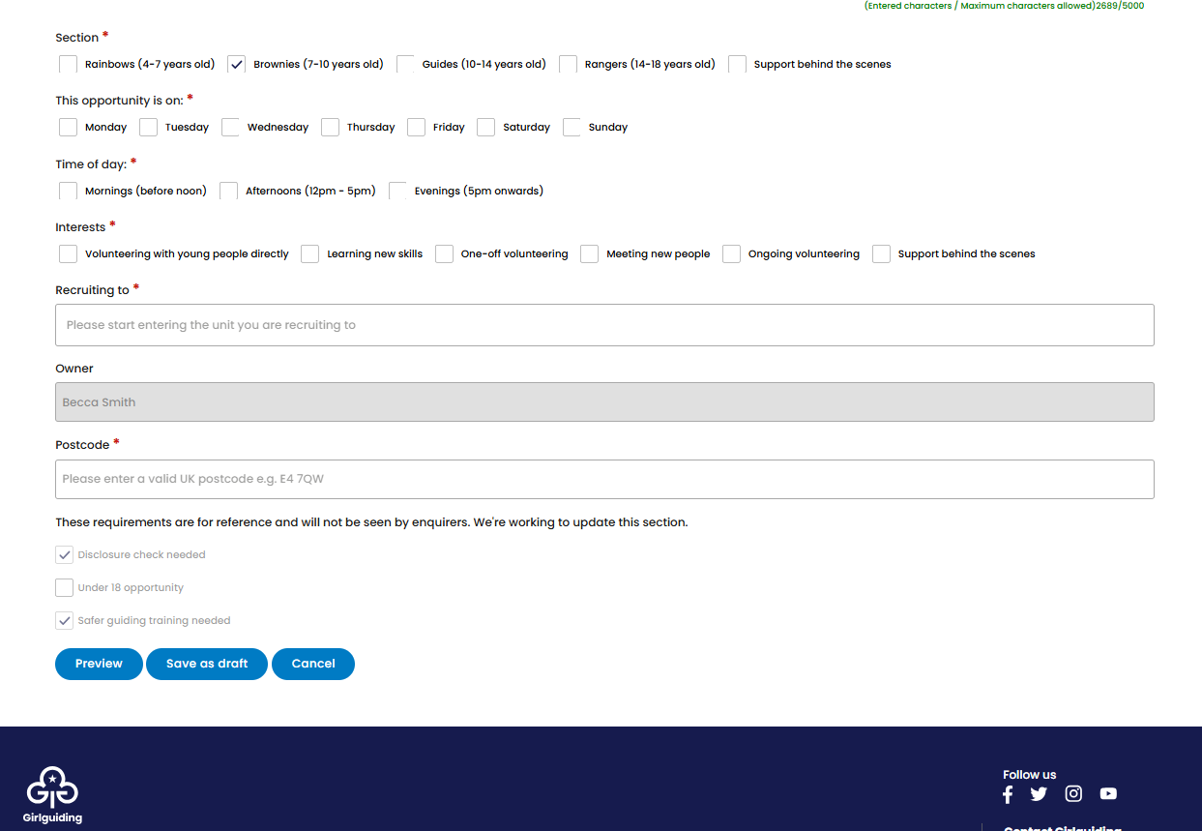
Creating opportunities
7. Click on the relevant checkboxes that are appropriate for your opportunity, such as: section, day of the week, time of day and interests.
8. For 'recruiting to', start typing the unit or level you're recruiting to and select it from the drop down.
9. Once you’ve entered the unit or guiding level you’re recruiting to, the postcode will either pre-populate in the box or you can enter the postcode for the opportunity, such as a specific unit postcode or a postcode in a district or division.
10. The checkboxes directly above 'preview' will be pre-populated and you will be unable to change them. These are for your reference only. They will not be shown to the enquirer.

Slide 18
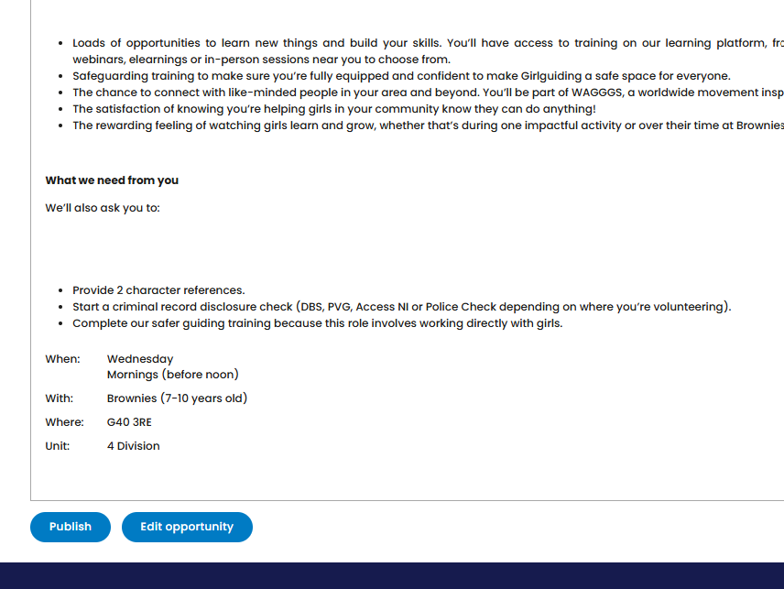
Creating opportunities
11. Once you are happy with your opportunity click ‘Preview’.
12. This will take you to a preview of what the opportunity will look like. Either click ‘Edit opportunity’ to edit further or 'Publish’ to list the opportunity for enquirers to see.
At any point you can click ‘Save as draft’ to save your progress, and your opportunity will be available to edit further from the ‘My opportunities’ page.

Slide 19
Creating opportunities
13. Once published your opportunity will appear in the list on the ‘My opportunities' page and will show as published in the ‘status’ column.
Your opportunity will also be visible to potential volunteers when they make a search using the tool. To find it you'll need to search for your postcode as if you were looking to volunteer. To see how you do this go to slide 23.
Note: If your opportunity does not appear straight away in the 'My opportunities' page, please wait a couple of minutes and refresh your page.

Slide 20
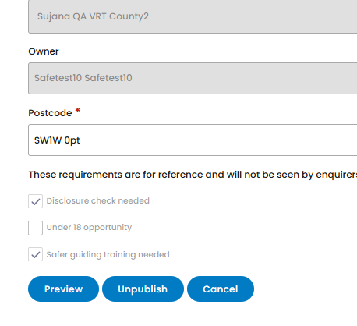
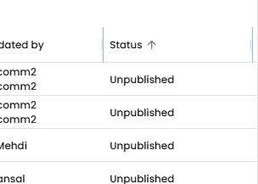
Unpublishing opportunities
To unpublish (remove) an opportunity so it is no longer live for prospective volunteers to view, you can:
1. Navigate to the ‘my opportunities’ page (you will automatically land on this page as a recruiter when you log in).
2. Click on the specific opportunity you would like to unpublish, this will open the opportunity up.
3. Scroll to the bottom and click 'unpublish'. The opportunity will remain in the ‘my opportunities’ page but will show as ‘unpublished’ in the ‘status’ column.

Slide 21
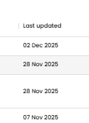
Editing opportunities once published
To edit an opportunity once published, for example if you've made a mistake or want to update it, you can:
1. Navigate to the ‘my opportunities’ page (you will automatically land on this page as a recruiter when you log in).
2. Click on the specific opportunity you would like to edit. This will open the opportunity up.
3. Make any edits you'd like to, then click preview.
4. This will take you to a page where you can preview what the opportunity will look like and either click ‘edit opportunity’ to edit further or ‘publish’ to list the opportunity for enquirers to see.
5. The 'last updated' column in the 'my opportunities' page for the opportunity will update.

Slide 22
Promoting your opportunity (post launch in January 2026) by:
1. Copying and sharing the link
2. Printing the opportunity

Slide 23
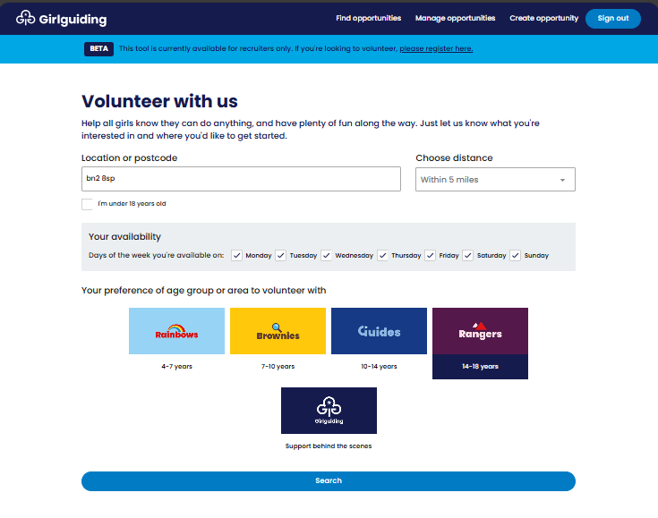
Promoting your opportunity
Once you've published an opportunity, you can promote it and encourage prospective volunteers to apply. Each opportunity has a unique link, so you'll be able to either copy and share this link or print the opportunity.
To do this, you'll need to search and find the opportunity as if you're a prospective volunteer. Depending where you want to share the link, you may want to do this via desktop/laptop/iPad, or via your mobile phone.
1. Navigate to the 'find opportunities' page by clicking on find opportunities in the top menu, or visit volunteer.girlguiding.org.uk

Slide 24
Promoting your opportunity
2. Enter the postcode, day(s) of the week and section/area to volunteer with for your opportunity.
3. Click the blue 'search' button.

Slide 25
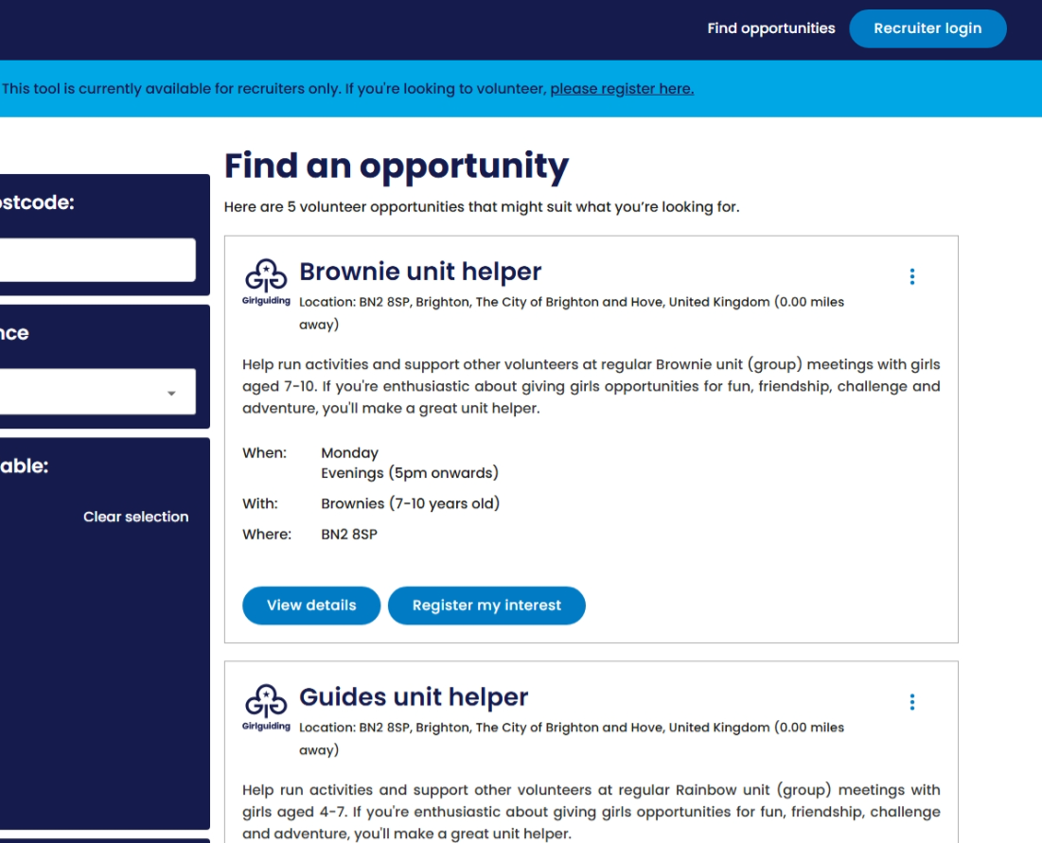
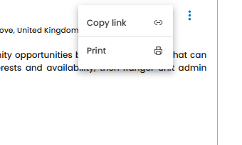
Promoting your opportunity
4. Once you have found your opportunity, click on the 3 dots icon on the right, this will bring up the option to copy the link or print.
5.
a. To copy the unique link for your opportunity, one way is to click the icon next to copy link (other option on next slide). You'll then be able to paste the link wherever you would like to, such as in an email, message or on a social media post.
b. To print your opportunity, click the printer icon next to print.

Slide 26
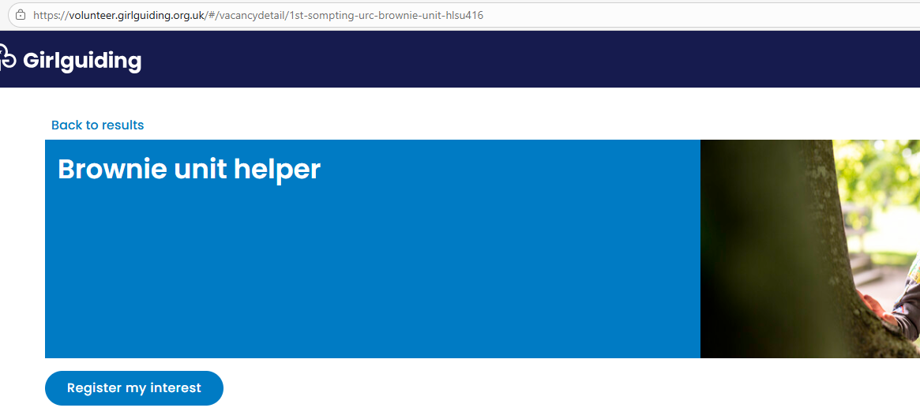
Promoting your opportunity
6.
a. Another way to copy the unique link for your opportunity is by clicking the 'view details' button. This will open your opportunity.
b. Then copy the link from your browser search bar at the top of the page.

Slide 27
Searching and applying to volunteer

Slide 28
Searching for opportunities
1. Anyone can search for opportunities by entering:
The postcode or area where they'd like to volunteer.
Their availability.
Section/area they're interested in volunteering with.
Then by clicking the blue 'search' button.

Slide 29
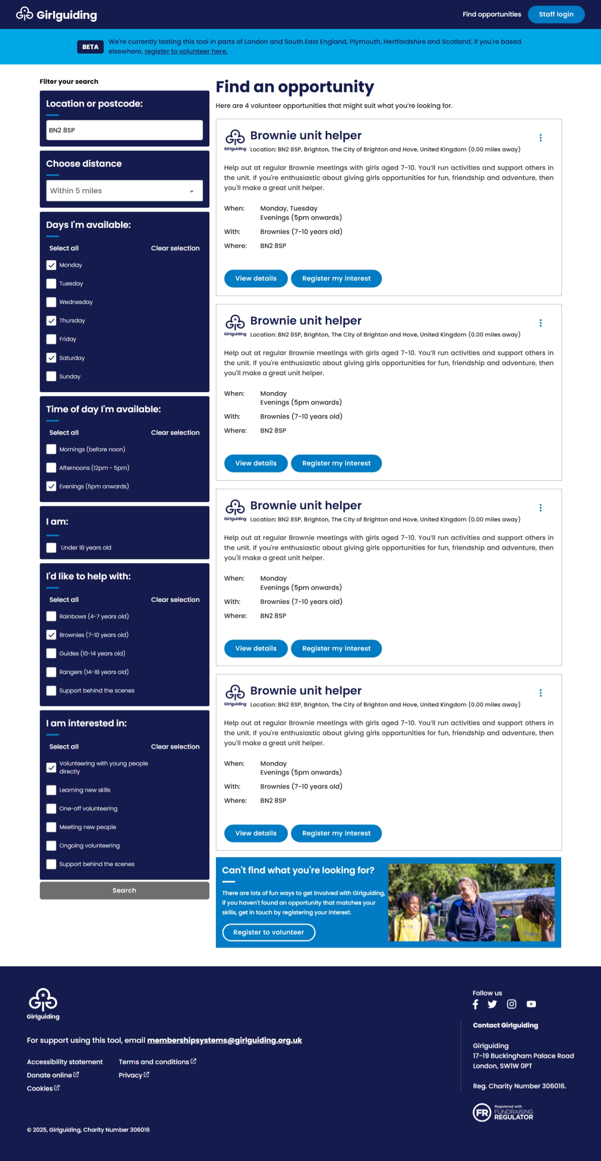
Searching for opportunities
3. They can refine and filter their search further using the options on the lefthand side.
2. They will be able to view any opportunities that match with their search criteria. Opportunities will be in order of proximity to the postcode entered (closest first).

Slide 30
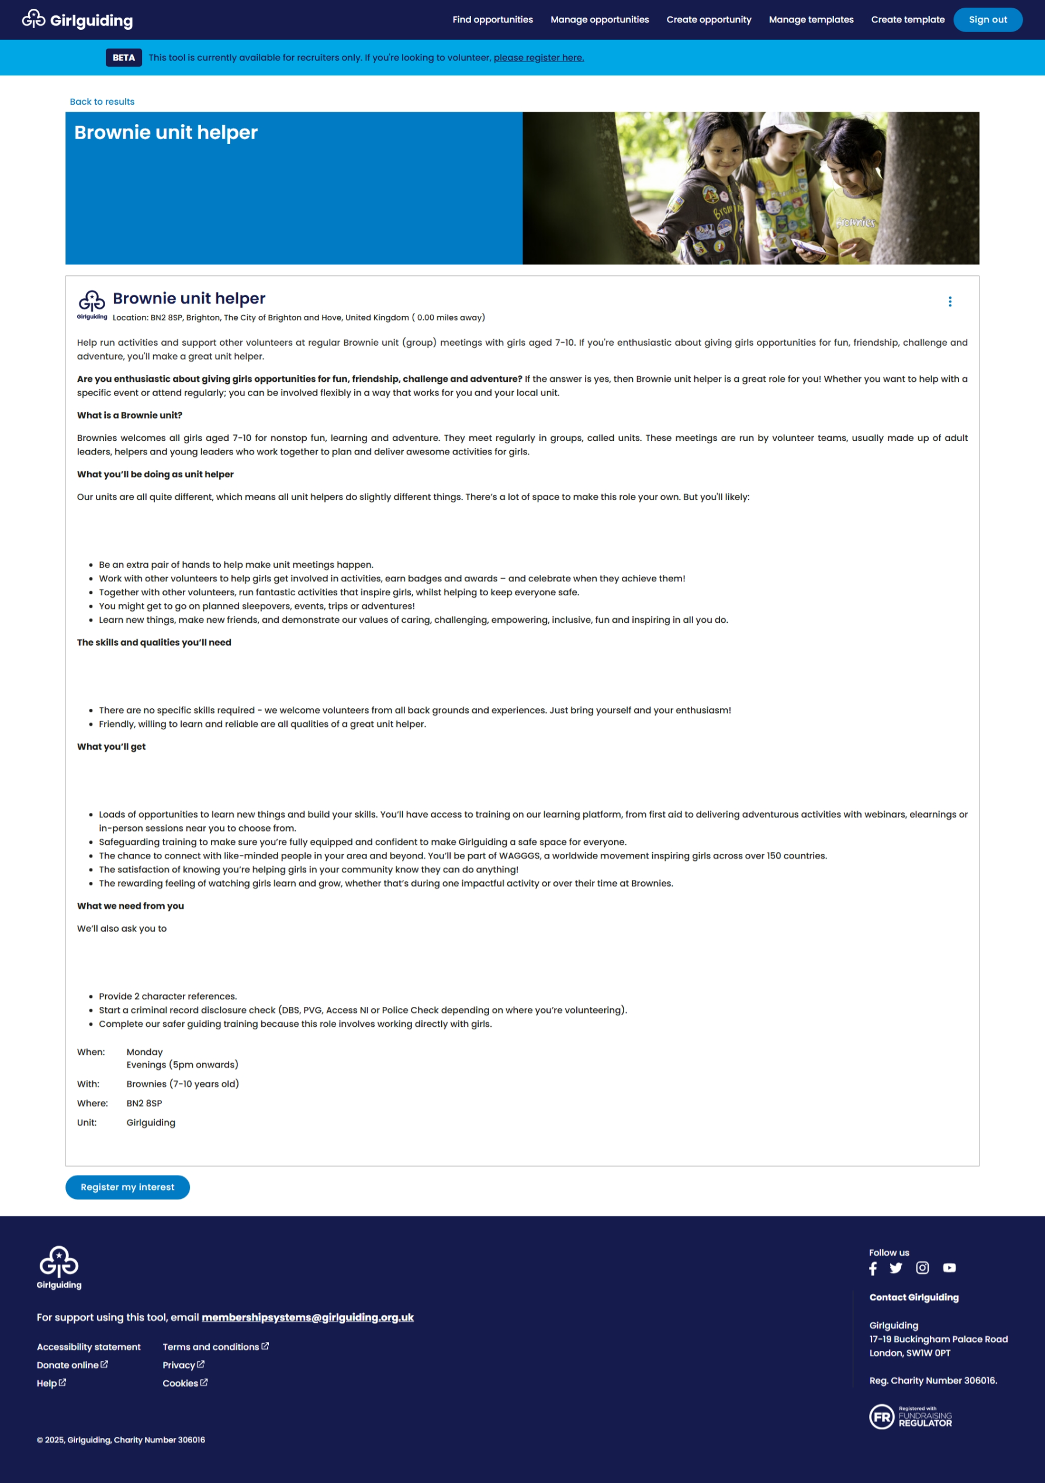
Registering for a specific opportunity
4. If they want to apply for a specific opportunity they can either:
a. Click 'Register my interest' directly on the search results page.
b. Click 'View details' to open the opportunity and find out more. Then click 'register my interest' at the bottom of the page.

Slide 31
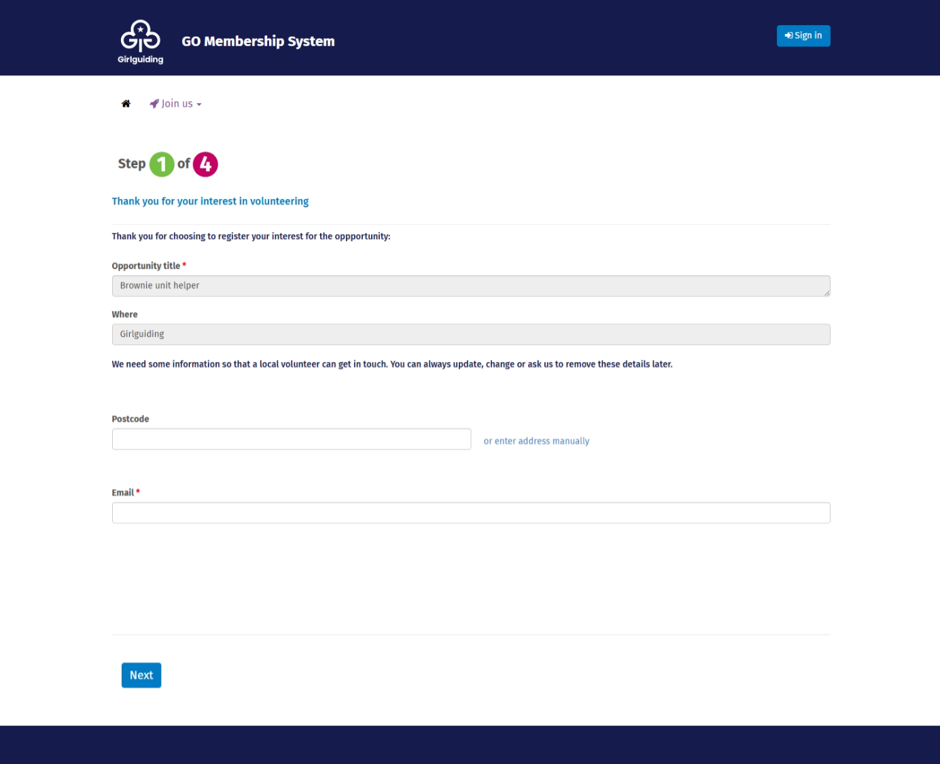
Registering for a specific opportunity
5. They'll need to complete the GO form
Note: this form will auto populate the opportunity they have clicked on to register for.
If the email address they enter in the form is linked to an account already registered with GO (this will be because they are or have previously been a volunteer, parent or carer or young member) they'll need to login before continuing.

Slide 32
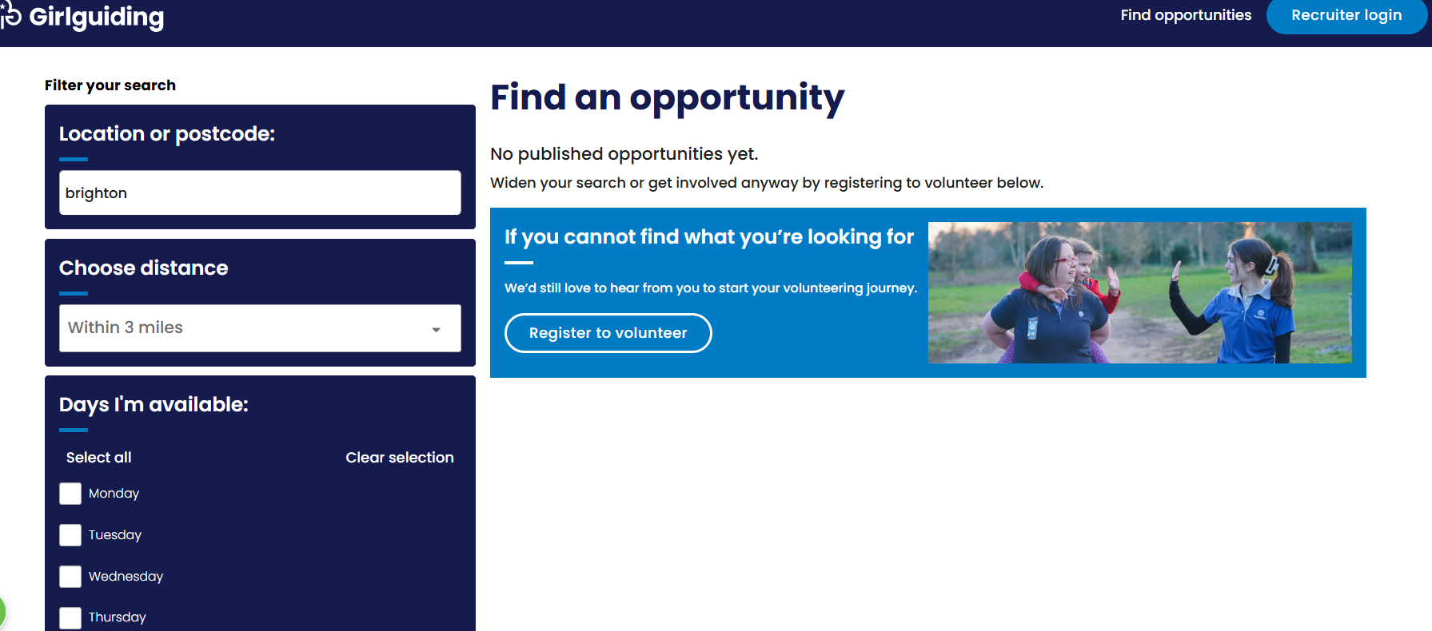
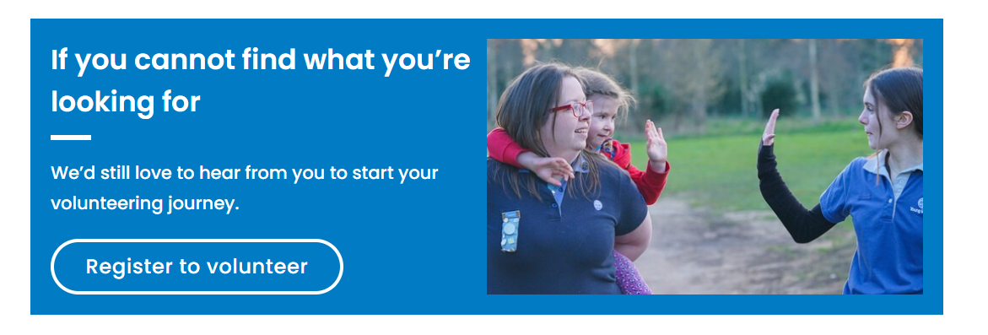
Expressing their interest if no suitable opportunity in area
1. If there are no suitable opportunities a prospective volunteer can use the 'If you cannot find what you're looking for' option. This card appears at the bottom of every search results page and has a 'Register to volunteer' button they can click on.

Slide 33
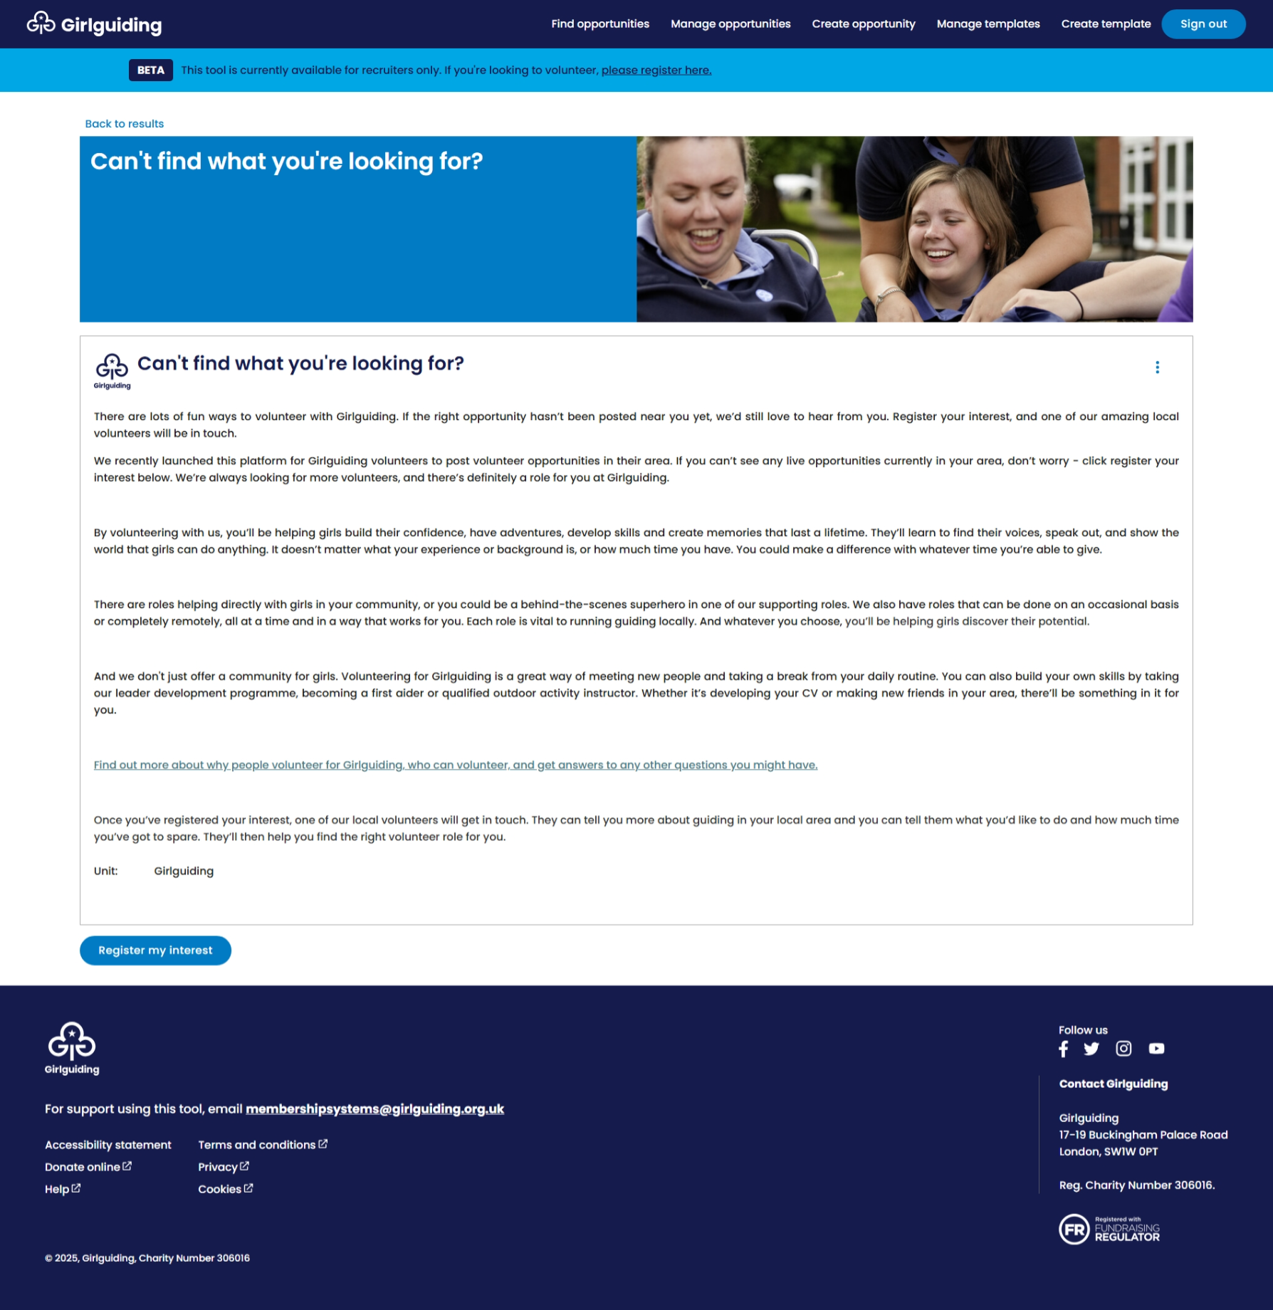
Expressing their interest if no suitable opportunity in area
2. This will open a page with more information about volunteering with Girlguiding. They can then click 'register my interest' at the bottom of the page.

Slide 34
Expressing their interest if no suitable opportunity in area
3. They'll need to complete the GO form
Note for under 18s expressing their interest: they will be asked to select a preferred unit to volunteer with when completing this form.
If the email address they enter in the GO form is linked to an account already registered with GO (this will be because they are or have previously been a volunteer, parent or carer or young member) they'll be asked to login to GO and express their interest via the 'My enquiries' tab by clicking the 'View map to volunteer' button.
For a step-by-step guide of how they can express their interest in GO, see our GO help file.

Slide 35
How to get help using the tool

Slide 36
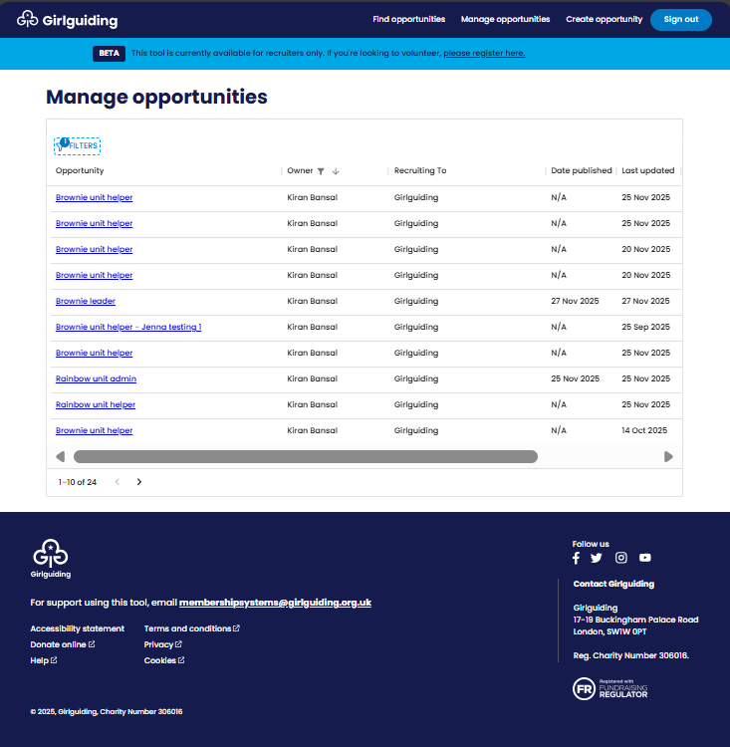
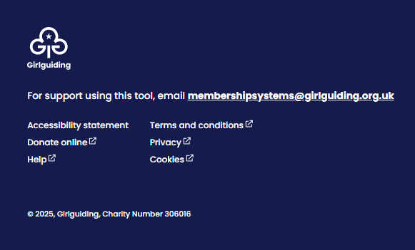
Accessing the volunteer recruitment tool help page
You can access our volunteer recruitment tool help page by clicking on the 'help' button in the bottom left of the footer from any page of the volunteer recruitment tool or by going to our help page.

Slide 37
Thank you

