Slide 1
Girlguiding’s Strategy
Today, tomorrow, together
Working PowerPoint presentation

Slide 3
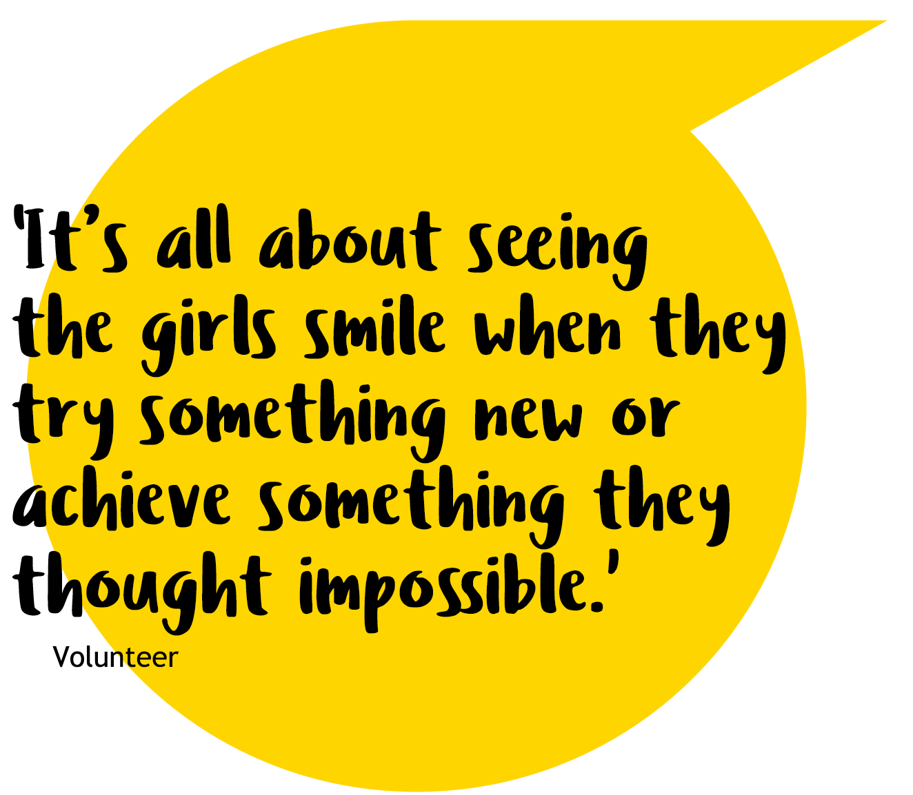
Introduction
Girlguiding exists to help girls and young women find their voice and build skills and confidence - inspiring them to discover the best in themselves and empower them to make a positive difference in their community.
Between school, social media, friendships and relationships – there’s a lot going on for girls today. Not to mention the future, the planet, education and what jobs might be around in few years’ time. That’s why Girlguiding is more important than ever.

Slide 4
Introduction
Girlguiding offers a place where girls can just be themselves. They can make friends, learn skills, grow in confidence and find their voice. We’re a supportive community, with solid foundations and a rich heritage that we can all lean on.
Now it’s time to look to the future, together.
Developed with Girlguiding, for Girlguiding, this strategy is our plan for today, tomorrow, together. We’ll go on more adventures, welcome new friends, have even more fun, whilst better supporting our current and future volunteers.
We’ll be led by what girls want and need, we’ll learn new skills and help one another become more confident. We’ll make positive change in our communities locally and nationally.

Slide 5
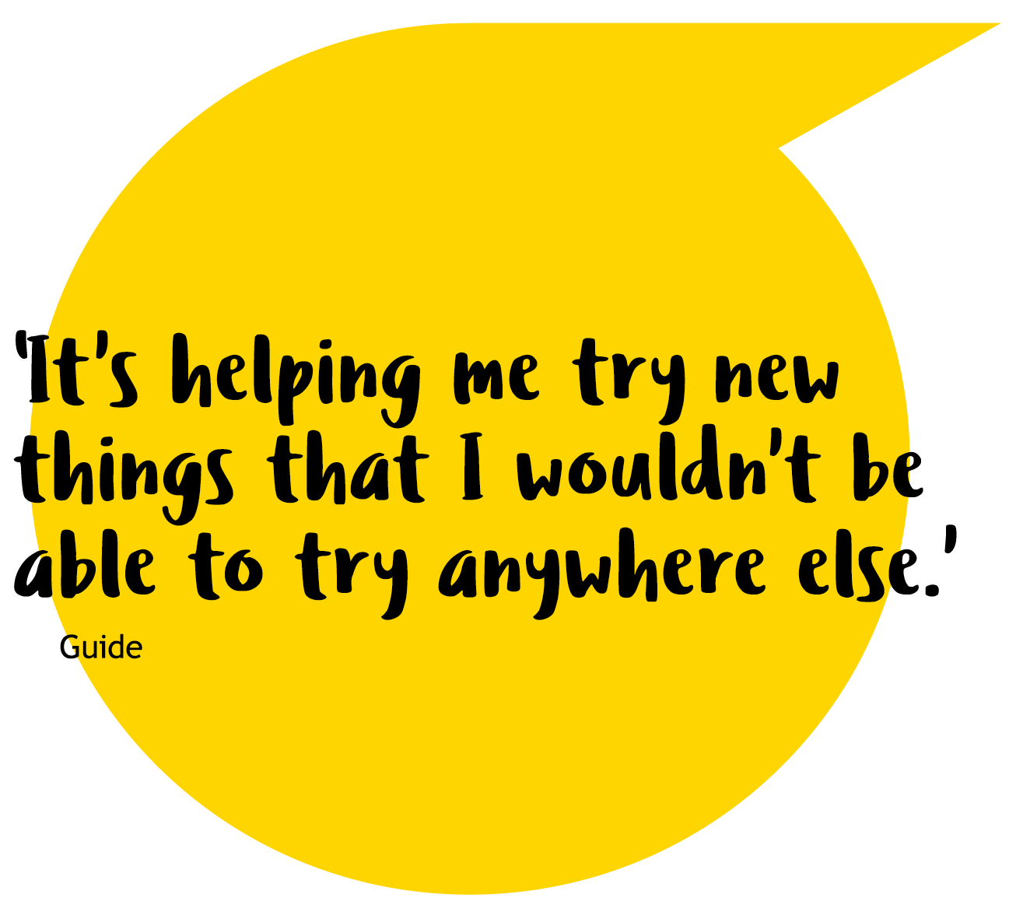
Introduction
Our Girlguiding community is made up of 500,000 girls, young women and volunteers - as well as parents and staff colleagues from every corner of the UK and beyond. Over the last two years, 50,000 people in the Girlguiding community told us what matters to them today and what they want for Girlguiding in the future.
We’ve heard what changes we need to make and together we’ve made Girlguiding’s Strategy, today, tomorrow, together.

Slide 6
Listening to each other
26,000 girls took part in the strategy unit meeting activities Girls focussed on how they felt about Girlguiding and the changes they hoped for.
19,000 people took part in online research This included girls over the age of 14, parents, volunteers and staff colleagues. People gave their opinion on key issues and picked the ones that were most important.
In 2018 and 2019, Girlguiding asked 50,000 members of our community - girls, volunteers, staff, parents and partners - to tell us what they wanted for our future.
From this, we’ve made Girlguiding’s Strategy. It’s created from a real picture of the challenges Girlguiding’s facing, as well as its potential.

Slide 7
Listening to each other
We used the research company YouGov We asked over 1,000 people from outside of Girlguiding to give their feedback. This helped us check if new members would find our ideas exciting.
We travelled all over the UK We visited camps, Little Giggle, Wellies & Wristbands and even hosted an event online.
1,000 members took part in workshops They answered a survey that explored the culture of Girlguiding - how we all work together as part of our community, our unwritten rules and beliefs. We thought about who we are today and who we want to be in the future.

Slide 8
Shared goals for Girlguiding
The research found three key themes. We’ve built our goals around these, and we’re excited to share them with you here.

Slide 9
Let’s create exceptional experiences for girls and young women
We want to offer experiences so fun, accessible and empowering that they inspire more girls, young women and volunteers to join than ever before.
So, we’re going to keep putting girls at the centre of everything we do. Every decision we make, big or small, should be led by our girls and young women.

Slide 10
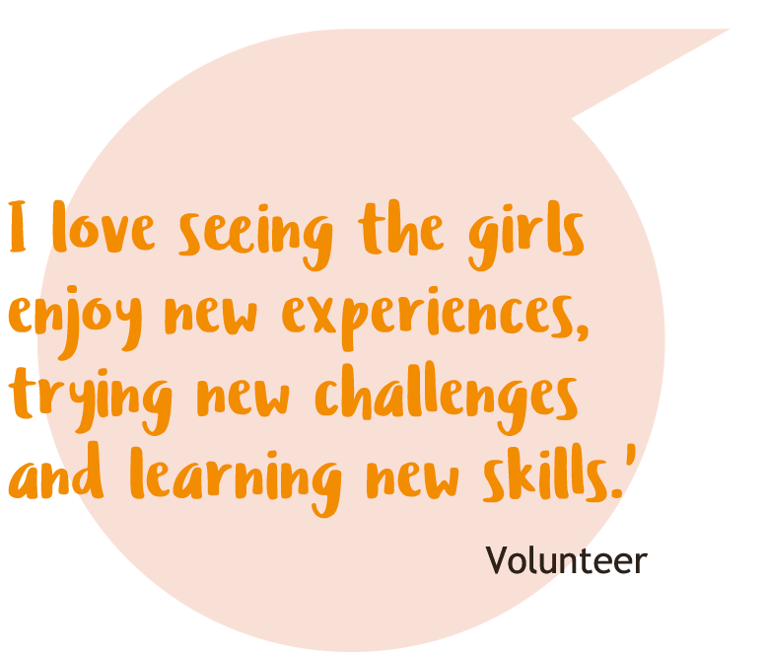
Continue to develop our award- winning programme and the unique Girlguiding experience Create even more inspiring activities for all girls and develop how Girlguiding experiences run, from activities to camps and trips, to helping our communities. This means more girls, whoever and wherever they are, can enjoy guiding.

Slide 11
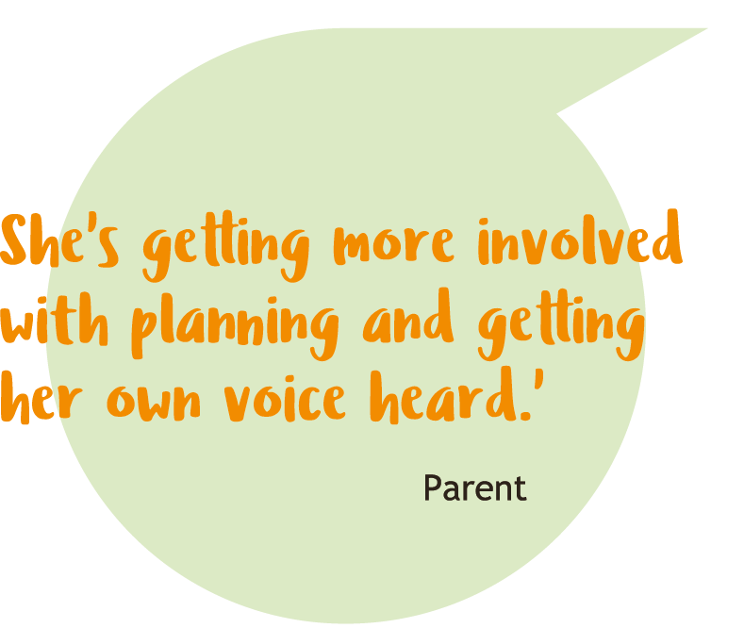
Led by girls Our young members will influence and shape what happens in Girlguiding by being at the heart of decision making and developing their own experiences.

Slide 12
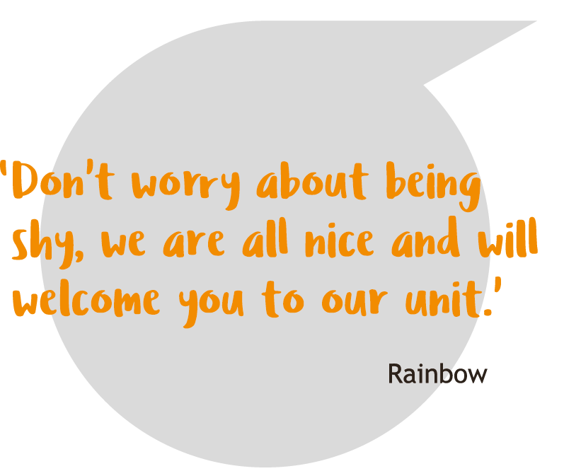
Encourage new friendships In the wider Girlguiding community and beyond - connect girls, young women and volunteers who might not otherwise get to meet - both digitally and face-to-face.

Slide 13
Let’s develop a rewarding volunteer experience
We want volunteering to be flexible so it’s easier for people to give their time. So, we’re going to create opportunities that fit around people’s lives.
This will give more people the opportunity to share their talents and deliver great guiding to reach more girls and young women.

Slide 14
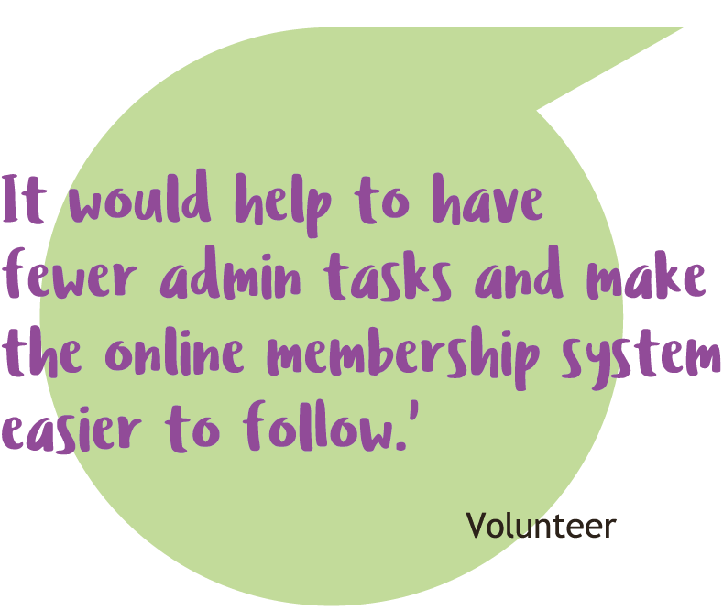
Better support for volunteers Invest in making our digital and IT easier to use, reducing the admin burden so volunteers can spend less time on admin and more time creating great experiences for girls and young women.
Recruiting and welcoming volunteers Make joining Girlguiding simple with quick and easy steps.

Slide 15
Flexible volunteering Develop volunteer roles that make it easier for people to support Girlguiding in sustainable ways and make the most of their time and talents. Create volunteer opportunities that make volunteering a more rewarding and enjoyable experience.

Slide 16
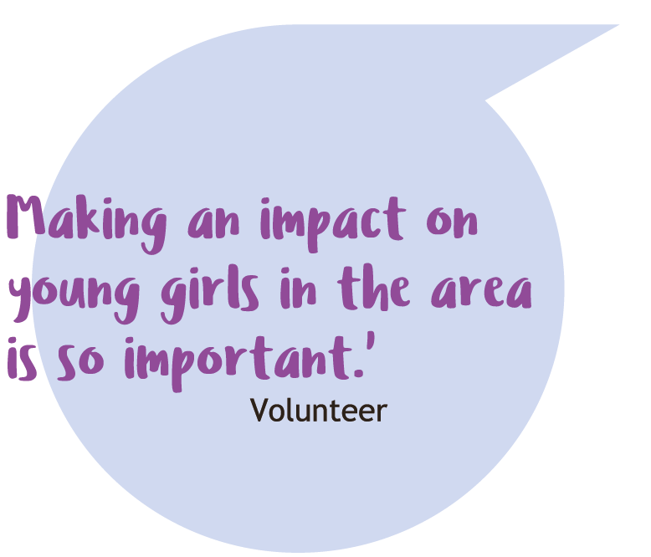
Learning for today Develop a digital learning programme tailored for today’s Girlguiding, the world and volunteers. Teaching skills in everything from leadership to building campfires, using things like peer mentoring and qualifications to build peoples’ confidence and let them be creative.

Slide 17
Let’s be more inclusive and make a bigger impact
We want Girlguiding to have an even bigger impact and influence on local communities and across the UK.
So we’re going to find fresh and exciting ways to welcome new girls and volunteers to make sure our community develops to reflect the world around us. We’re going to make more people better aware of Girlguiding by proudly telling the world about our amazing achievements and hero girls’ voices.

Slide 18
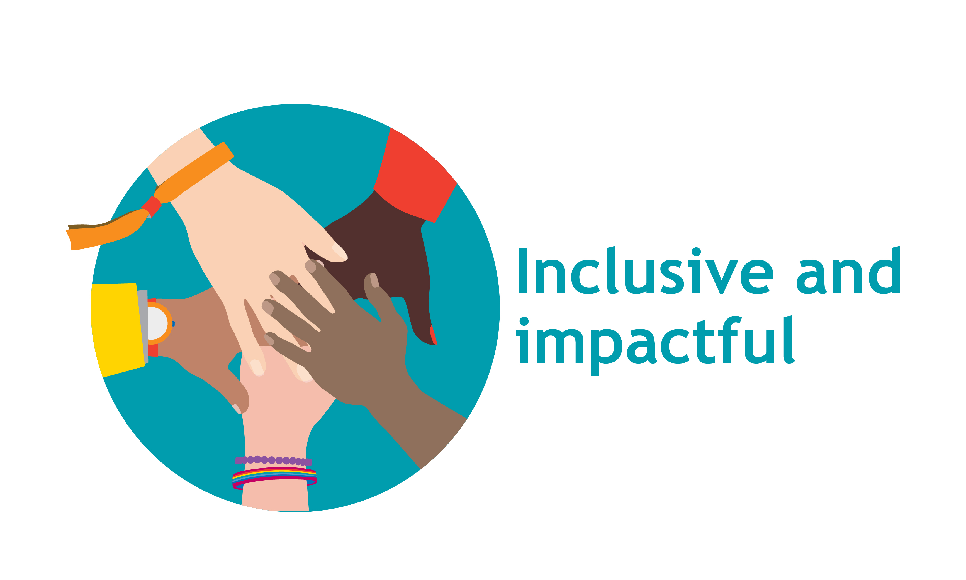
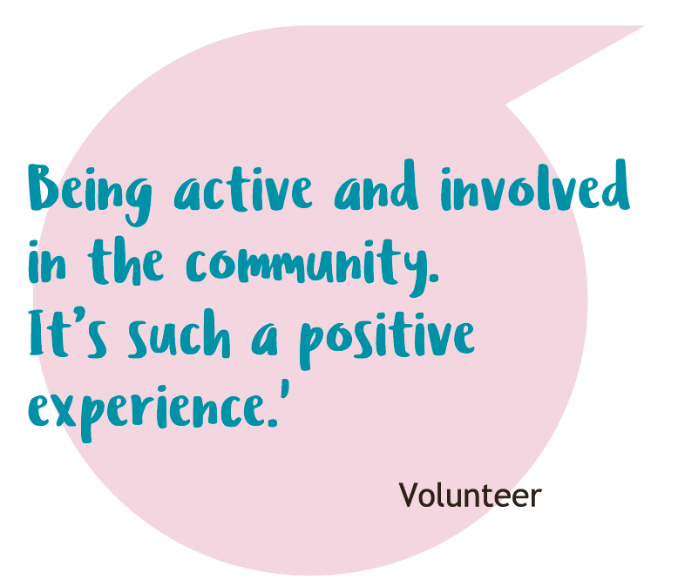
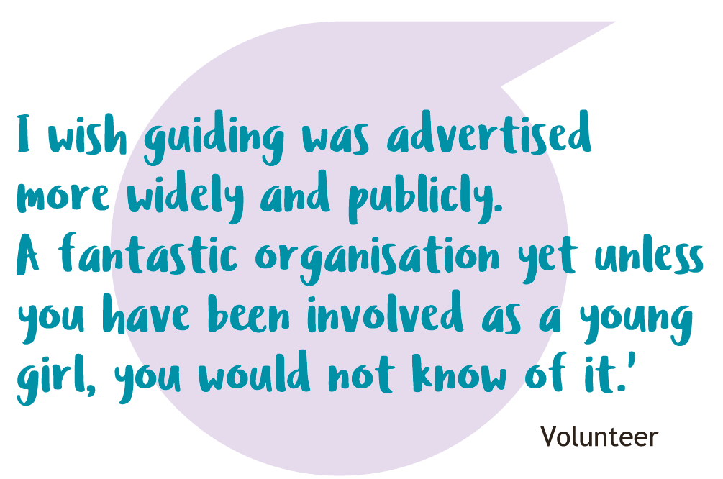
Grow the number of people who know about Girlguiding Use inspiring marketing campaigns and ambassadors to shout out about Girlguiding and the awesome things we do in communities and nationally.
Show our impact Create clear ways to measure and show the difference we make.

Slide 19
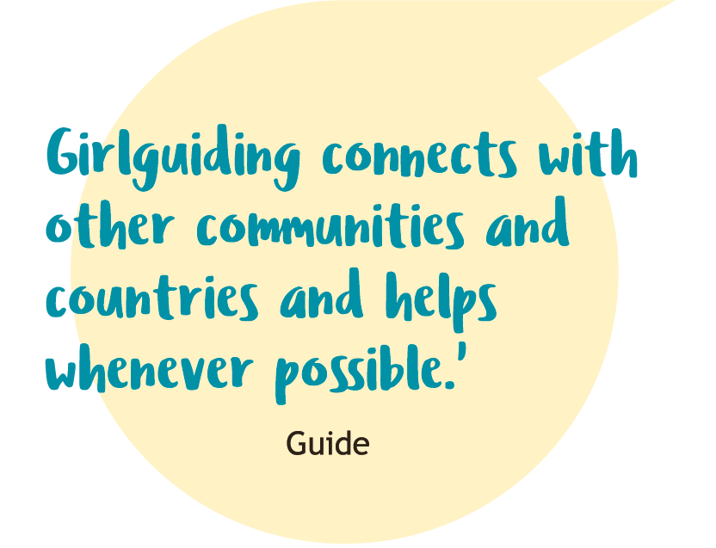
Open to all girls Work with local communities to create new opportunities for every girl and develop how we think, talk and work so our membership reflects the world we live in.
Making an impact together Come together as a community of women to support Future Girl and make change in the world on issues most important to girls.

Slide 20
And let’s get the basics right
The best way to do brilliant things, is by getting the basics right. We’re going to build solid foundations, including: Strong structures and processes We’ll invest in the way we work to make sure our people and resources are in the right place doing the right things. We’ll make sure people can stay better connected, be informed and access the information and tools they need easily and quickly. Empowering girls to lead the way As the largest youth organisation for girls and young women in the UK we’ll be led by our
girls and young women. Their views and opinions will lead our decisions and make sure everything we do puts girls first. New ways of working We achieve amazing things when we work together as one team. We’ll make the most of the skills, experience and time that we have already in the Girlguiding community. So we’re going to set up new, shared ways of working, which bring us together and helps us use our talents.

Slide 21
Thank you
Thank you to everyone who gave their time or took part in our research over the last two years. It’s been wonderful to have so many people who care so much about Girlguiding come together to shape our shared future and create Girlguiding’s Strategy.
This is for all of us - it gives us a map to build on all the inspiring work volunteers, girls, young women and staff colleagues do day in and day out at Girlguiding.
We’re adding a new chapter to our rich history - today, tomorrow, together.

